Slide 1

Quantum information and the monogamy of entanglement
Aram Harrow
MIT (UCL until Jan 2015)

Slide 2

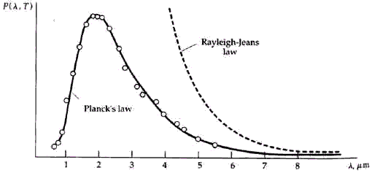
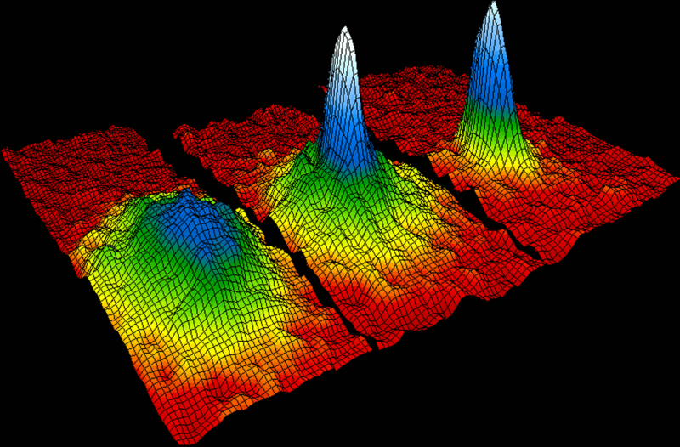
Quantum mechanics
Blackbody radiation paradox:
How much power does a hot object emit at wavelength ¸?
Classical theory (1900): const / ¸⁴
Quantum theory (1900 – 1924):
Bose-Einstein condensate (1995)
QM has also explained:
the stability of atoms
the photoelectric effect
everything else we’ve looked at

Slide 3
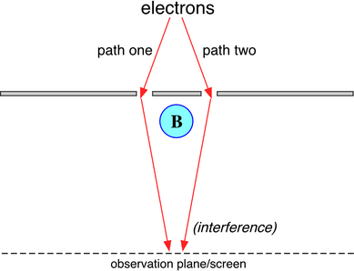
Difficulties of quantum mechanics
Heisenberg’s uncertainty principle
Topological effects
Entanglement
Exponential complexity:
Simulating N objects
requires effort »exp(N)

Slide 4
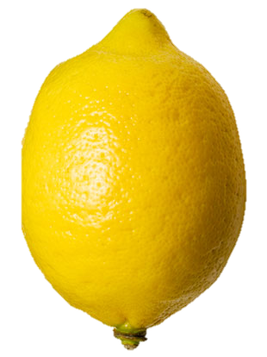
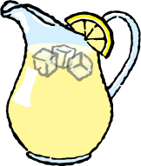
The doctrine of quantum information
Abstract away physics to device-independent fundamentals: “qubits”
operational rather than foundational statements:
Not “what is quantum information” but “what can we do with quantum information.”

Slide 5
Product and entangled states
state of
system A
state of
system B
⨂
product joint state of A and B
etc.
Entanglement
“Not product” := “entangled”
cf. correlated random variables
The power of [quantum] computers
One qubit ´ 2 dimensions
n qubits ´ 2^{n} dimensions
e.g.

Slide 6
[quantum] entanglement
[classical] correlation
vs.
Make comparable using density matrices
Entangled state
Correlated state
By contrast, a random mixture of |00i and |11i is
How to distinguish? off-diagonal elements not enough

Slide 7
when is a mixed state entangled?
S
Definition: ρ is separable (i.e. not entangled)
if it can be written as
conv(S)
∈conv{|α⟩⟨α| ⊗ |β⟩⟨β|}
probability
distribution
unit vectors
Difficulty: This is hard to check.
Heuristic: All separable states are PPT (Positive under Partial Transpose).
Problem: So are some entangled states.
Notes:
instead, let’s approach entangled via games

Slide 8
Why care about Sep testing?
1. validate experiment | Creating entanglement is a major experimental challenge. Even after doing tomography on the created states, how do we know we have succeeded?
2. understand noise and error correction | How much noise will ruin entanglement? How can we guard against this? Need good characterizations of entanglement to answer.
3. other q. info tasks | Sep testing is equivalent to many tasks without obvious connections, such as communication rates of q. channels. [H.-Montanaro, 1001.0017]
4. relation to optimization and simulation | described later (see also 1001.0017)

Slide 9
limits on entanglement testing
Detecting pure-state entanglement is easy, so
detecting mixed-state entanglement is hard
[H-Montanaro,
1001.0017]
Given , how close is |ψ⟩ to a
state of the form |α₁⟩⨂|α₂⟩⨂…⨂|α_{N}⟩?
With one copy of |ψ⟩ this is impossible to estimate.
We give a simple test that works for two copies.
Combine this with
  [Aaronson-Beigi-Drucker-Fefferman-Shor 0804.0802]
  a widely believed assumption (the “exponential time hypothesis”)
  other connecting tissue (see our paper)
to prove that testing whether a d-dimensional state is approximately
separable requires time ≥ d^{log(d)}.
4. This rules out any simple heuristic (e.g. checking eigenvalues).

Slide 10
CHSH game
a∊{0,1}
b∊{0,1}
a | b | x,y
0 | 0 | same
0 | 1 | same
1 | 0 | same
1 | 1 | different
Alice
shared
strategy
Bob
y2{-1,1}
x2{-1,1}
Goal: xy = (-1)^{ab}
Max win probability is 3/4. Randomness doesn’t help.

Slide 11
CHSH with entanglement
Alice and Bob share state
Based on inputs a,b they choose measurement angles.
Measurement outcomes determine outputs x,y.
When | Alice measures
a=0
a=1
When | Bob measures
b=0
b=1
x=-1
y=-1
x=1
y=1
x=-1
y=-1
y=1
win prob
cos²(π/8)
≈ 0.854
x=1

Slide 12
CHSH with entanglement
a=0
x=-1
b=0
y=-1
a=1
x=-1
goal: xy=(-1)^{ab}
b=1
y=1
Why it works
Winning pairs
are at angle π/8
Losing pairs
are at angle 3π/8
∴ Pr[win]=cos²(π/8)
a=0
x=1
b=0
y=1
a=1
x=1
b=1
y=-1

Slide 13
games measure entanglement
a∊{0,1}
b∊{0,1}
ρ
Alice
Bob
y2{-1,1}
x2{-1,1}
ρ separable → Pr[win] ≤ 3/4
conversely, Pr[win] – 3/4 is a measure of entanglement.

Slide 14
Monogamy of entanglement
a∊{0,1}
b∊{0,1}
c∊{0,1}
Alice
Bob
Charlie
x∊{-1,1}
y∊{-1,1}
z∊{-1,1}
max Pr[AB win] + Pr[AC win] =
max Pr[xy = (-1)^{ab}] + Pr[xz = (-1)^{ac}]
< 2 cos²(π/8)
why? If AB win often, then B is like a “hidden variable” for AC.

Slide 15
shareability implies separability
a
b₁
b₂
b_{k}
…
A
B₁
B₂
B_{k}
x
y₁
y₂
y_{k}
CHSH
any game
Intuition: Measuring B₂, …, B_{k} leaves A,B₁ nearly separable
Proof uses information theory: [Brandão-H., 1210.6367, 1310.0017]
1. conditional mutual information shows game values monogamous
2. other tools show “advantage in non-local games” ≈ “entanglement”

Slide 16
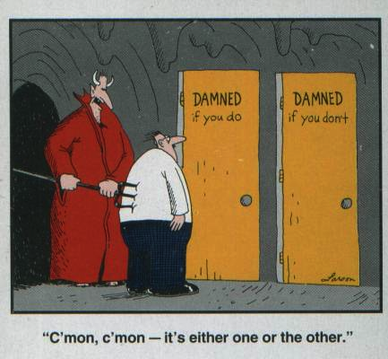
proof sketch
outcome distribution is p(x,y₁,…,y_{k}|a,b₁,…,b_{k})
case 1
p(x,y₁|a,b₁) ≈
p(x|a) ⋅p(y₁|b₁)
case 2
p(x,y₂|y₁,a,b₁,b₂)
has less mutual
information

Slide 17
less sketchy proof sketch
∴ for some j we have
Y₁, …, Y_{j-1} constitute a “hidden variable” which we can
condition on to leave X,Y_{j} nearly decoupled.
Trace norm bound follows from Pinsker’s inequality.

Slide 18
what about the inputs?
Apply Pinsker here to show that this is
& || p(X,Y_{k} | A,b_{k}) – LHV ||₁²
then repeat for Y_{k-1}, …, Y₁

Slide 19
A hierachy of tests for entanglement
Definition: ρ^{AB} is k-extendable if there exists an extension
with for each i.
all quantum states (= 1-extendable)
2-extendable
100-extendable
separable =
∞-extendable
Algorithms: Can search/optimize over k-extendable states in time d^{O(k)}.
Question: How close are k-extendable states to separable states?

Slide 20
application #1: mean-field approximation
∞-D
used in limit of high coordination number, e.g.
1-D
2-D
Bethe
lattice
3-D

Slide 21
mean-field ≅ product states
mean-field ansatz for homogenous systems: |α⟩^{⊗N}
for inhomogenous systems: |α₁⟩⨂|α₂⟩⨂…⨂|α_{N}⟩
Result: Controlled approximation to ground-state energy with no homogeneity assumptions based only on coordination number. [Brandão-H. 1310.0017]
Application: “No low-energy trivial states” conjecture [Freedman-Hastings] states that there exist Hamiltonians where all low-energy states have topological order.
∴ This can only be possible with low coordination number.

Slide 22
application #2: optimization
connections to:
polynomial opt.
unique games
conjecture
Given a Hermitian matrix M:
  max_{α} hα| M |αi is easy
  max_{α,β} hα⨂β| M |α⨂βi is hard
Approximate with
A
Computational effort: d^{O(k)}
Key question:
approximation error as a function of k and d
B₁
B₂
B₃
B₄

Slide 23
speculative application: simulating lightly-entangled quantum systems
Original motivation for quantum computing [Feynman ’82]
Nature isn't classical, dammit, and if you want to make a simulation of Nature, you'd better make it quantum mechanical, and by golly it's a wonderful problem, because it doesn't look so easy.
modern translation: Unentangled quantum systems can be simulated
classically but in general we need quantum computers for this.

Slide 24
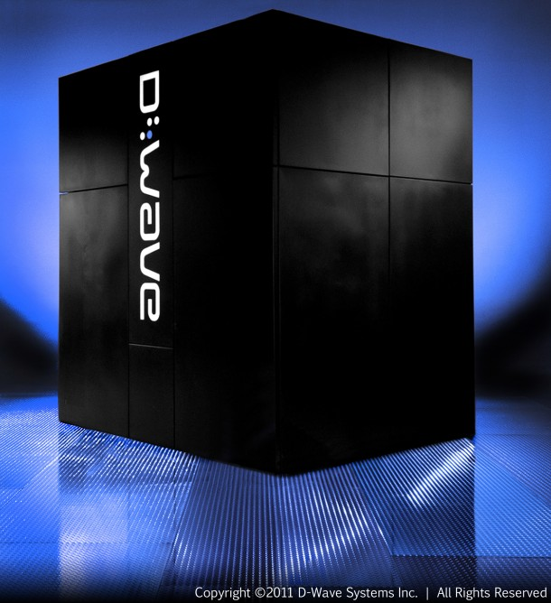
low-entanglement simulation
degree of entanglement
?
classically
simulatable
supports
universal
classical
computing
supports
universal
quantum
computing
Open question:
Are there good classical simulations
of lightly-entangled
quantum systems?
Idea: model k-body
reduced density matrices
where k scales with
entanglement. cf. results
for ground states in 1310.0017.
≈0.1ns single-qubit Rabi oscillations
≈2.5ns decoherence time
≈10µs computation time

Slide 25
references
Product test and hardness | 1001.0017
New monogamy relations | 1210.6367
Application to optimization | 1205.4484
Application to mean-field | 1310.0017
all papers: http://web.mit.edu/aram/www/

