Slide 1
quantum information and convex optimization
Aram Harrow (MIT)
Simons Institute 25.9.2014

Slide 2
outline
quantum information, entanglement, tensors
optimization problems from quantum mechanics
SDP approaches
analyzing LPs & SDPs using (quantum) information theory
ε-nets

Slide 3
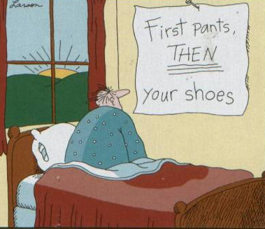
quantum information ≈ noncommutative probability
probability
quantum
Δ_{n} = {p∈R^{n}, p≥0, ∑_{i} p_{i} = ||p||₁ = 1}
D_{n} = {ρ∈C^{n×n}, ρ≥ 0 trρ= ||ρ||₁ = 1}
states
measurement
m∈R^{n} 0≤m_{i}≤1
M∈C^{n×n},
0 ≤ M ≤ I
“accept”
⟨m,p⟩
⟨M,ρ⟩ = tr[Mρ]
distance
= best bias

Slide 4
bipartite states
probability
quantum
product states (independent)
(p⊗q)_{ij} = p_{i} q_{j}
(ρ⊗σ)_{ij,kl} = ρ_{i,k} σ_{j,l}
local measurement
m⊗1_{n} or 1_{n}⊗m
M⊗I_{n} or I_{n}⊗M
marginal
state
p_{i}⁽¹⁾ = ∑_{j} p_{ij}
p_{j}⁽²⁾ = ∑_{i} p_{ij}
ρ_{i,j}⁽¹⁾ = tr₂ρ= ∑_{k} ρ_{ik,jk}
ρ_{i,j}⁽²⁾ = tr₁ρ= ∑_{k} ρ_{ki,kj}
separable states (not entangled)
conv{p⊗q} = Δ_{n2}
(never entangled)
Sep =conv{p⊗σ} ⊊ D_{n2}
(sometimes entangled)

Slide 5
entanglement and optimization
Definition: ρ is separable (i.e. not entangled)
if it can be written as
ρ = ∑_{i} p_{i} v_{i} v_{i}* ⊗ w_{i} w_{i}*
Sep = conv{vv* ⊗ ww*}
= conv{ρ⊗σ}
₌
probability distribution
unit vectors
Weak membership problem: Given ρ and the promise that ρ∈Sep or ρ is far from Sep, determine which is the case.
Optimization: h_{Sep}(M) := max { tr[Mρ] : ρ∈Sep }
Notes:
instead, let’s approach entangled via games

Slide 6
complexity of h_{Sep}
Equivalent to: [H, Montanaro ‘10]
computing ||T||_{inj} := max_{x,y,z} |⟨T, x⊗y⊗z⟩|
computing ||A||_{2->4} := max_{x} ||Ax||₄ / ||x||₂
computing ||T||_{2->op} := max_{x} ||∑_{i}x_{i}T_{i}||_{op}
maximizing degree-4 polys over unit sphere
maximizing degree-O(1) polys over unit sphere
h_{Sep}(M) ± 0.1 ||M||_{op} at least as hard as
planted clique [Brubaker, Vempala ‘09]
3-SAT[log²(n) / polyloglog(n)] [H, Montanaro ‘10]
h_{Sep}(M) ± 100 h_{Sep}(M) at least as hard as
small-set expansion [Barak, Brandão, H, Kelner, Steurer, Zhou ‘12]
h_{Sep}(M) ± ||M||_{op} / poly(n) at least as hard as
3-SAT[n] [Gurvits ‘03], [Le Gall, Nakagawa, Nishimura ‘12]

Slide 7
multipartite states
n d-dimensional systems → d^{n} dimensions This explains:
power of quantum computers
difficulty of classically simulating q mechanics
Can also interpret as 2n-index tensors.
i₁
ρ
ρ
M
ρ
j₁
i₂
j₂
i₃
j₃
tr₃ρ
tr[Mρ]

Slide 8
local Hamiltonians
Definition: k-local operators are linear combinations of
{A₁ ⊗ A₂ ⊗ ... ⊗ A_{n} : at most k positions have A_{i} ≠ I.}
intuition: Diagonal case = k-CSPs = degree-k polys
Local Hamiltonian problem:
Given k-local H, find λ_{min}(H) = min_{ρ} tr[Hρ].
QMA-complete to estimate to accuracy ||H|| / poly(n).
qPCP conjecture: ... or with error ε||H||
QMA vs NP: do low-energy states have good classical descriptions?

Slide 9
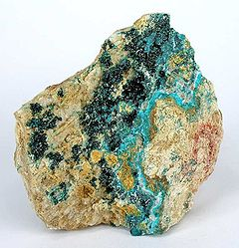
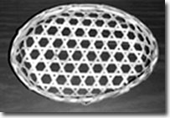
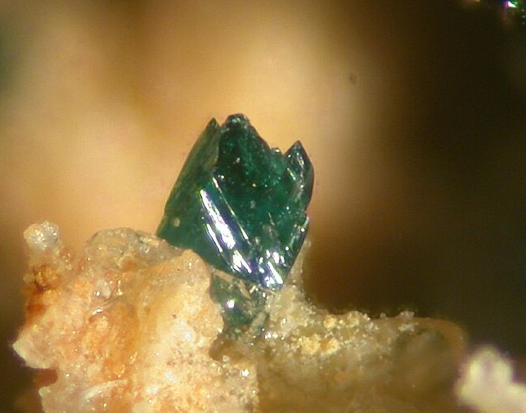
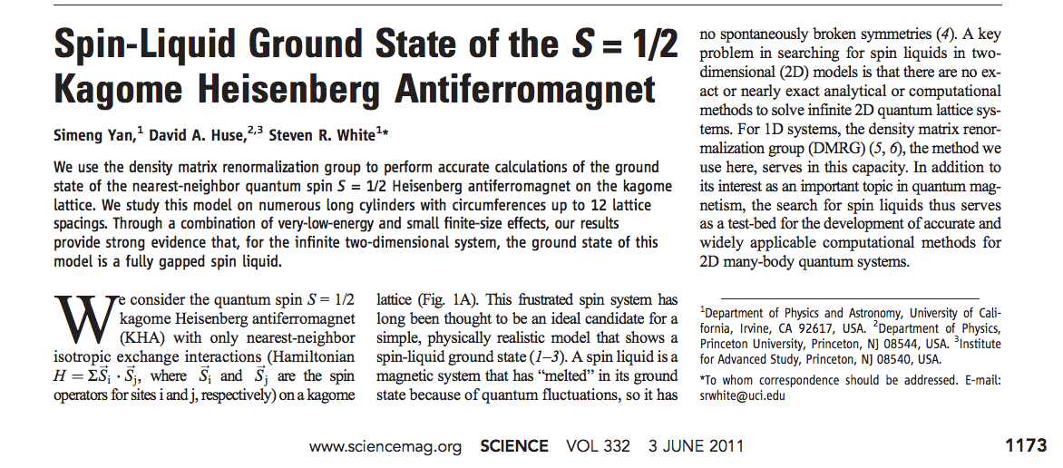
kagome antiferromagnet
ZnCu₃(OH)₆Cl₂
Herbertsmithite

Slide 10
quantum marginal problem
Local Hamiltonian problem:
Given l-local H, find λ_{min}(H) = min_{ρ} tr[Hρ].
Write H = ∑_{|S|≤l} H_{S} with H_{S} acting on systems S.
Then tr[Hρ] = ∑_{|S|≤l} tr[H_{S}ρ^{(S)}].
O(n^{l})-dim convex optimization:
min ∑_{|S|≤l} tr[H_{S}ρ^{(S)}]
such that {ρ^{(S)}}_{|S|≤l} are compatible.
QMA-complete to check
O(n^{k})-dim relaxation: (k≥l)
min ∑_{|S|≤l} tr[H_{S}ρ^{(S)}]
such that {ρ^{(S)}}_{|S|≤k} are locally compatible.

Slide 11
Other Hamiltonian problems
Properties of ground state:
i.e. estimate tr[Aρ] for ρ = argmin tr[Hρ]
reduces to estimating λ_{min}(H + μA)
Non-zero temperature:
Estimate log tr e^{-H} and derivatives
#P-complete, but some special cases are easier
(Noiseless) time evolution:
Estimate matrix elements of e^{iH}
BQP-complete

Slide 12
SOS hierarchies for q info
Goal: approximate Sep Relaxation: k-extendable + PPT (positive partial transpose)
Goal: λ_{min} for Hamiltonian on n qudits Relaxation: L : k-local observables → R such that L[X*X] ≥ 0 for all k/2-local X.
Goal: sup_{ρ,{A},{B} s.t. ...} ∑_{xy} c_{xy}⟨ρ, A_{x} ⊗ B_{y}⟩ Relaxation: L : products of ≤k operators → R such that L[p*p] ≥ 0 ∀noncommutative poly p of deg ≤ k/2, and operators on different parties commute. Non-commutative positivstellensatz [Helton-McCullough ‘04]

Slide 13
1. SOS hierarchies for Sep
SepProdR = conv{xx^{T} ⊗ xx^{T} : ||x||₂=1, x∈R^{n}}
relaxation [Doherty, Parrilo, Spedalieri ’03]
σ∈D_{nk} is a fully symmetric tensor
ρ=tr_{3...k}[σ]
Other versions use
less symmetry. e.g. k-ext + PPT
σ
σ
=

Slide 14
2. SOS hierarchies for λ_{min}
exact convex optimization: (hard)
min ∑_{|S|≤k} tr[H_{S}ρ^{(S)}]
such that {ρ^{(S)}}_{|S|≤k} are compatible.
equivalent:
min ∑_{|S|≤k} L[H_{S}] s.t.
∃ρ ∀ k-local X, L[X] = tr[ρX]
relaxation:
min ∑_{|S|≤k} L[H_{S}] s.t.
L[X*X] ≥ 0 for all k/2-local X L[I]=1

Slide 15
classical analogue of Sep
quadratic optimization over simplex
max {⟨Q, p⊗p⟩ : p∈Δ_{n}} = h_{conv{p⊗p}} (Q)
If Q=A, then max = 1 – 1 / clique#.
relaxation: q∈Δ_{nk} symmetric (aka “exchangeable”)
π = q^{(1,2)}
convergence: [Diaconis, Freedman ‘80], [de Klerk, Laurent, Parrilo ‘06]
dist(π, conv{p⊗p}) ≤ O(1/k)
→ error ||Q||∞ / k in time n^{O(k)}

Slide 16
Nash equilibria
Non-cooperative games: Players choose strategies p^{A} ∈ Δ_{m}, p^{B} ∈ Δ_{n}. Receive values ⟨V_{A}, p^{A} ⊗ p^{B}⟩ and ⟨V_{B}, p^{A} ⊗ p^{B}⟩.
Nash equilibrium: neither player can improve own value ε-approximate Nash: cannot improve value by > ε
Correlated equilibria: Players follow joint strategy p^{AB} ∈ Δ_{mn}. Receive values ⟨V_{A}, p^{AB}⟩ and ⟨V_{B}, p^{AB}⟩. Cannot improve value by unilateral change.
Can find in poly(m,n) time with LP.
Nash equilibrium = correlated equilibrum with p = p^{A} ⊗ p^{B}

Slide 17
finding (approximate) Nash eq
Known complexity: Finding exact Nash eq. is PPAD complete. Optimizing over exact Nash eq is NP-complete. Algorithm for ε-approx Nash in time exp(log(m)log(n)/ε²) based on enumerating over nets for Δ_{m}, Δ_{n}. Planted clique and 3-SAT[log²(n)] reduce to optimizing over ε-approx Nash.
[Lipton, Markakis, Mehta ‘03], [Hazan-Krauthgamer ’11], [Braverman, Ko, Weinstein ‘14]
New result: Another algorithm for finding ε-approximate Nash with the same run-time.
(uses k-extendable distributions)

Slide 18
algorithm for approx Nash
Search over such that the A:B_{i} marginal is a correlated equilibrium conditioned on any values for B₁, …, B_{i-1}.
LP, so runs in time poly(mn^{k})
Claim: Most conditional distributions are ≈ product. Proof:
log(m) ≥ H(A) ≥ I(A:B₁...B_{k}) = ∑_{1≤i≤k} I(A:B_{i}|B_{<i}) 𝔼_{i} I(A:B_{i}|B_{<i}) ≤ log(m)/k =: ε² ∴ k = log(m)/ε² suffices.

Slide 19
SOS results for h_{Sep}
Sep(n,m) = conv{ρ₁ ⊗ ... ⊗ ρ_{m} : ρ_{m} ∈ D_{n}}
SepSym(n,m) = conv{ρ^{⊗m} : ρ ∈ D_{n}}
bipartite
doesn’t match hardness
Thm: If M =∑_{i} A_{i} ⊗B_{i} with ∑_{i} |A_{i}| ≤ I, each |B_{i}| ≤ I, then h_{Sep(n,2)}(M) ≤ h_{k-ext}(M) ≤ h_{Sep(n,2)}(M) + c (log(n)/k)^{1/2}
[Brandão, Christandl, Yard ’10], [Yang ’06], [Brandão, H ’12], [Li, Winter ‘12]
multipartite
Thm:
ε-approx to h_{SepSym(n,m)}(M) in time exp(m² log²(n)/ε²).
ε-approx to h_{Sep(n,m)}(M) in time exp(m³ log²(n)/ε²).
[Brandão, H ’12], [Li, Smith ’14]
≈matches Chen-Drucker hardness

Slide 20
SOS results for λ_{min}
H = E_{(i,j)∈E} H_{i,j} acts on (C^{d})^{⊗n} such that
each ||H_{i,j}|| ≤ 1
|V| = n
(V,E) is regular
adjacency matrix has ≤r eigenvalues ≥poly(ε/d)
Theorem
λ_{min}(H) ≈_{ε} h_{Sep(d,n)}(H)
and can compute this to error ε with r∙poly(d/ε) rounds of SOS,
i.e. time n^{r}∙^{poly(d/ε)}.
[Brandão-H, ’13] based on [Barak, Raghavendra, Steurer ‘11]

Slide 21
net-based algorithms
M =∑_{i∈[m]} A_{i} ⊗B_{i} with ∑_{i} A_{i} ≤ I, each |B_{i}| ≤ I, A_{i} ≥ 0
hierarchies estimate h_{Sep}(M) ±ε in time exp(log²(n)/ε²)
h_{Sep}(M) = max_{α,β}tr[M(α⊗β)] = max_{p∈S} ||p||_{B}
S = {p : ∃α s.t. p_{i} = tr[A_{i}α]} ⊆Δ_{m}
||x||_{B} = ||∑_{i} x_{i} B_{i}||_{op}
Lemma: ∀p∈Δ_{m} ∃q k-sparse (each q_{i} = integer / k) ||p-q||_{B} ≤ c(log(n)/k)^{1/2}. Pf: matrix Chernoff [Ahlswede-Winter]
Algorithm: Enumerate over k-sparse q
check whether ∃p∈S, ||p-q||_{B} ≤ε
if so, compute ||q||_{B}
Performance
k ≃ log(n)/ε², m=poly(n)
run-time
O(m^{k}) = exp(log²(n)/ε²)

Slide 22
nets for Banach spaces
X:A->B ||X||_{A->B} = sup ||Xa||_{B} / ||a||_{A} operator norm
||X||_{A->C->B} = min {||Z||_{A->C} ||Y||_{C->B} : X=YZ} factorization norm
Let A,B be arbitrary. C = l₁^{m}
Only changes are sparsification (cannot assume m≤poly(n))
and operator Chernoff for B.
Type 2 constant: T₂(B) is smallest λ such that
result:
estimated in time exp(T₂(B)² log(m)/ε²)

Slide 23
ε-nets vs. SOS
Problem | ε-nets | SOS/info theory
max_{p∈Δ} p^{T}Ap | KLP ‘06 | DF ’80 KLP ‘06
approx Nash | LMM ‘03 | H. ‘14
free games | AIM ‘14 | Brandão-H ‘13
h_{Sep} | Shi-Wu ‘11 Brandão-H ‘14 | BCY ‘10 Brandão-H ’12 BKS ‘13

Slide 24
questions / references
Application to 2->4 norm and small-set expansion.
Matching quasipolynomial algorithms and hardness.
simulating noisy/low-entanglement dynamics
conditions under which Hamiltonians are easy to simulate
Relation between hierarchies and nets
Meaning of low quantum conditional mutual information
Hardness/connections | 1001.0017
Relation to 2->4 norm, SSE | 1205.4484
SOS for h_{Sep} | 1210.6367
SOS for λ_{min} | 1310.0017

Slide 25
