Slide 1
Product-state approximations to quantum ground states
Fernando Brandão (UCL)
Aram Harrow (MIT)
arXiv:1310.0017

Slide 2
Constraint Satisfaction Problems
c₃
k-CSP:
Variables {x₁, …, x_{n}} in Σ^{n}
Alphabet Σ
Constraints {c_{1,} …, c_{m}}
c_{j} : ∑^{k} → {0,1}
UNSAT:=
x₁
x₂
x₃
x₄
x₅
x₆
x₇
x₈
c₂
c₁
Includes 3-SAT, max-cut, vertex cover, …
Computing UNSAT is NP-complete

Slide 3
CSPs » eigenvalue problems
Hamiltonian
d = |∑|
local terms
UNSAT = λ_{min} (H)
e.g. Ising model, Potts model, general classical Hamiltonians

Slide 4
Local Hamiltonians, aka quantum k-CSPs
k-local Hamiltonian:
local terms: each H_{i} acts nontrivially on ≤ k qudits
and is bounded: ||H_{i}||≤1
qUNSAT = λ_{min} (H)
optimal assignment = ground state wavefunction
How hard are qCSPs?
Quantum Hamiltonian Complexity addresses this question
Notes:
why interesting?
same as classical, constant error is the most relevant approximation regime and we want to know the complexity
existence of NP witnesses is important for theoretical physics
robustness of quantum effects to nonzero temperature

Slide 5
The local Hamiltonian problem
Problem
Given a local Hamiltonian H, decide if
λ_{min}(H) ≤α or λ_{min}(H) ≥ α + Δ.
Thm [Kitaev ’99] The local Hamiltonian problem is QMA-complete for Δ=1/poly(n).
(quantum analogue of the Cook-Levin theorem)
QMA := quantum analogue of NP, i.e. can verify quantum proof in poly time on quantum computer.
Even simple models are QMA-complete:
Oliveira-Terhal ‘05: qubits on 2-D grid
Aharanov-Gottesman-Irani-Kempe ‘07: qudits in 1-D
Childs-Gosset-Webb: Bose-Hubbard model in 2-D

Slide 6
quantum complexity theory
complexity | classical | quantum
computable in polynomial time | P | BQP
verifiable in polynomial time | NP | QMA
P
q. simulation
Conjectures
BQP
Requires exponential
time to solve on
classical computers.
factoring
3-SAT
local
Hamiltonian
NP
Requires exponential
time to solve even on
quantum computers.
QMA

Slide 7

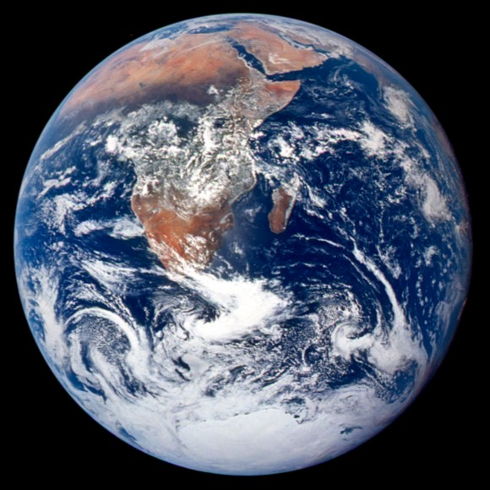
NP vs QMA
Here is the QCD Hamiltonian. Can you decribe the wavefunction of the proton in a way that will let me compute its mass?
Can you give me some description I can use to get a 0.1% accurate estimate using fewer than 10⁵⁰ steps?
No.
Greetings! The proton is the ground state of the u, u and d quarks.
I can, however, give you many protons, whose mass you can measure.

Slide 8
Constant accuracy?
3-SAT revisited:
NP-hard to determine if UNSAT=0 or UNSAT ≥ 1/n³
PCP theorem: [Babai-Fortnow-Lund ’90, Arora-Lund-Motwani-Sudan-Szegedy ’98]
NP-hard to determine if UNSAT(C)=0 or UNSAT(C) ≥ 0.1
Equivalent to existence of Probabilistically Checkable Proofs for NP.
Quantum PCP conjecture:
There exists a constant Δ>0 such that it is QMA complete to estimate λ_{min} of a 2-local Hamiltonian H to accuracy Δ⋅||H||.
[Bravyi, DiVincenzo, Terhal, Loss ‘08] Equivalent to conjecture for
O(1)-local Hamiltonians over qudits.
≈ equivalent to estimating the energy at constant temperature.
Contained in QMA. At least NP-hard (by the PCP theorem).

Slide 9
Previous Work and Obstructions
[Aharonov, Arad, Landau, Vazirani ’08]
Quantum version of 1 of 3 parts of Dinur’s proof of the PCP thm (gap amplification)
But: The other two parts (alphabet and degree reductions) involve massive copying of information; not clear how to do it with a highly entangled assignment
[Bravyi, Vyalyi ’03; Arad ’10; Hastings ’12; Freedman, Hastings ’13; Aharonov, Eldar ’13, …]
No-go (NP witnesses) for large class of commuting Hamiltonians and almost-commuting Hamiltonians
But: Commuting case might really be easier

Slide 10
result 1: high-degree in NP
Theorem
If H is a 2-local Hamiltonian on a D-regular graph of n qudits, then there exists a product state
|ψ⟩ = |ψ₁⟩ ­ … ­ |ψ_{n}⟩ such that
λ_{min} ≤ ⟨ψ|H|ψ⟩ ≤ λ_{min} ⁺ O(d^{2/3} / D^{1/3})
Corollary
The ground-state energy can be approximated to accuracy
O(d^{2/3} / D^{1/3}) in NP.

Slide 11
intuition: mean-field theory
∞-D
1-D
2-D
Bethe
lattice
3-D

Slide 12
clustered approximation
Given a Hamiltonian H on a graph G with vertices
partitioned into m-qudit clusters (X₁, …, X_{n/m}), can
approximateλ_{min} to error
with a state that has no
entanglement between clusters.
good approximation if
X₃
expansion is o(1)
degree is high
entanglement satisfies
subvolume law
X₂
X₁
X₄
X₅

Slide 13

1. Approximation from low expansion
Hard instances must use highly expanding graphs
X₃
X₂
X₁
X₄
X₅

Slide 14
2. Approximation from high degree
Unlike classical CSPs:
PCP + parallel repetition imply that 2-CSPs are NP-hard to approximate to error d®/D¯ for any ®,¯>0.
Parallel repetition maps C → C’ such that
D’ = D^{k}
Σ’ = Σ^{k}
UNSAT(C) = 0 → UNSAT(C’)=0
UNSAT(C) > 0 → UNSAT(C’) > UNSAT(C)
Corollaries:
Quantum PCP and parallel repetition not both true.
Φ ≤ 1/2 - Ω(1/D) means highly expanding graphs in NP.

Slide 15
3. Approximation from low entanglement
Subvolume law (S(X_{i}) << |X_{i}|) implies NP approximation
1. Previously known only if S(X_{i}) << 1.
2. Connects entanglement to complexity.
3. For mixed states, can use mutual information instead.

Slide 16
proof sketch
mostly following [Raghavendra-Tan, SODA ‘12]
Chain rule Lemma:
I(X:Y₁…Y_{k}) = I(X:Y₁) + I(X:Y₂|Y₁) + … + I(X:Y_{k}|Y₁…Y_{k-1})
→ I(X:Y_{t}|Y₁…Y_{t-1}) ≤ log(d)/k for some t≤k.
Decouple most pairs by conditioning:
Choose i, j₁, …, j_{k} at random from {1, …, n}
Then there exists t<k such that
Discarding systems j₁,…,j_{t} causes error ≤k/n and leaves a distribution q for which

Slide 17
Does this work quantumly?
What changes?
😊 Chain rule, Pinsker, etc, still work.
😧 Can’t condition on quantum information.
😥 I(A:B|C)_{ρ} ≈ 0 doesn’t imply ρ is approximately separable
[Ibinson, Linden, Winter ‘08]
Key technique: informationally complete measurement
maps quantum states into probability distributions with poly(d) distortion.
d⁻² || ρ - σ||₁ ≤ || M(ρ) – M(σ) ||₁ ≤ || ρ - σ ||₁

Slide 18
Proof of qPCP no-go
Measure εn qudits and condition on outcomes.
Incur error ε.
Most pairs of other qudits would have mutual information
≤ log(d) / εD if measured.
Thus their state is within distance d²(log(d) / εD)^{1/2} of product.
Witness is a global product state. Total error is
ε + d²(log(d) / εD)^{1/2}.
Choose ε to balance these terms.

Slide 19
result 2: “P”TAS
PTAS for Dense k-local Hamiltonians
improves on 1/d^{k-1} +εapproximation from [Gharibian-Kempe ’11]
PTAS for planar graphs
Builds on [Bansal, Bravyi, Terhal ’07] PTAS
for bounded-degree planar graphs
Algorithms for graphs with low threshold rank
Extends result of [Barak, Raghavendra, Steurer ’11].
run-time for ε-approximation is
exp(log(n) poly(d/ε) ⋅#{eigs of adj. matrix ≥ poly(ε/d)})

Slide 20
The Lasserre SDP hierarchy for local Hamiltonians
Classical
Quantum
problem
2-CSP
2-local Hamiltonian
LP hierarchy
Optimize over k-body marginals
E[f] for deg(f) ≤ k ⟨ψ|H|ψ⟩ for k-local H
(technically an SDP)
Add global PSD constraint
SDP hierarchy
⟨ψ|H†H|ψ⟩≥0
for k/2-local H
E[f²]≥0 for deg(f)≤k/2
analysis when
k = poly(d/ε)⋅
rank_{poly(ε/d)}(G)
Barak-Raghavendra-Steurer
1104.4680
similar

Slide 21
Open questions
The Quantum PCP conjecture!
Is quantum parallel repetition possible?
Are commuting Hamiltonians easier?
Better de Finetti theorems / counterexamples
main result says random subsets of qudits are ≈ separable
Aharonov-Eldar have incomparable qPCP no-go.
Unifying various forms of Lasserre SDP hierarchy
(a) approximating separable states via de Finetti (1210.6367)
(b) searching for product states for local Hamiltonians (this talk)
(c) noncommutative positivstellensatz approach to games
SDP approximations of lightly entangled time evolutions

