Slide 1
Hohensalzburg Fortress

Slide 2
National Opera and Ballet of Belarus

Slide 3
Historic Center of Bruges

Slide 4
Sofia Land

Slide 5
Prague Orloj

Slide 6
Little Mermaid Statue

Slide 7



Slide 8


Slide 9



Slide 10


Slide 11


Slide 12


Slide 13
Historic Center of Tallinn

Slide 14
Finlandia Hall

Slide 15
Eiffel Tower

Slide 16
Schloss Neuschwanstein

Slide 17
The Acropolis

Slide 18
Buda Castle

Slide 19


Slide 20


Slide 21


Slide 22


Slide 23


Slide 24



Slide 25
The Colosseum

Slide 26
Riga Motor Museum

Slide 27
Historic Center of Vilnius

Slide 28
Grand Ducal Palace

Slide 29
Chișinău Nativity Cathedral

Slide 30
Van Gogh Museum

Slide 31


Slide 32


Slide 33


Slide 34


Slide 35


Slide 36


Slide 37
Oslofjord

Slide 38
Wieliczka Salt Mine

Slide 39
Torre Vasco da Gama

Slide 40
The Danube Delta

Slide 41
The Kremlin

Slide 42
Nikola Tesla Museum

Slide 43
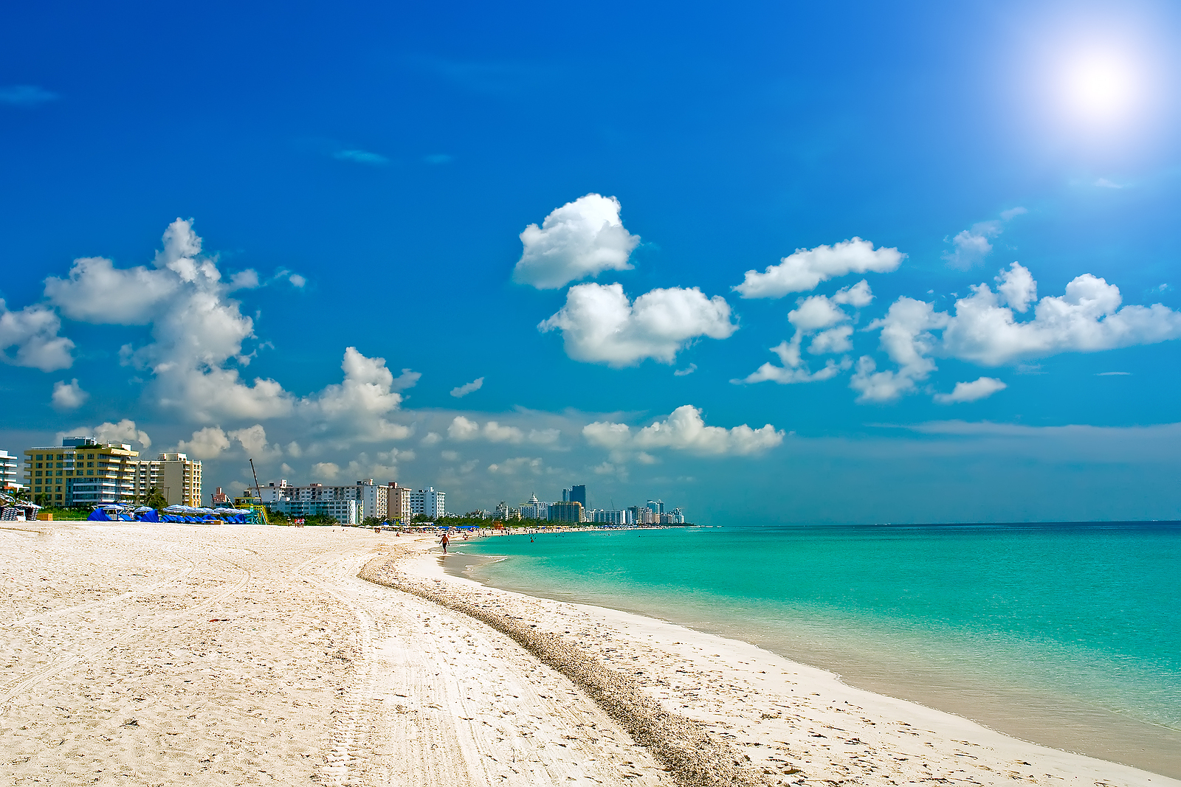


Slide 44


Slide 45


Slide 46


Slide 47


Slide 48


Slide 49
Bratislavský
Hrad

Slide 50
Sagrada Familia

Slide 51
Nobel Museum

Slide 52
Large Hadron Collider

Slide 53
Chernobyl

Slide 54
Big Ben

Slide 55


Slide 56


Slide 57


Slide 58


Slide 59


Slide 60


