Slide 1
Haptic exploration
9.357: Touching and Grasping with Soft Fingers
Maddie Cusimano

Slide 2
Lederman & Klatzky (1987), Hand Movements: A Window into Haptic Object Recognition.
Lederman & Klatzky (2004), Haptic identification of common objects: Effects of constraining the manual exploration process
Notes:
Today’s papers….

Slide 3
Lederman & Klatzky (1987), Hand Movements: A Window into Haptic Object Recognition.
Lederman & Klatzky (2004), Haptic identification of common objects: Effects of constraining the manual exploration process
Notes:
Lederman and Klatzky had a paper in 1985 that showed that blindfolded people could identify everyday 3D objects (such as a whistle, pen, sweater) nearly completely accurately after touching them for only a couple seconds.

Slide 4
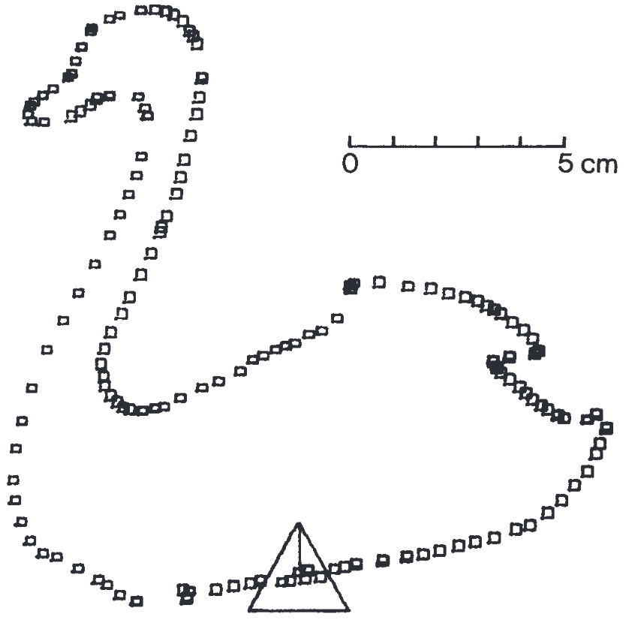
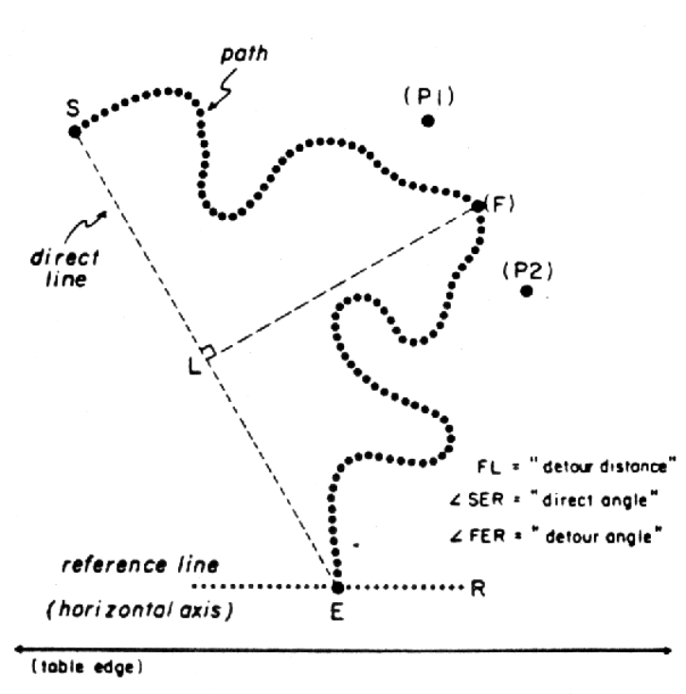
Magee & Kennedy, 1980
Lederman, Klatzky, & Barber, 1985
Notes:
When they wrote that paper, they were responding to a consensus in the literature that the haptic system could not perceive spatial structure effectively; and this had been tested through getting participants to essentially trace raised line drawings.
So let’s compare 3D and 2D haptic perception
DEMO– duck outline, real 3D duck, outline of something else that hasn’t been seen yet? Press into hand. twist. Trace.
questions: what are some differences between the 2D and 3D? Differences between having seen this thing ^ and touching a raised display for something you haven’t seen before
3d things have Shape, size, texture, weight, but 2d things do not. Kinesthetics are only in 2d have lots of experience seeing&touching things like this. not trying to determine very accurate spatial information.

Slide 5
Haptic ‘subsystems’
Sensory – cutaneous, kinesthetic input
Motor – active manipulation
Key idea: hand’s motor abilities are inherent to its sensory abilities
J.J. Gibson (1962, 1966):
  “perceptual” vs. “sensory” systems
Notes:
What do threeD objects buy you? Very different involvement of motor system
Cutaneous inputs: mechanoreceptors and thermoreceptors
Four different kinds of mechanoreceptors in skin: different areas of receptive field and different adaptation rates (i.e. some will continue to respond to a sustained input)
Kinesthetic: mechanoreceptors in muscles, tendons, joints → limb position and movement

Slide 6
Haptic ‘subsystems’
Sensory – cutaneous, kinesthetic input
Motor – active manipulation
Key idea: hand’s motor abilities are inherent to its sensory abilities
J.J. Gibson (1962, 1966):
  “perceptual” vs. “sensory” systems
Notes:
DEMO with pencaps, toliet paper roll: everyone hold their hand out without moving. I put something in their palm. See what you can tell without motion.
Then allow people to close their hand around the object. What can they tell now?
Finally, move your hand around the object
J.J. Gibson
1962: Observations on active touch
1966: Senses considered as perceptual systems
consider “perceptual” systems rather than “sensory” systems, “obtain” rather than “receive” a stimulus

Slide 7
Hypothesis
Hand movements should vary with sensory input and type of information desired
Exploratory procedures (EP)
  Stereotyped movement pattern with certain invariance
Notes:
Lederman&Klatzky’s hypothesis
We’ll talk about the specific exploratory procedures they hypothesize existing after we try this out for ourselves
Doesn’t seem like the same definition of “invariance” as Gibson…

Slide 8
Let’s explore
Notes:
Demos: explore stuff in a bag … BUY PAPER BAGS to put all objects in
Any motions that you find yourself doing for each object/prompt?
How do you tell that something in your hand is a single coherent object?
Non-EPs…
Bluetac, hairtie: pliable >> stretching (find something elastic)
Black beans vs. rice vs. flour in balloon >> rolling/pressure combined motion
(There’s three balloons in the bag with items inside them. Find the one with rice inside it.)
Red pepper slice: wet (name something in there that’s wet) → other interesting thing about this one is the texture on both sides
EPs…
Marbles (find the smallest object in the bag… what are different materials?)
Wooden block (find something made of wood)
Velcro (specific function … “sound” confirmation)
Sharpened sticks (find something sharp – pressure)
Observations???
Pick it up first always
Often are doing more than one thing at once, doing some action achieves many types of information gathering
Isolated object in hand
Ever do scratching instead of rubbing?
I feel like the in hand manipulations of the object are really important, rotations applying pressure to one side, etc. and feeling the pressure on the other parts of the hand is really important, but hard to verbalize
ONE more ---
Eggs. One partner close eyes and take the eggs. The other partner crinkles the paper bag. Figure out the difference between them

Slide 9
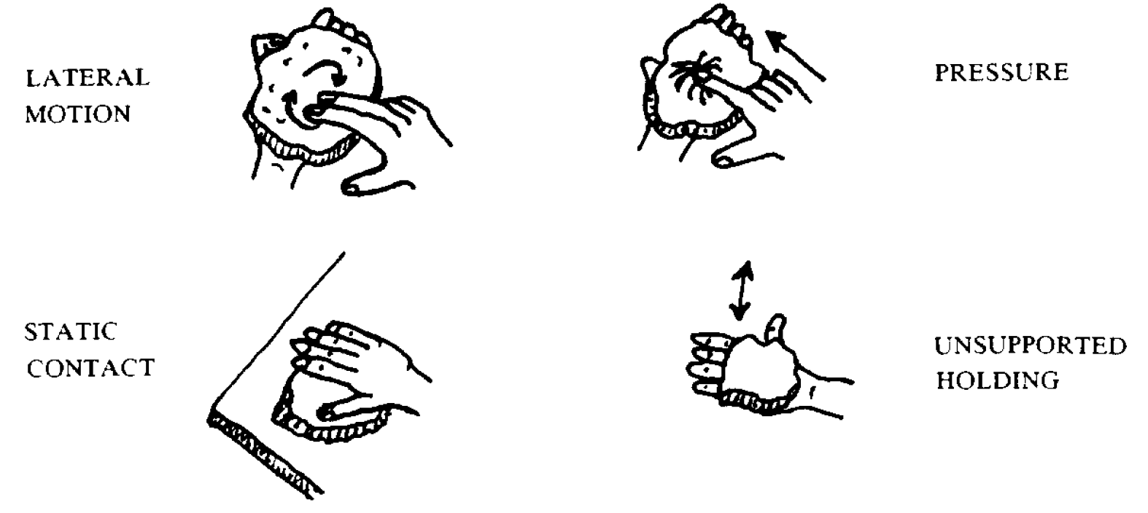
Notes:
THEIR EPs:
Lateral motion >> sideways movement between skin and object surface, supposed to be for texture
Pressure >> apply torque, normal forces to object while another part is stabilized, supposed to be for hardness
Static Contact >> supported externally, hand rests on it without molding, supposed to be for temperature
Unsupported holding >> object lifted away from any supporting surface and maintained in hand, supposed to be for weight

Slide 10
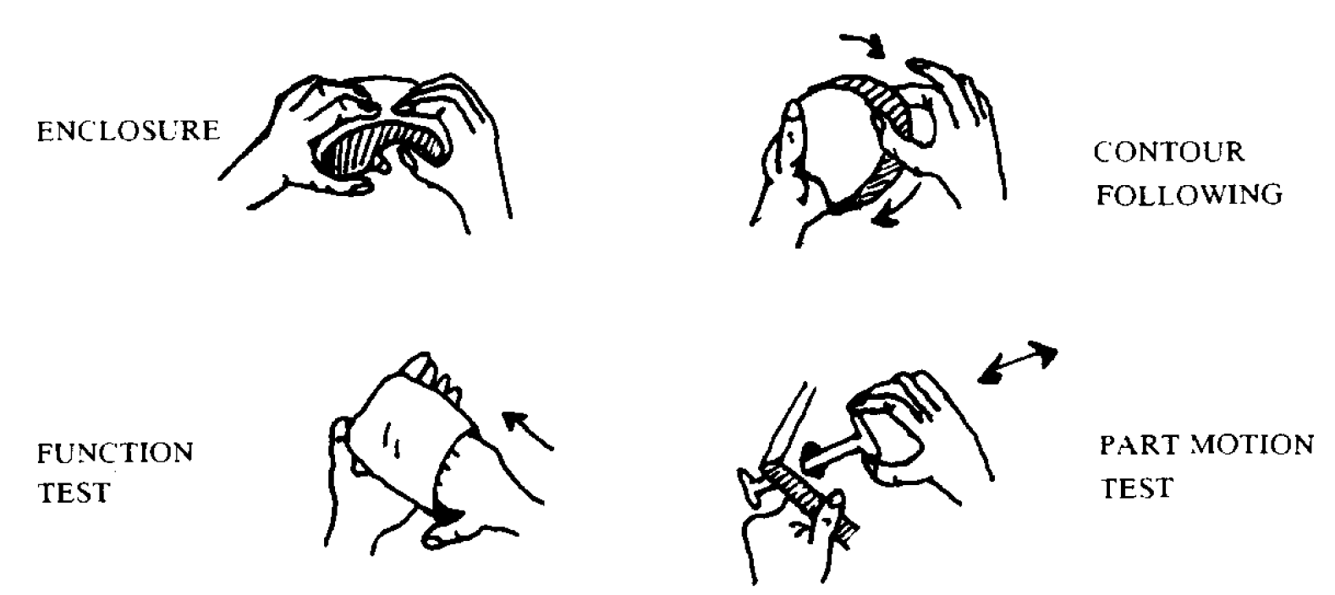
Notes:
Enclosure >> wrap hand around as much of object as possible, supposed to be for global shape & volume
Contour following >> hand maintains contact with contour of object (exact shape, volume)
Part motion test >> stabilize one part of object while applying force to another ( to check if there’s a moving part )
Function testing >> testing out a possible specific function of an object
>>> more discussion…

Slide 11
2 match-to-sample tasks
Varied instructions and videotaped hands during exploration
  Are EPs driven by the type of information sought?
Allowed only 1 EP during exploration
  How effective is each EP at obtaining different types of information?

Slide 12
2 match-to-sample tasks
Varied instructions and videotaped hands during exploration
  Are EPs driven by the type of information sought?
Allowed only 1 EP during exploration
  How effective is each EP at obtaining different types of information?

Slide 13
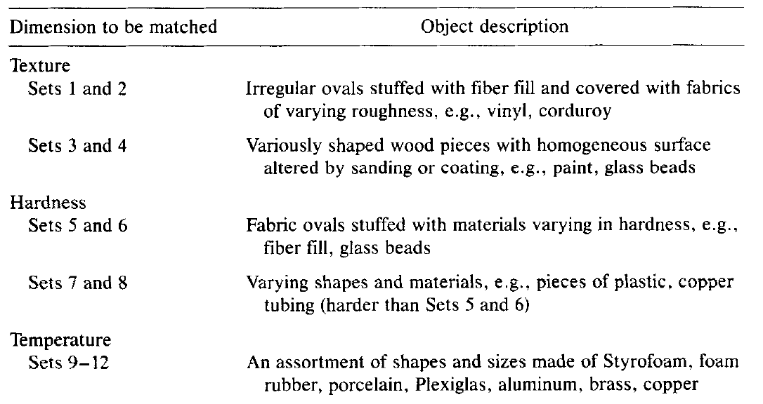
Experiment 1: method
Mostly unfamiliar objects
Notes:
Each set: 1 standard object and 3 comparison objects, one of which was the standard’s best match along some particular dimension
9 Dimensions of interest that correspond to the EPs (Texture, hardness, temperature, weight, volume, general shape, exact shape, part motion, function)

Slide 14
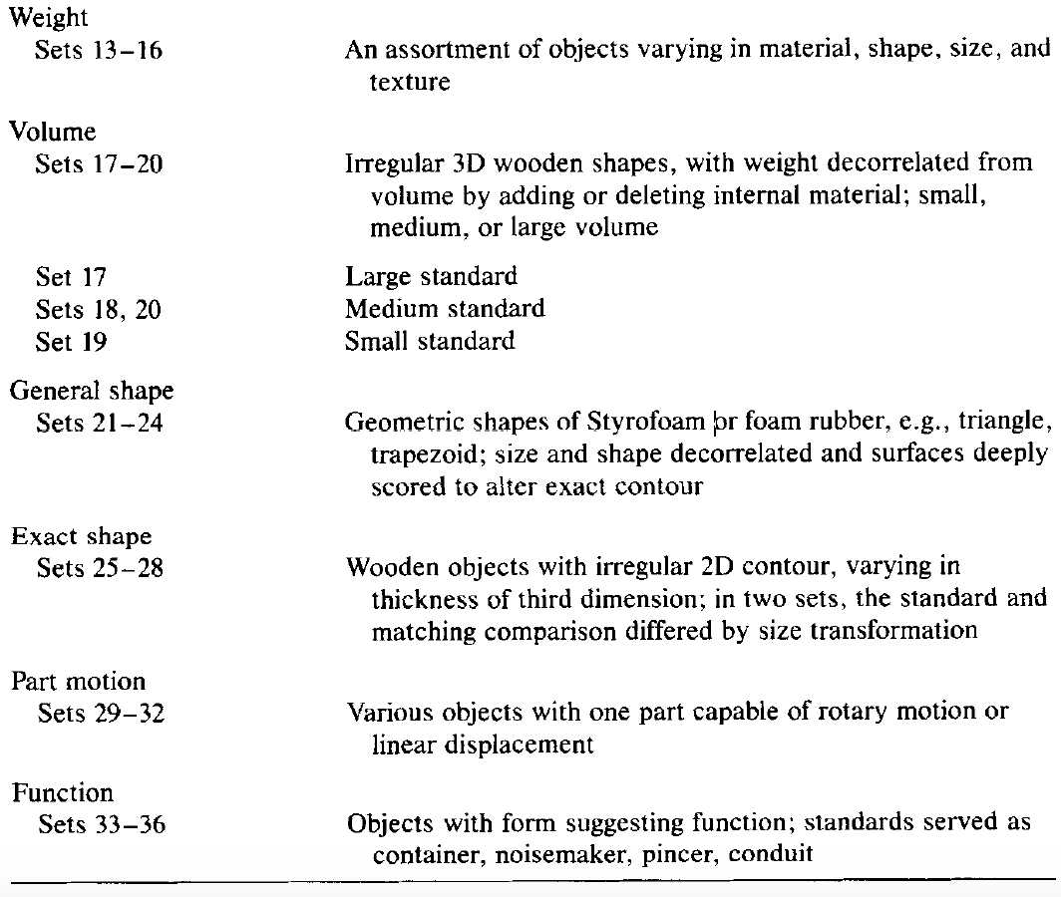
Notes:
So for each set they were presented with, participants were told what dimension they should match the objects on
Participants were blindfolded, headphones used to muffle environmental sounds
As objects were explored, hands were videotaped
For every single set, the video frames were labeled as showing one of first six EPs (whereas part motion and function only checked for those sets). A frame could also be labeled as “Task maintenance” : maintain object in stable position or reorientation
Reliability: there were two scorers, weren’t using the same rules, I found this part pretty vague and unsatisfying

Slide 15
Experiment 1: matching accuracy
Matching dimension | Mean % Agreement Range over sets Overall category mean
Texture | 88.9 – 100.0 | 93.05
Hardness | 88.9 – 100.0 | 94.43
Temperature | 72.2 – 100.0 | 88.73
Weight | 44.4 – 88.9 | 65.28
Volume | 61.1 – 100.0 | 80.55
General shape | 72.2 – 100.0 | 87.48
Exact shape | 66.7 – 88.9 | 76.40
Part motion | 83.3 – 100.0 | 93.05
Function | 83.3 – 88.9 | 84.70

Slide 16
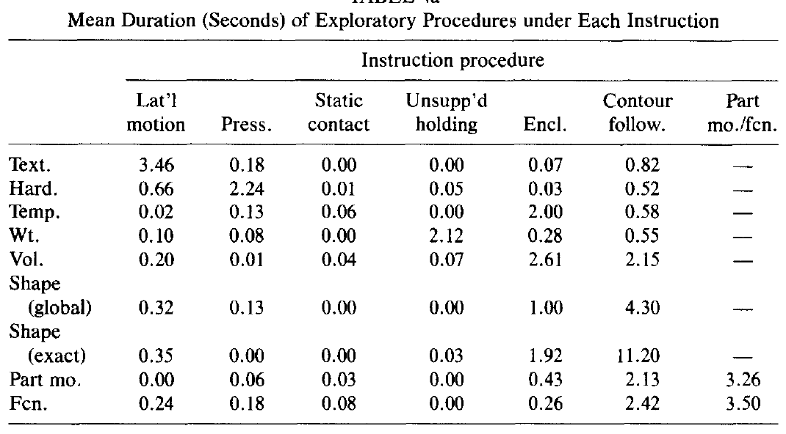
Experiment 1:
EP durations
Notes:
Contour following tends to take longer overall, z-scores (normalized by EP)

Slide 17
Experiment 2: method
Same match-to-sample task as experiment 1, but participants were instructed to only use a specific motion
Notes:
Excluded function and part motion
- Enclosure: participants had to keep their hands on the table, palm up

Slide 18
Experiment 2: method
Necessary: only EP to produce above chance performance
Sufficient: EPs that lead to above chance performance on a task
Optimal: Greater accuracy than any other EP (if comparable accuracy, look at speed)
Specialization: z_{max} – mean(z_{rest})
Notes:
Excluded function and part motion
How much better an EP does in its most successful condition than in other circumstances
Z-scores within an instruction

Slide 19
Experiment 2: analysis summary
Dimension | Lateral Motion | Pressure | Static Contact | Unsupp. Holding | Enclose | Contour following
Texture | O | S | S |  | S | S
Hardness | S | O |  | S | S | S
Temperature | S | S | O | S | S | S
Weight |  |  |  | O | S | S
Volume |  |  | O | S | S | S
Global Shape |  |  | O | S | S | S
Exact Shape |  |  |  |  |  | N
Special score | 2.06 | 2.79 | 1.56 | 1.95 | 0.62 | 1.92
Notes:
Enclosure and contour following are the most general of the EPs, can get some information about all of dimensions
Lateral motion and pressure
Strange that they included static contact given the results of the first experiment? It just basically never happened.

Slide 20
Lederman & Klatzky (1987), Hand Movements: A Window into Haptic Object Recognition.
Lederman & Klatzky (2004), Haptic identification of common objects: Effects of constraining the manual exploration process
Notes:
Not exactly the paper I wanted. Wanted to see the effects of hand constraints on exploratory behaviour. First we’ll go through this and then play around with some more objects

Slide 21
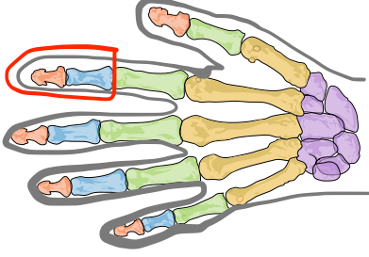
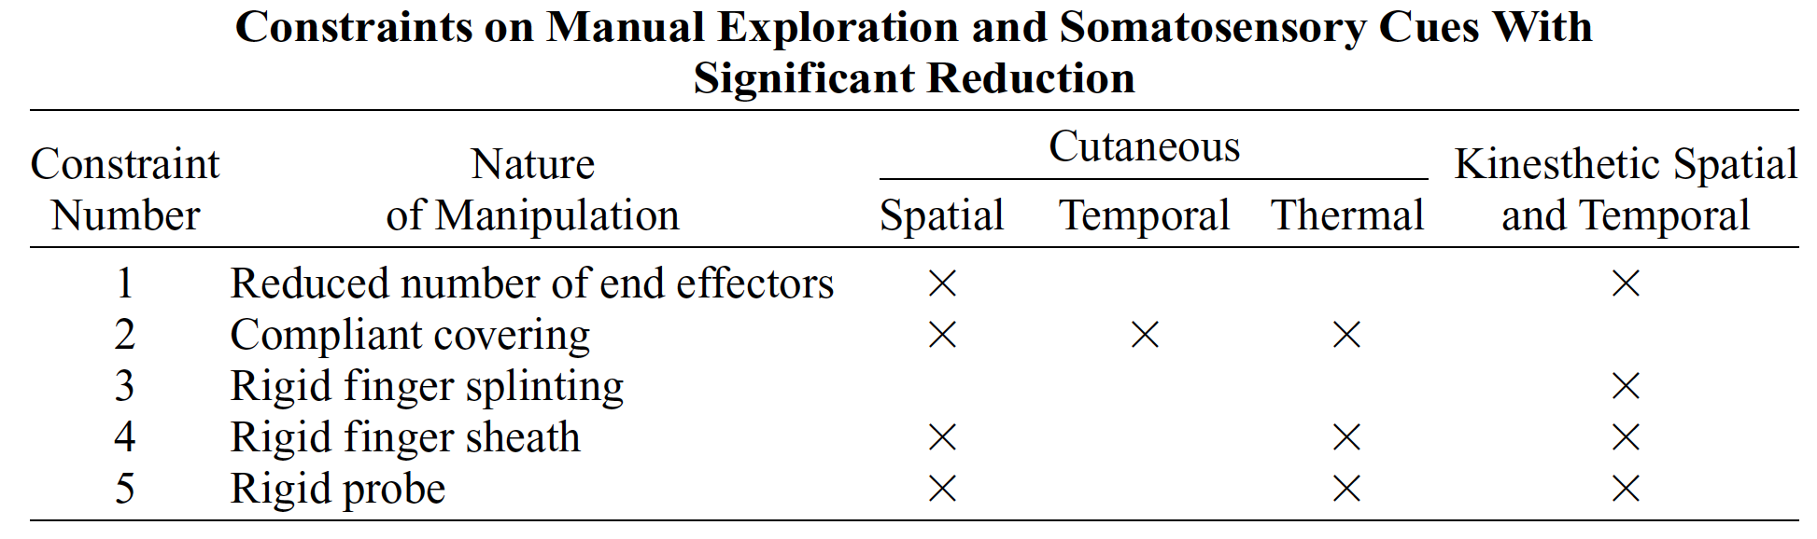
Types of constraints
Fewer fingers
Compliant glove (can bend, skin covered)
Rigid finger splint (cannot bend, skin uncovered)
Rigid finger sheath (cannot bend, skin covered)
Rigid probe
Notes:
Constraint 1: Less contact with the object, can’t manipulate in hand
Constraint 2: reduced spatially distributed force patterns, thermal information
Constraint 3: Can’t match hand to object
Constraint 4: in a previous paper, they found texture perception was only moderately impaired (temporal)
No cutaneous deformation, no kinesthetic or thermal cues
Constraint 5:

Slide 22
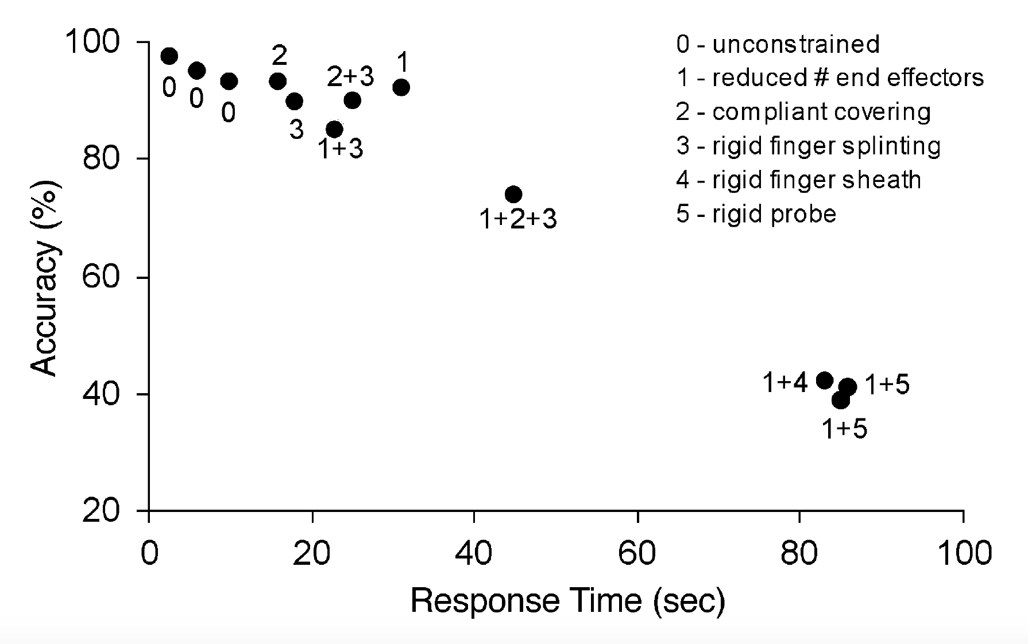
Results: recognition of everyday objects

Slide 23
What about EPs?
Constraints:
  One or two fingers
  Rigid probe: one or two chopsticks
  Non-rigid probe: pipe cleaner
  Clay/styrofoam tips
  Compliant gloves, bags
  Duct-taped hands
Notes:
Do you use the same EPs adapted to new tools? Do you come up with new EPs or fail otherwise?
Eg. Size (Exact shape)
Linguine, the way I did this:
Two fingers: wiggling the end
Chopsticks, single finger: contour following
Two hands: grab ends, kinesthetics
Eg. Global shape
Pipe cleaner, rigid probe, ducttaped hands, normal hands: medicine bottle
Eg. Weight
- Clay on textured surfaces
One chopstick: push around
Two chopstick (slippery object):
Eg. Texture
-Instant noodles (brittleness, how do you know you can break it?): hands, chopsticks
-Gloves: ball materials, black beans and rice
-opening bag of black beans and rice and using probes
Eg. Hardness
Start with a pipe cleaner and press on different things

