Slide 1
Lecture 4: CountSketch High Frequencies
COMS E6998-9 F15
Notes:
Left to the title, a presenter can insert his/her own image pertinent to the presentation.

Slide 2
Plan
Scriber?
Plan:
CountMin/CountSketch (continuing from last time)
High frequency moments via Precision Sampling

Slide 3
Part 1: CountMin/CountSketch
Let $f_{i}$ be frequency of $i$
Last lecture:
2nd moment: $\sum_{i}{f_{i}^{2}}$
Tug of War
Max: heavy hitter
CountMin
IP | Frequency
1 | 3
2 | 2
3 | 0
4 | 9
5 | 0
… | 0
$$n$$ | 1

Slide 4
CountMin: overall
Heavy hitters: $\frac{\hat{f_{i}}}{∑f_{j}}≥φ$
If $\frac{f_{i}}{∑f_{j}}≤φ\left(1−ε\right)$, not reported
If $\frac{f_{i}}{∑f_{j}}≥φ\left(1+ε\right)$, reported as heavy hitter
Space: $O\left(\frac{\log{n}}{εφ}\right)$ cells
Algorithm CountMin:
Initialize(L, w):
array S[L][w]
L hash functions $h_{1}…h_{L}$, into {1,…w}
Process(int i):
for(j=0; j<L; j++)
S[j][ $h_{j}(i)$ ] += 1;
Estimator:
foreach i in PossibleIP {
${\hat{f}}_{i}$ = $\min_{j}$(S[j][$h_{j}\left(i\right)$]);
}

Slide 5
Time
Can improve time; space degrades to $O\left(\frac{\log^{2}{n}}{εφ}\right)$
Idea: dyadic intervals
Each level: one CountMin sketch on the virtual stream
Find heavy hitters by following down the tree the heavy hitters
$$\sum_{i=1}^{n}{f_{i}}$$
(virtual) stream 1,
with 1 element
[1,n]
[1,n]
$$\sum_{i=1}^{n/2}{f_{i}}$$
$$\sum_{i=\frac{n}{2}+1}^{n}{f_{i}}$$
(virtual) stream 2,
with 2 elements
[1,n/2], [n/2+1,n]
[1,n/2]
…
(virtual) stream $j$,
with $2^{j}$ elements
[1,n/2^j], …
[3,4]
3
(real) stream $\log{n}$,
with $n$ elements
1,2,…n
$$f_{1}$$
$$f_{2}$$
$$f_{3}$$
$$f_{i}$$
$$f_{n}$$

Slide 6
CountMin: linearity
Is CountMin linear?
CountMin($f^{′}+f′′$) from CountMin($f′$) and CountMin($f′′$) ?
Just sum the two!
sum the 2 arrays, assuming we use the same hash function $h_{j}$
Used a lot in practice
https://sites.google.com/site/countminsketch/

Slide 7
CountSketch
Algorithm CountSketch:
Initialize(L, w):
array S[L][w]
L hash func’s $h_{1}…h_{L}$, into [w]
L hash func’s $r_{1},…r_{L}$, into {$±1$}
Process(int i, real $δ_{i}$):
for(j=0; j<L; j++)
S[j][ $h_{j}(i)$ ] += $r_{j}\left(i\right)⋅δ_{i}$;
Estimator:
foreach i in PossibleIP {
${\hat{f}}_{i}$ = $median_{j}$(S[j][$h_{j}\left(i\right)$]);
}
How about $f=f^{′}−f′′$ ?
Or general streaming
“Heavy hitter”:
if $\left|f_{i}\right|≥φ\sum_{j}{\left|f_{j}\right|}=φ⋅||f||_{1}$
“min” is an issue
But median is still ok
Ideas to improve it further?
Use Tug of War $r$ in each bucket => CountSketch
Better in certain sense (cancelations in a cell)

Slide 8
CountSketch$⇒$Compressed Sensing
Sparse approximations:
$f∈ℜ^{n}$
$k$-sparse approximation $f^{∗}$:
$\min{||f^{∗}−f||}$
Solution: $f^{∗}$ = the $k$ heaviest elements of $f$
Compressed Sensing:
[Candes-Romberg-Tao’04, Donoho’04]
Want to acquire signal $f$
Acquisition: linear measurements (sketch) $S\left(f\right)=Sf$
Goal: recover $k$-sparse approximation $\hat{f}$ from $Sf$
Error guarantee:
$$\left||\hat{f}−f|\right|≤\min_{k−sparse f^{∗}}{||f^{∗}−f||}$$
Theorem: need only $O(k⋅\log{n})$–size sketch!

Slide 9
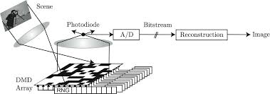
Signal Acquisition for CS
Single pixel camera
[Takhar-Laska-Waskin-Duarte-Baron-Sarvotham-Kelly-Baraniuk’06]
One linear measurement = one row of $S$
CountSketch: a version of Compr Sensing
Set $φ=1/2k$
$\hat{f}$: take all the heavy hitters (or $k$ largest)
Space: $O(klog n )$
source: http://dsp.rice.edu/sites/dsp.rice.edu/files/cs/cscam-SPIEJan06.pdf

Slide 10
Back to Moments
General moments:
$p^{th}$ moment: $\sum_{i}{f_{i}^{p}}$
normalized: ${\left(\sum_{i}{f_{i}^{p}}\right)}^{1/p}$
$p=2$ : $∑f_{i}^{2}$
$O(\log{n})$ via Tug of War (Lec. 3)
$p=0$ : count # distinct!
$O(\log{n})$ [Flajolet-Martin] from Lec. 2
$p=1$: $∑|f_{i}|$
$O\left(\log{n}\right)$ : will see later (for all $p∈(0,2)$)
$p=∞$ (normalized): $\max_{i}f_{i}$
Impossible to approximate, but can heavy hitters (Lec. 3)
Remains: $2<p<∞$ ?
Space: $Θ\left(n^{1−\frac{2}{p}}\log^{2}{n}\right)⇒$ Precision Sampling (next)
IP | Frequency
1 | 3
2 | 2
3 | 0
4 | 9
5 | 0
… | 0
$$n$$ | 1

Slide 11
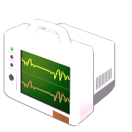
A task: estimate sum
Given: $n$ quantities $a_{1}, a_{2}, …a_{n}$ in the range $[0,1]$
Goal: estimate $S=a1+a2+…a_{n}$ “cheaply”
Standard sampling: pick random set $J=\{j1,…jm\}$ of size $m$
Estimator: $\tilde{S}=\frac{n}{m}⋅(a_{j_{1}}+a_{j_{2}}+…a_{j_{m}})$
Chebyshev bound: with 90% success probability
$S – O(n/m) <\tilde{S} < S + O(n/m)$
For constant additive error, need $m=Ω(n)$
Compute an estimate $\tilde{S}$ from $a1, a3$
a₁
a₃
a₁
a₂
a₃
a₄

Slide 12
Precision Sampling Framework
Alternative “access” to $ai$’s:
For each term $ai$, we get a (rough) estimate ${\tilde{a}}_{i}$
up to some precision $ui$, chosen in advance: $|ai –{\tilde{a}}_{i}| < ui$
Challenge: achieve good trade-off between
quality of approximation to $S$
use only weak precisions $ui$ (minimize “cost” of estimating $\tilde{a}$)
Compute an estimate $\tilde{S}$ from ${\tilde{a}}_{1},{\tilde{a}}_{2}, {\tilde{a}}_{3}{,\tilde{a}}_{4}$
u₁
u₂
u₃
u₄
ã₁
ã₂
ã₃
ã₄
a₁
a₂
a₃
a₄

Slide 13
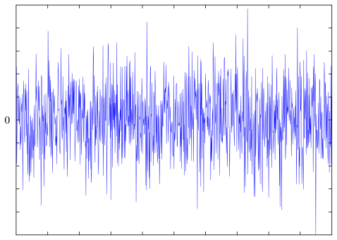
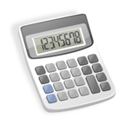
Formalization
Sum Estimator
Adversary
1. fix precisions $ui$
1. fix $a1,a2,…a_{n}$
2. fix ${\tilde{a}}_{1}, {\tilde{a}}_{2}, …{\tilde{a}}_{n}$ s.t. $|a_{i}−{\tilde{a}}_{i}| < ui$
3. given ${\tilde{a}}_{1}, {\tilde{a}}_{2}, …{\tilde{a}}_{n}$, output $\tilde{S}$ s.t.
$\left|\sum_{i}{a_{i}}−γ\tilde{S}\right|<1$ (for $γ≈1$)
What is cost?
Here, average cost = $1/n⋅∑ 1/ui$
to achieve precision $ui$, use $1/ui$ “resources”: e.g., if $ai$ is itself a sum $ai=∑jaij$computed by subsampling, then one needs $Θ(1/ui)$ samples
For example, can choose all $ui=1/n$
Average cost ≈ $n$

Slide 14
Precision Sampling Lemma
Goal: estimate $S=∑a_{i}$ from $\{{\tilde{a}}_{i}\}$ satisfying $|a_{i}−{\tilde{a}}_{i}|<u_{i}$.
Precision Sampling Lemma: can get, with 90% success:
O(1) additive error and 1.5 multiplicative error:
$S/1.5−O\left(1\right)<\tilde{S}<1.5⋅S+O(1)$
with average cost equal to $O(log⁡n)$
Example: distinguish $Σa_{i}=3$ vs $Σa_{i}=0$
Consider two extreme cases:
if three $ai=1$: enough to have crude approx for all $(ui=0.1)$
if all $ai=3/n$: only few with good approx $ui=1/n$, and the rest with $ui=1$

Slide 15
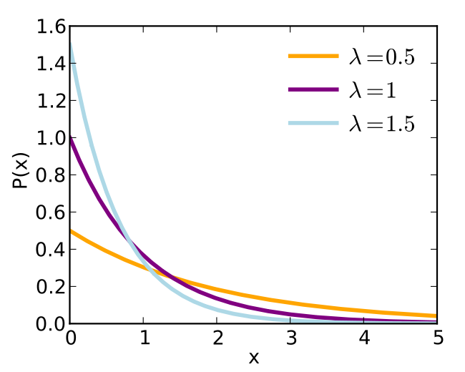
Precision Sampling: Algorithm
Precision Sampling Lemma: can get, with 90% success:
O(1) additive error and 1.5 multiplicative error:
$S/1.5−O\left(1\right)<\tilde{S}<1.5⋅S+O(1)$
with average cost equal to $O(log⁡n)$
Algorithm:
Choose each $u_{i}Exp(1)$ i.i.d.
Estimator: $\tilde{S}=\max_{i} {\tilde{a}}_{i}/u_{i}$.
Proof of correctness:
Claim 1: $\max{a_{i}/u_{i}}∼∑a_{i}/Exp(1)$
Hence, $\max{{\tilde{a}}_{i}/u_{i}}=\frac{∑a_{i}}{Exp\left(1\right)}±1$
Claim 2: Avg cost =$O(\log{n})$
$$Exp(1)∼e^{−x}$$

Slide 16
$p$-moments via Prec. Sampling
Theorem: linear sketch for $p$-moment with $O(1)$ approximation, and $O(n^{1−2/p}\log^{O(1)}{n})$ space (with 90% success probability).
Sketch:
Pick random $ri\{±1\}$, and $u_{i}∼Exp(1)$
let $y_{i}=f_{i}⋅r_{i}/u_{i}^{1/p}$
Hash into a hash table $S$,
$w=O(n^{1−\frac{2}{p}}\log^{O\left(1\right)}{n})$ cells
Estimator:
$\max_{j}{{\left|S\left[j\right]\right|}^{p}}$
Linear
$$u∼e^{−u}$$
$$f=$$
$$f1$$ | $$f2$$ | $$f3$$ | $$f4$$ | $$f5$$ | $$f6$$
$$y_{1}+y_{3}$$ | $$y_{4}$$ | $$y_{2}+y_{5}+y_{6}$$
$$S=$$

Slide 17
Correctness of estimation
Theorem: $\max_{j}{{\left|S\left[j\right]\right|}^{p}}$ is $O(1)$ approximation with 90% probability, with
$w=O(n^{1−2/p} \log^{O\left(1\right)}⁡n)$ cells
Proof:
Use Precision Sampling Lem.
$a_{i}={\left|f_{i}\right|}^{p}$
$∑a_{i}=∑{\left|f_{i}\right|}^{p}=F_{p}$
${\tilde{a}}_{i}={\left|S\left[h\left(i\right)\right]\right|}^{p}$
Need to show $|a_{i}−{\tilde{a}}_{i}|$ small
more precisely: $\left|\frac{{\tilde{a}}_{i}}{u_{i}}−\frac{a_{i}}{u_{i}}\right|≤εF_{p}$
Algorithm PrecisionSamplingFp:
Initialize(w):
array S[w]
hash func $h$, into [w]
hash func $r$, into {$±1$}
reals $u_{i}$, from $Exp$ distribution
Process(vector $f∈ℜ^{n}$):
for(i=0; i<n; i++)
S[$h(i)$] += $f_{i}⋅\frac{r_{i}}{u_{i}^{1/p}}$;
Estimator:
$\max_{j}{{\left|S\left(j\right)\right|}^{p}}$

Slide 18
Correctness 2
$$f1$$ | $$f2$$ | $$f3$$ | $$f4$$ | $$f5$$ | $$f6$$
Claim: $\left|S{\left[h\left(i\right)\right]}^{p}−f_{i}^{p}/u_{i}\right|≤O(εF_{p})$
Consider cell $z=h(i)$
$S\left[z\right]=\frac{f_{i}}{u_{i}^{1/p}}+C$
How much chaff $C$ is there?
$C=\sum_{j≠i^{∗}}{y_{j}}⋅ χ\left[h\left(j\right)=z\right]$
$E\left[C^{2}\right]=… ≤ ||y||^{2}/w$
What is $||y||^{2}$ ?
$E_{u}||y||^{2} ≤ ||f||^{2}⋅E\left[\frac{1}{u^{2/p}}\right]= ||f||^{2}⋅O\left(\log{n}\right)$
$||f||^{2}≤n^{1−2/p}||f||_{p}^{2}$
By Markov’s: $C^{2}≤ ||f||_{p}^{2}⋅n^{1−2/p}⋅O(\log{n})/w$ with probability >90%
Set $w=\frac{1}{ε^{2/p}}n^{1−2/p}⋅O(\log{n})$, then
${\left|C\right|}^{p}≤||f||_{p}^{p}⋅ε=εF_{p}$
$$y_{1}+y_{3}$$ | $$y_{4}$$ | $$y_{2}+y_{5}+y_{6}$$
$$S=$$
$$y_{i} = f_{i}⋅r_{i}/u_{i}^{1/p}$$
where $r_{i}\{±1\}$
$u_{i}$ exponential r.v.

Slide 19
Correctness (final)
Claim: $\left|S{\left[h\left(i\right)\right]}^{p}−f_{i}^{p}/u_{i}\right|≤O(εF_{p})$
$S{\left[h\left(i\right)\right]}^{p}={\left(\frac{f_{i}}{u_{i}^{1/p}}+C\right)}^{p}$
where $C=\sum_{j≠i^{∗}}{y_{j}}⋅ χ\left[h\left(j\right)=h(i)\right]$
Proved:
$E\left[C^{2}\right]≤||y||^{2}/w$
this implies $C^{p}≤εF_{p}$ with 90% for fixed $i$
But need for all $i$ !
Want: $C^{2}≤β||y||^{2}/w$ with high probability for some smallish $β$
Can indeed prove for $β=O(\log^{2}{n})$ with strong concentration inequality (Bernstein).

Slide 20
Recap
CountSketch:
Linear sketch for general streaming
$p$-moment for $p>2$
Via Precision Sampling
Estimate of sum from poor estimates
Sketch: Exp variables + CountSketch

