Slide 1
Lecture 8:
Dimension Reduction
Notes:
Left to the title, a presenter can insert his/her own image pertinent to the presentation.

Slide 2
Plan
Pick up PS1 at the end of the class
PS2 out
Dimension Reduction
Fast Dimension Reduction
Scriber?

Slide 3
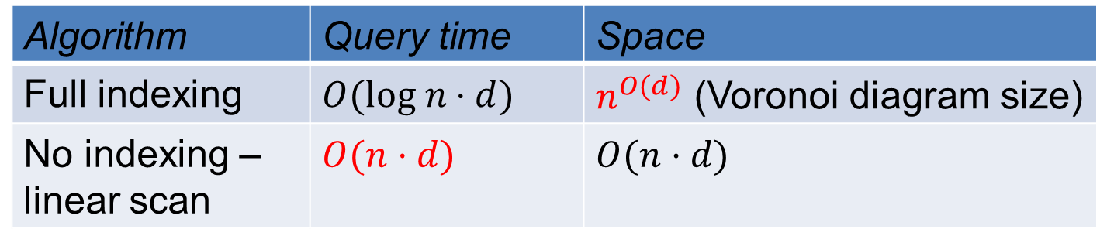

High-dimensional case
Exact algorithms degrade rapidly with the dimension $d$
Algorithm | Query time | Space
Full indexing | $$O(log n⋅d)$$ | $n^{O(d)}$ (Voronoi diagram size)
No indexing – linear scan | $$O(n⋅d)$$ | $$O(n⋅d)$$

Slide 4
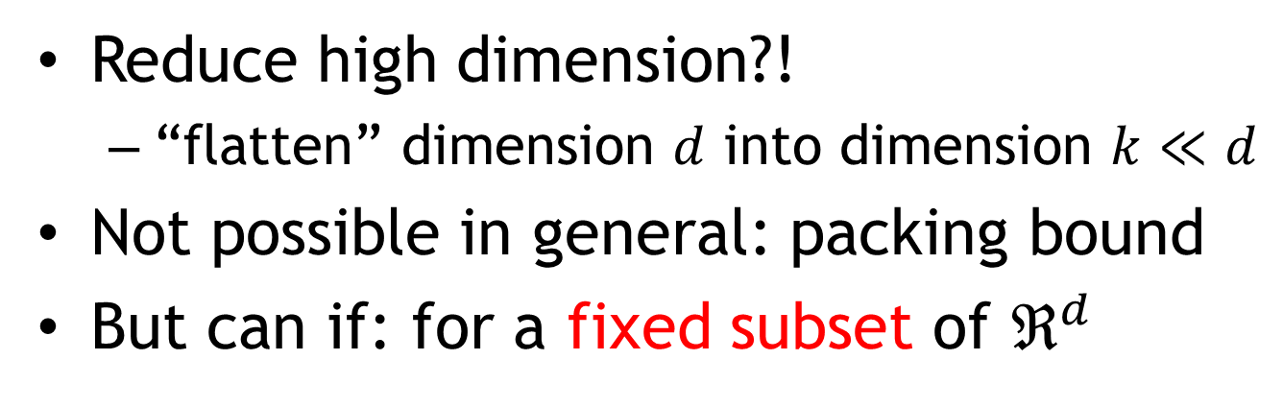
Dimension Reduction
Reduce high dimension?!
  “flatten” dimension $d$ into dimension $k≪d$
Not possible in general: packing bound
But can if: for a fixed subset of $ℜ^{d}$

Slide 5

Johnson-Lindenstrauss Lemma
[JL84]: There is a randomized linear map $F:ℓ_{2}^{d}→ℓ_{2}^{k}$, $k≪d$, that preserves distance between two vectors $x,y$
  up to $1+ε$ factor:
  $$||x−y||≤||F\left(x\right)−F\left(y\right)||≤\left(1+ε\right)⋅||x−y||$$
  with $1−e^{{−Cε}^{2}k}$ probability ($C$ some constant)
Preserves distances between $n$ points for $k=O\left(\frac{\log{n}}{ε^{2}}\right)$ with probability at least $1−1/n$

Slide 6

Dim-Reduction for NNS
[JL84]: There is a randomized linear map $F:ℓ_{2}^{d}→ℓ_{2}^{k}$, $k≪d$, that preserves distance between two vectors $x,y$
  up to $1+ε$ factor:
  $$||x−y||≤||F\left(x\right)−F\left(y\right)||≤\left(1+ε\right)⋅||x−y||$$
  with $1−e^{{−Cε}^{2}k}$ probability ($C$ some constant)
Application: NNS in $ℓ_{2}^{d}$
  Trivial scan: $O(n⋅d)$ query time
  Reduce to $O(n⋅k)+T_{dim−red}$ time after using dimension reduction
  where $T_{dim−red}$ time to reduce dimension of the query point
  Important that $F$ is oblivious !
Have we seen something similar to JL84 in class?

Slide 7
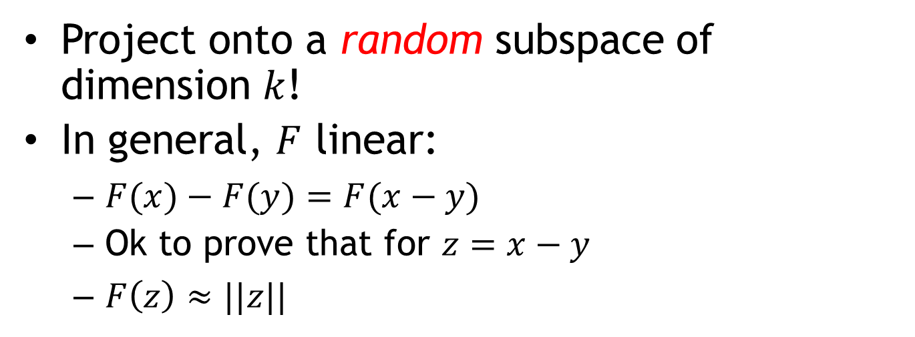
Idea:
Project onto a random subspace of dimension $k$!
In general, $F$ linear:
  $F(x)−F(y)=F(x−y)$
  Ok to prove that for $z=x−y$
  $F\left(z\right)≈||z||$

Slide 8
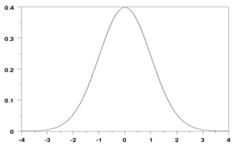

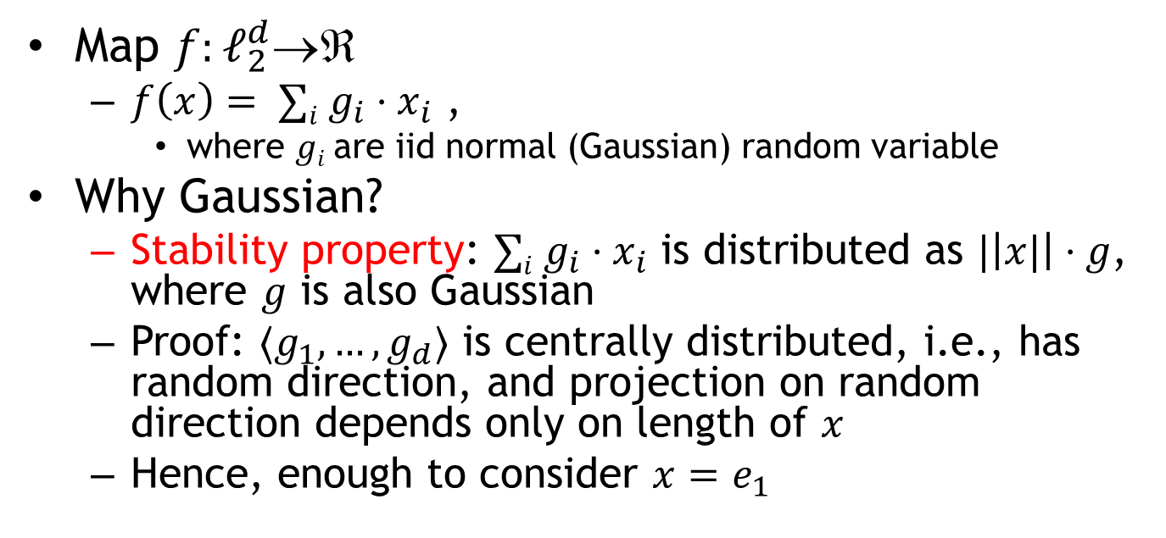
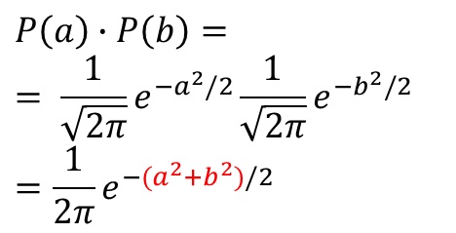

1D embedding
pdf = ${\frac{1}{\sqrt{2π}}e}^{−g^{2}/2}$
$$E[g]=0$$
$$E[g^{2}]=1$$
Map $f:ℓ_{2}^{d}$
  $f\left(x\right)= ∑i g_{i}⋅x_{i}$ ,
    where $gi$are iid normal (Gaussian) random variable
Why Gaussian?
  Stability property: $∑i g_{i}⋅x_{i}$ is distributed as $|\left|x|\right|⋅g$, where $g$ is also Gaussian
  Proof: $〈g_{1},…,g_{d}〉$ is centrally distributed, i.e., has random direction, and projection on random direction depends only on length of $x$
  Hence, enough to consider $x=e_{1}$
$$P\left(a\right)∙P\left(b\right)=$$
$$= \frac{1}{\sqrt{2π}}e^{−a^{2}/2}\frac{1}{\sqrt{2π}}e^{−b^{2}/2}$$
$$=\frac{1}{2π}e^{−{(a}^{2}+b^{2})/2}$$

Slide 9
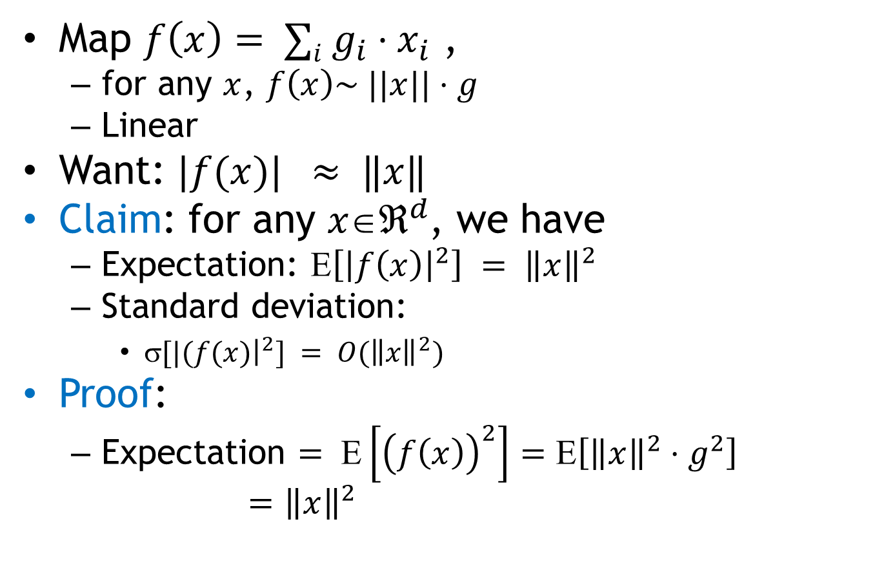
1D embedding
pdf = ${\frac{1}{\sqrt{2π}}e}^{−g^{2}/2}$
$$E[g]=0$$
$$E[g^{2}]=1$$
Map $f\left(x\right)= ∑i g_{i}⋅x_{i}$ ,
  for any $x$, $f\left(x\right)\sim ||x||⋅g$
  Linear
Want: $|f(x)| ≈ ‖x‖$
Claim: for any $xℜ^{d}$, we have
  Expectation: $\left[{\left|f\left(x\right)\right|}^{2}\right] = {\left\|x\right\|}^{2}$
  Standard deviation:
    $[|(f(x){\left.​\right|}^{2}] = O({\left\|x\right\|}^{2})$
Proof:
  Expectation $= Ε\left[{\left(f\left(x\right)\right)}^{2}\right]=Ε\left[{\left\|x\right\|}^{2}⋅g^{2}\right]$
  $={\left\|x\right\|}^{2}$

Slide 10
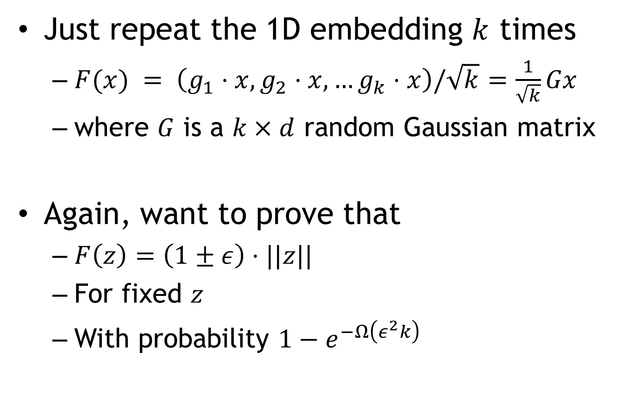
Full dimension reduction
Just repeat the 1D embedding $k$ times
  $F(x) = \left(g_{1}⋅x, g_{2}⋅x,…g_{k}⋅x\right)/\sqrt{k}$ $=\frac{1}{\sqrt{k}}Gx$
  where $G$ is a $k×d$ random Gaussian matrix
Again, want to prove that
  $F\left(z\right)=\left(1±ε\right)⋅||z||$
  For fixed $z$
  With probability $1−e^{−Ω\left(ε^{2}k\right)}$

Slide 11
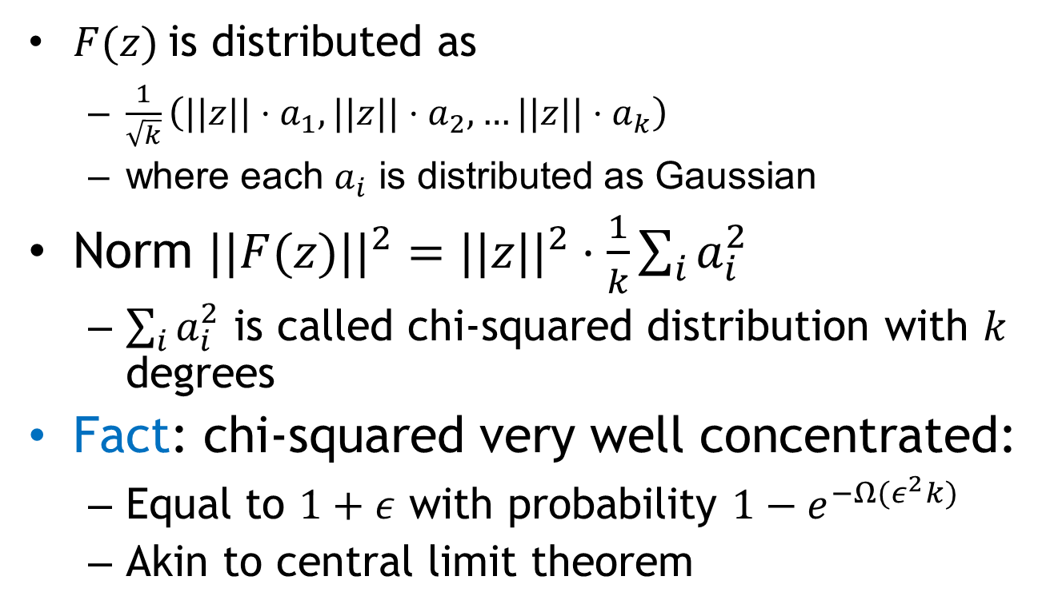
Concentration
$F(z)$is distributed as
  $\frac{1}{\sqrt{k}}\left(||z||{⋅a}_{1}, ||z||⋅a_{2}, …||z||⋅a_{k}\right)$
  where each $a_{i}$ is distributed as Gaussian
Norm ${||F(z)||}^{2}={||z||}^{2}⋅\frac{1}{k}\sum_{i}{a_{i}^{2}}$
  $\sum_{i}{a_{i}^{2}}$ is called chi-squared distribution with $k$ degrees
Fact: chi-squared very well concentrated:
  Equal to $1+ε$ with probability ${1−e}^{−Ω(ε^{2}k)}$
  Akin to central limit theorem

Slide 12
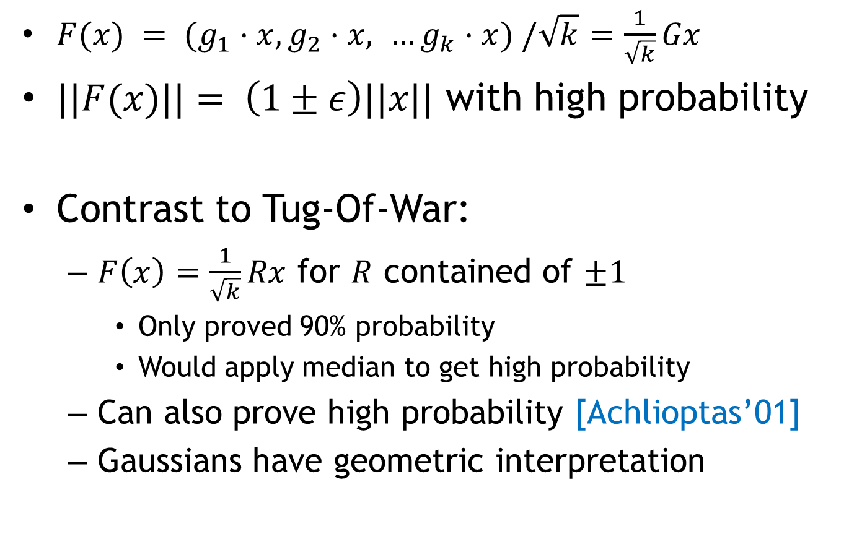
Johnson Lindenstrauss: wrap-up
$F(x) = (g_{1}⋅x, g_{2}⋅x, …g_{k}⋅x) /\sqrt{k}$ $=\frac{1}{\sqrt{k}}Gx$
$||F(x)||= \left(1±ε\right)||x||$ with high probability
Contrast to Tug-Of-War:
  $F\left(x\right)=\frac{1}{\sqrt{k}}Rx$ for $R$ contained of $±1$
    Only proved 90% probability
    Would apply median to get high probability
  Can also prove high probability [Achlioptas’01]
  Gaussians have geometric interpretation

Slide 13
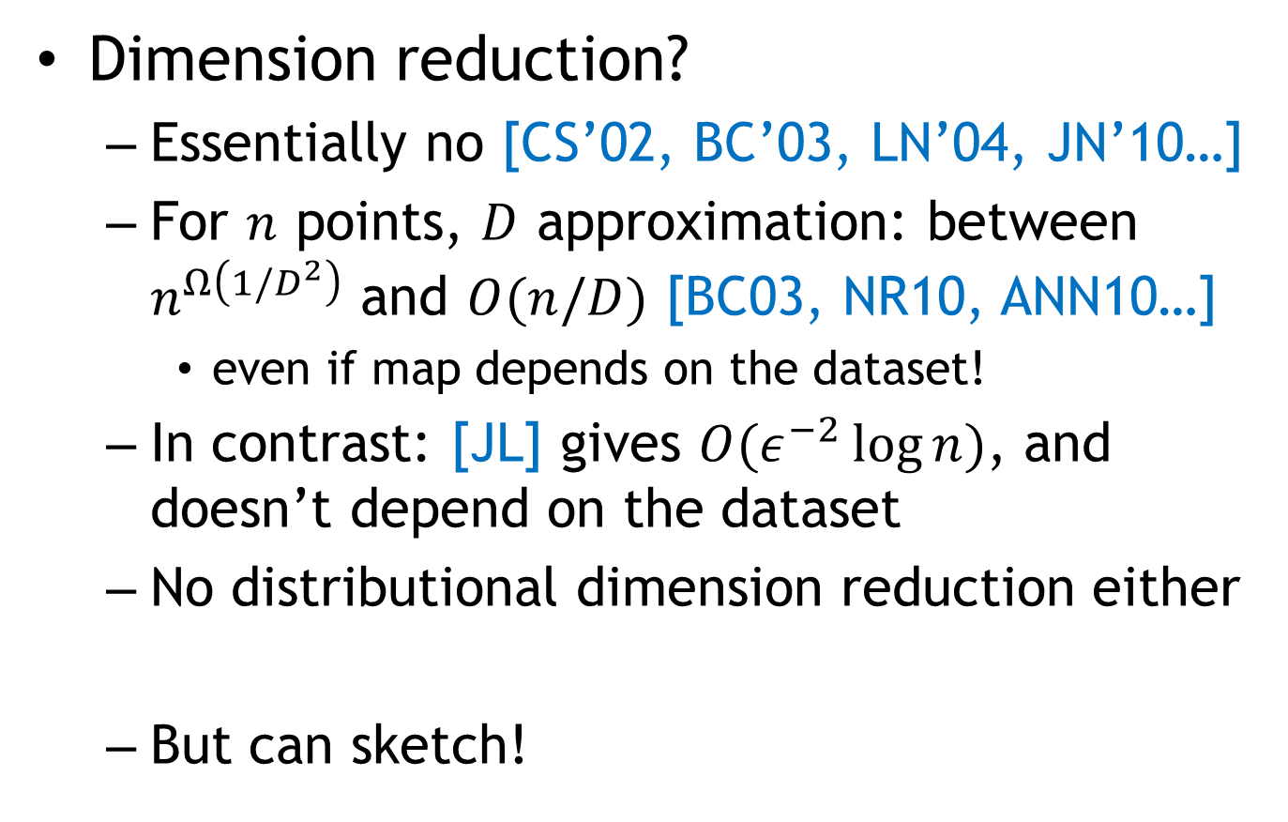

Dimension Reduction for $ℓ_{1}$
Dimension reduction?
  Essentially no [CS’02, BC’03, LN’04, JN’10…]
  For $n$ points, $D$ approximation: between $n^{Ω\left(1/D^{2}\right)}$ and $O(n/D)$ [BC03, NR10, ANN10…]
    even if map depends on the dataset!
  In contrast: [JL] gives $O(ε^{−2}\log{n})$, and doesn’t depend on the dataset
  No distributional dimension reduction either
  But can sketch!

Slide 14
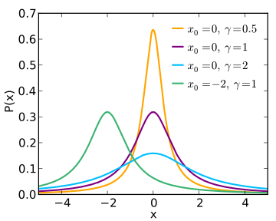
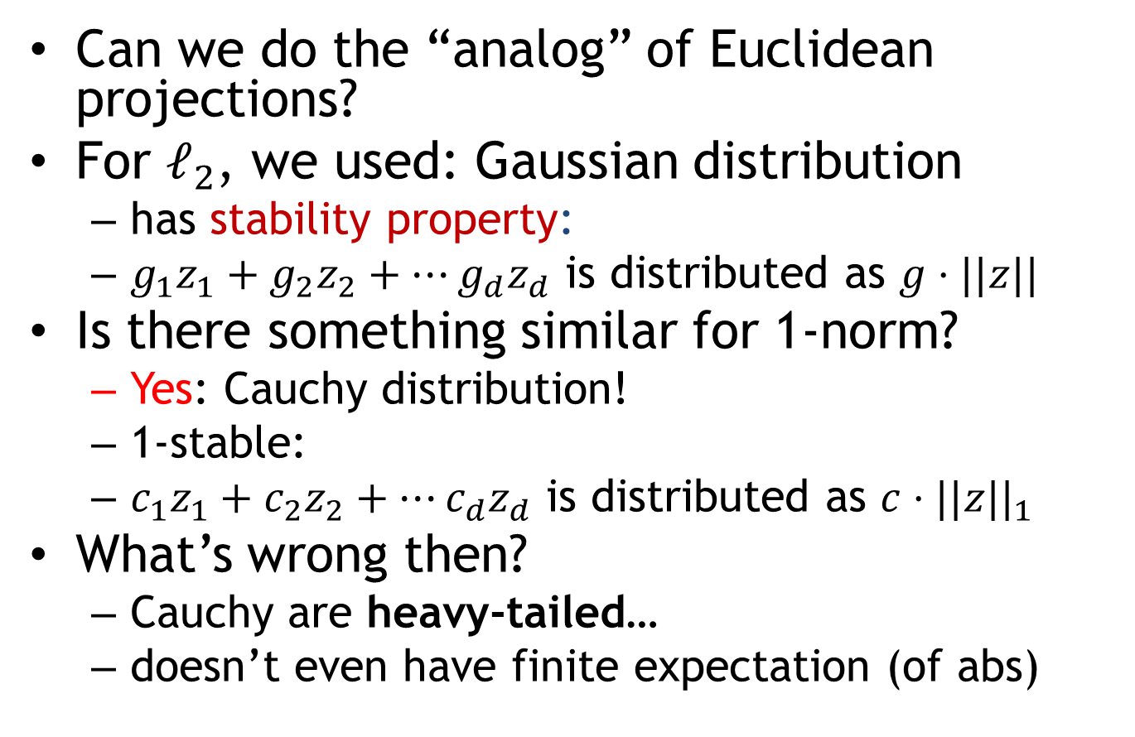
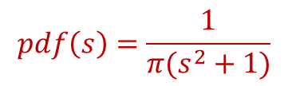
Sketch
Can we do the “analog” of Euclidean projections?
For $ℓ_{2}$, we used: Gaussian distribution
  has stability property:
  $g_{1}z_{1}+g_{2}z_{2}+…g_{d}z_{d}$ is distributed as $g⋅||z||$
Is there something similar for 1-norm?
  Yes: Cauchy distribution!
  1-stable:
  $c_{1}z_{1}+c_{2}z_{2}+…c_{d}z_{d}$ is distributed as $c⋅||z||_{1}$
What’s wrong then?
  Cauchy are heavy-tailed…
  doesn’t even have finite expectation (of abs)
$$pdf\left(s\right)=\frac{1}{π(s^{2}+1)}$$

Slide 15
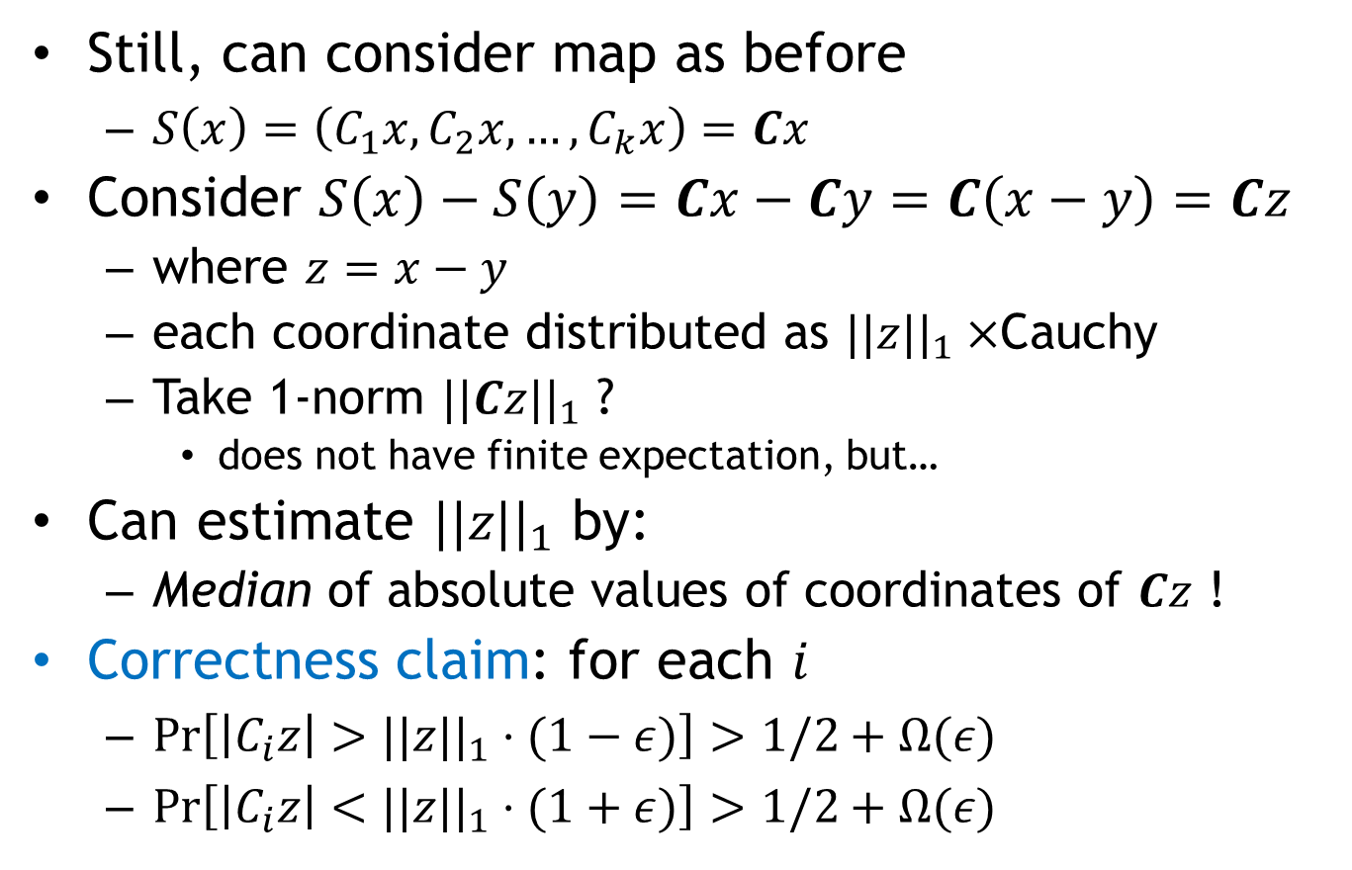

Sketching for $ℓ_{1}$ [Indyk’00]
Still, can consider map as before
  $S\left(x\right)=\left(C_{1}x, C_{2}x, …,C_{k}x\right)=Cx$
Consider $S\left(x\right)−S\left(y\right)=Cx−Cy=C\left(x−y\right)=Cz$
  where $z=x−y$
  each coordinate distributed as $||z||_{1}×$Cauchy
  Take 1-norm $||Cz||_{1}$ ?
    does not have finite expectation, but…
Can estimate $||z||_{1}$ by:
  Median of absolute values of coordinates of $Cz$ !
Correctness claim: for each $i$
  $Pr\left[\left|C_{i}z\right|>||z||_{1}⋅(1−ε)\right]>1/2+Ω(ε)$
  $Pr\left[\left|C_{i}z\right|<||z||_{1}⋅(1+ε)\right]>1/2+Ω(ε)$

Slide 16
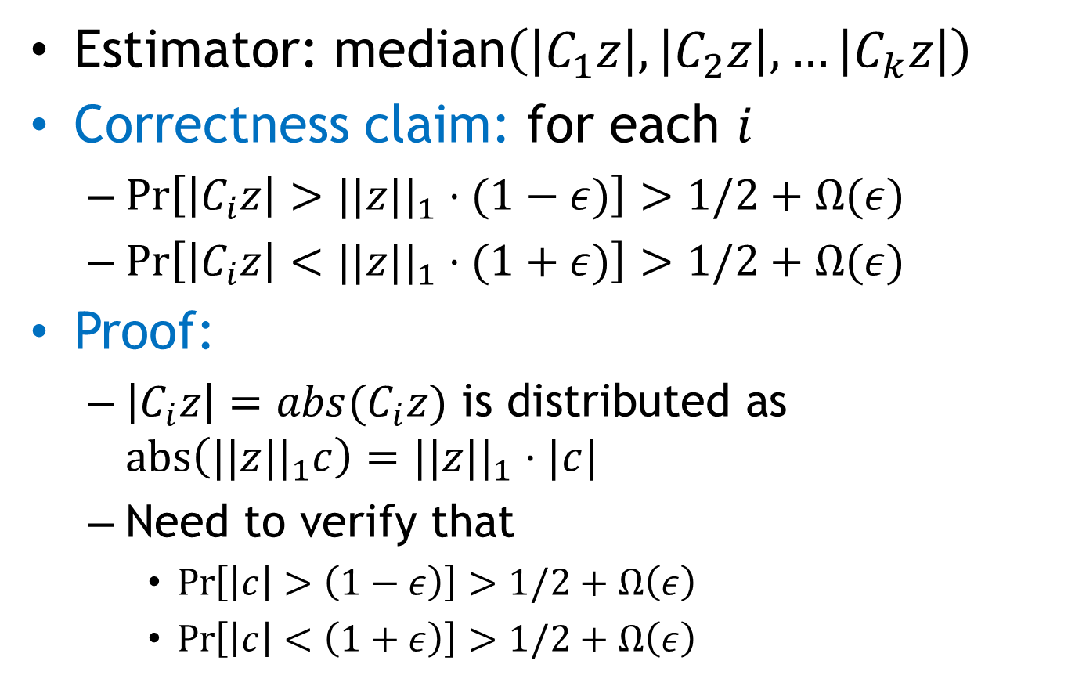

Estimator for $ℓ_{1}$
Estimator: median$\left(\left|C_{1}z\right|, \left|C_{2}z\right|,…\left|C_{k}z\right|\right)$
Correctness claim: for each $i$
  $Pr\left[\left|C_{i}z\right|>||z||_{1}⋅(1−ε)\right]>1/2+Ω(ε)$
  $Pr\left[\left|C_{i}z\right|<||z||_{1}⋅(1+ε)\right]>1/2+Ω(ε)$
Proof:
  $\left|C_{i}z\right|=abs(C_{i}z)$ is distributed as $abs\left(||z||_{1}c\right)=||z||_{1}⋅|c|$
  Need to verify that
    $\operatorname{Pr}\left[\left|c\right|>\left(1−ε\right)\right]>1/2+Ω\left(ε\right)$
    $\operatorname{Pr}\left[\left|c\right|<\left(1+ε\right)\right]>1/2+Ω\left(ε\right)$

Slide 17
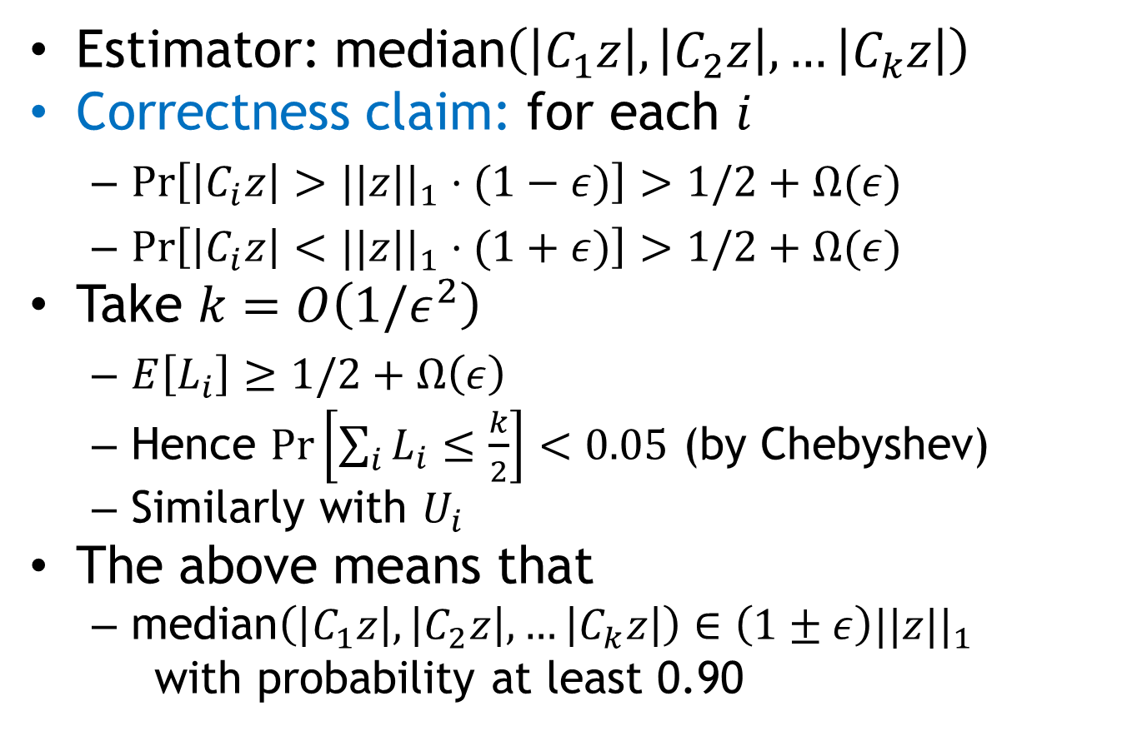



Estimator for $ℓ_{1}$
Estimator: median$\left(\left|C_{1}z\right|, \left|C_{2}z\right|,…\left|C_{k}z\right|\right)$
Correctness claim: for each $i$
  $Pr\left[\left|C_{i}z\right|>||z||_{1}⋅(1−ε)\right]>1/2+Ω(ε)$
  $Pr\left[\left|C_{i}z\right|<||z||_{1}⋅(1+ε)\right]>1/2+Ω(ε)$
Take $k=O\left(1/ε^{2}\right)$
  $E\left[L_{i}\right]≥1/2+Ω\left(ε\right)$
  Hence $\operatorname{Pr}\left[\sum_{i}{L_{i}}≤\frac{k}{2}\right]<0.05$ (by Chebyshev)
  Similarly with $U_{i}$
The above means that
  median$\left(\left|C_{1}z\right|, \left|C_{2}z\right|,…\left|C_{k}z\right|\right)∈\left(1±ε\right)||z||_{1}$
  with probability at least 0.90
$$L_{i}=1$$
if holds
$$U_{i}=1$$
if holds

Slide 18
PS1
Avg: 65.4
Standard deviation: 20.5
Max: 96
By problems (average % points):
  1: 0.83
  2: 0.62
  3: 0.44

