Slide 1
Lecture 7:
Dynamic sampling
Dimension Reduction
Notes:
Left to the title, a presenter can insert his/her own image pertinent to the presentation.

Slide 2
Plan
Admin:
  PSet 2 released later today, due next Wed
  Alex office hours: Tue 2:30-4:30
Plan:
  Dynamic streaming graph algorithms
  S2: Dimension Reduction & Sketching
Scriber?

Slide 3
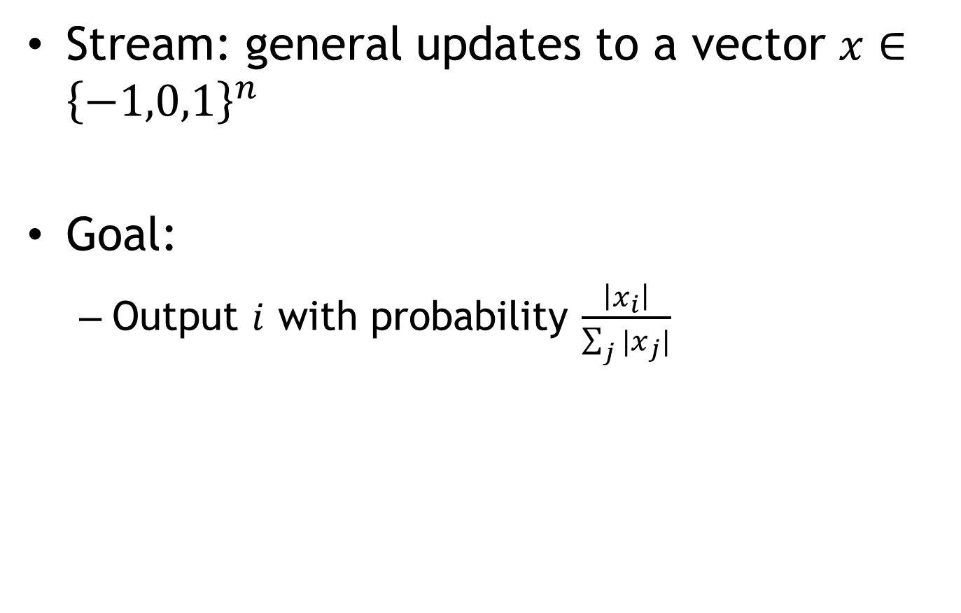
Sub-Problem: dynamic sampling
Stream: general updates to a vector $x∈{\left\{−1,0,1\right\}}^{n}$
Goal:
  Output $i$ with probability $\frac{\left|x_{i}\right|}{\sum_{j}{|x_{j}|}}$

Slide 4
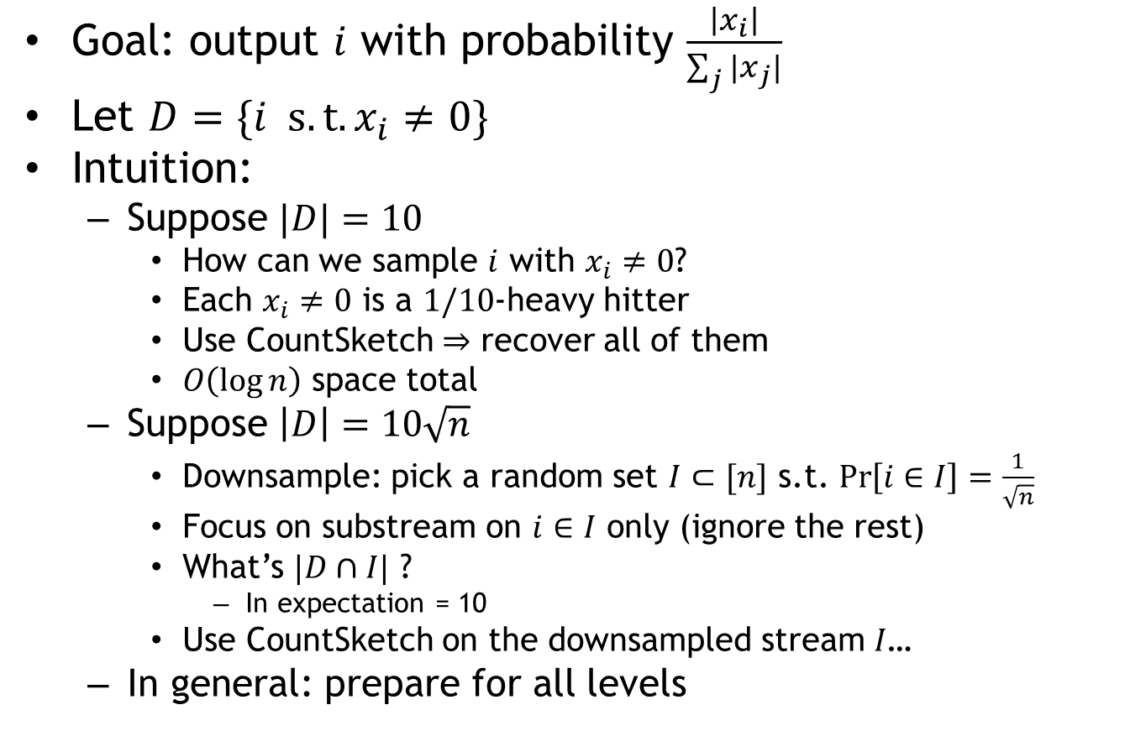
Dynamic Sampling
Goal: output $i$ with probability $\frac{\left|x_{i}\right|}{\sum_{j}{|x_{j}|}}$
Let $D=\{i s.t. x_{i}≠0\}$
Intuition:
  Suppose $|D|=10$
    How can we sample $i$ with $x_{i}≠0$?
    Each $x_{i}≠0$ is a $1/10$-heavy hitter
    Use CountSketch $⇒$ recover all of them
    $O\left(\log{n}\right)$ space total
  Suppose $\left|D\right|=10\sqrt{n}$
    Downsample: pick a random set $I⊂[n]$ s.t. $\operatorname{Pr}\left[i∈I\right]=\frac{1}{\sqrt{n}}$
    Focus on substream on $i∈I$ only (ignore the rest)
    What’s $|D∩I|$ ?
      In expectation = 10
    Use CountSketch on the downsampled stream $I$…
  In general: prepare for all levels

Slide 5
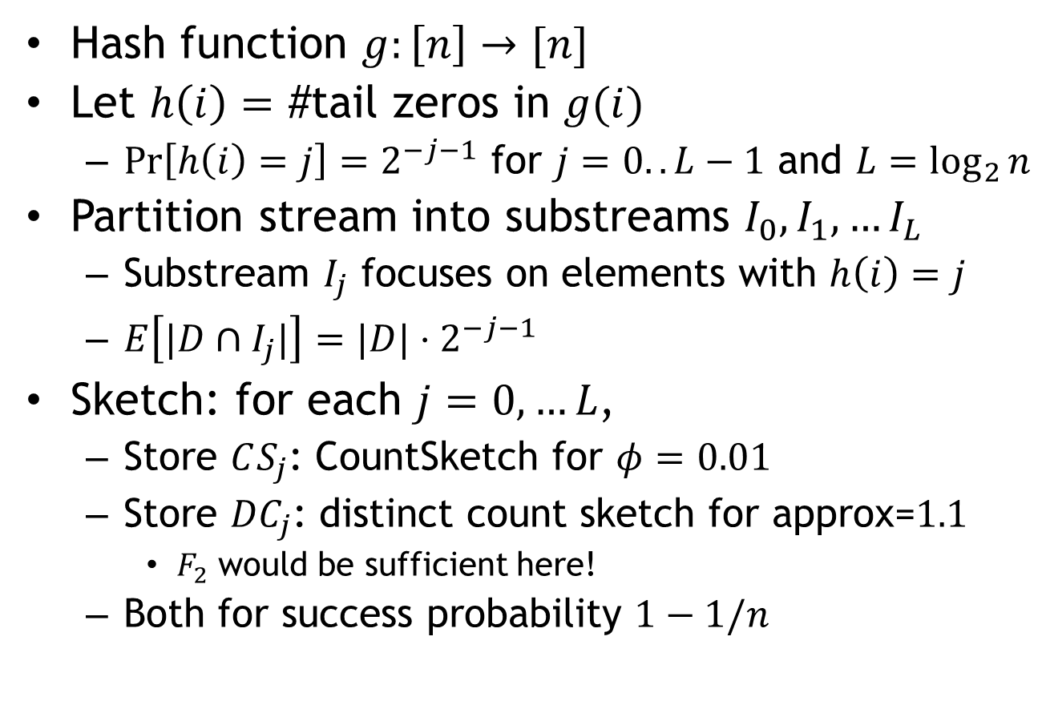
Basic Sketch
Hash function $g:\left[n\right]→[n]$
Let $h\left(i\right)=$ #tail zeros in $g(i)$
  $\operatorname{Pr}\left[h\left(i\right)=j\right]=2^{−j−1}$ for $j=0..L−1$ and $L=\log_{2}{n}$
Partition stream into substreams $I_{0},I_{1},…I_{L}$
  Substream $I_{j}$ focuses on elements with $h\left(i\right)=j$
  $E\left[|D∩I_{j}|\right]=|D|⋅2^{−j−1}$
Sketch: for each $j=0,…L$,
  Store $CS_{j}$: CountSketch for $φ=0.01$
  Store ${DC}_{j}$: distinct count sketch for approx=$1.1$
    $F_{2}$ would be sufficient here!
  Both for success probability $1−1/n$

Slide 6
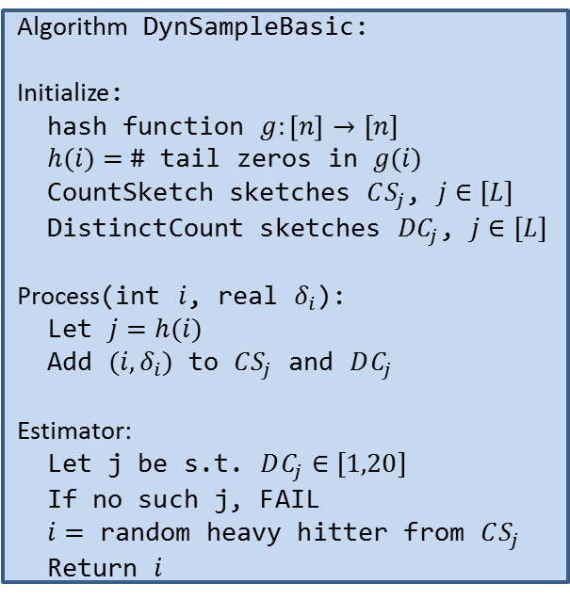
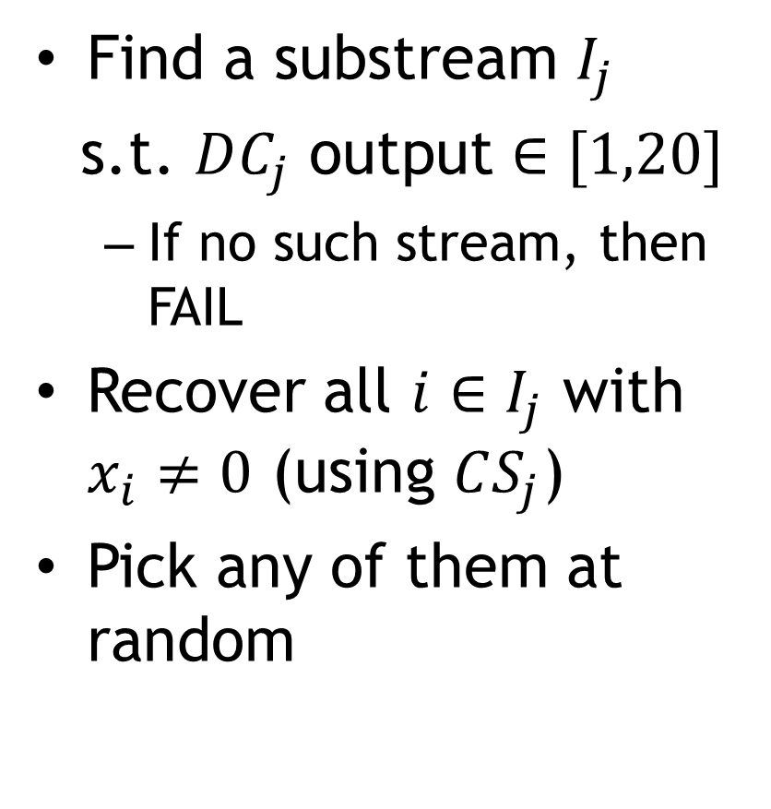
Estimation
Find a substream $I_{j}$
s.t. $DC_{j}$ output $∈[1,20]$
  If no such stream, then FAIL
Recover all $i∈I_{j}$ with $x_{i}≠0$ (using $CS_{j}$)
Pick any of them at random
Algorithm DynSampleBasic:
Initialize:
hash function $g:\left[n\right]→[n]$
$h(i)=$ # tail zeros in $g(i)$
CountSketch sketches $CS_{j}$, $j∈[L]$
DistinctCount sketches ${DC}_{j}$, $j∈[L]$
Process(int $i$, real $δ_{i}$):
Let $j=h(i)$
Add $(i,δ_{i})$ to $CS_{j}$ and $DC_{j}$
Estimator:
Let j be s.t. $DC_{j}∈[1,20]$
If no such j, FAIL
$i=$ random heavy hitter from $CS_{j}$
Return $i$

Slide 7
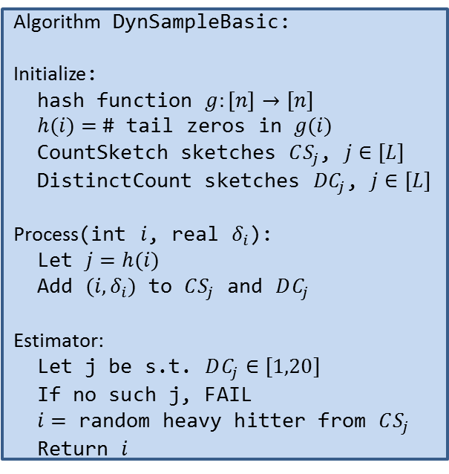
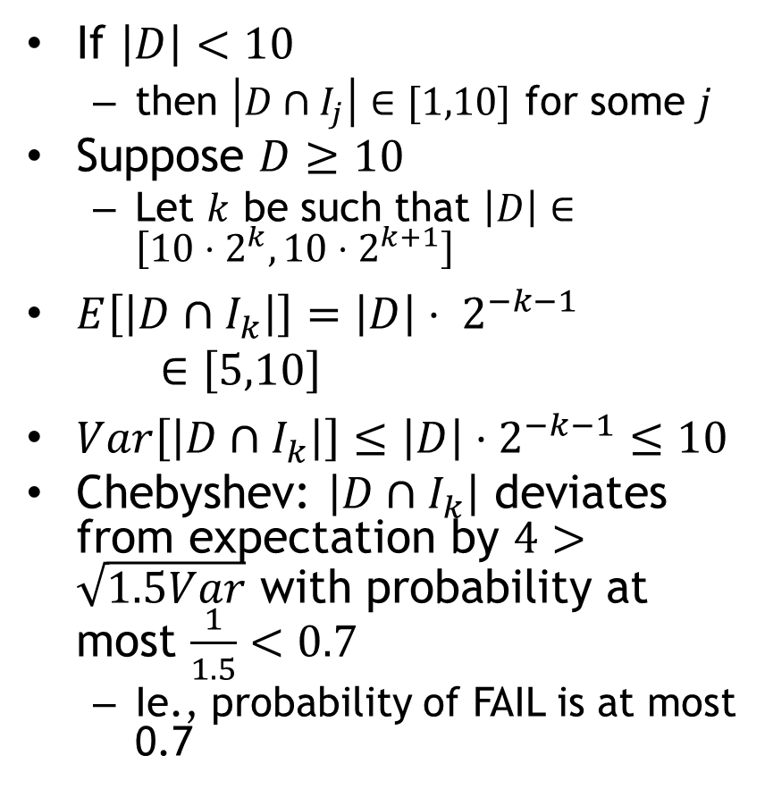
Analysis
Algorithm DynSampleBasic:
Initialize:
hash function $g:\left[n\right]→[n]$
$h(i)=$ # tail zeros in $g(i)$
CountSketch sketches $CS_{j}$, $j∈[L]$
DistinctCount sketches ${DC}_{j}$, $j∈[L]$
Process(int $i$, real $δ_{i}$):
Let $j=h(i)$
Add $(i,δ_{i})$ to $CS_{j}$ and $DC_{j}$
Estimator:
Let j be s.t. $DC_{j}∈[1,20]$
If no such j, FAIL
$i=$ random heavy hitter from $CS_{j}$
Return $i$
If $\left|D\right|<10$
  then $\left|D∩I_{j}\right|∈[1,10]$ for some $j$
Suppose $D≥10$
  Let $k$ be such that $\left|D\right|∈\left[10⋅2^{k},10⋅2^{k+1}\right]$
$E\left[\left|D∩I_{k}\right|\right]=\left|D\right|⋅ 2^{−k−1}$ $∈\left[5,10\right]$
$Var\left[\left|D∩I_{k}\right|\right]≤\left|D\right|⋅2^{−k−1}≤10$
Chebyshev: $\left|D∩I_{k}\right|$ deviates from expectation by $4>\sqrt{1.5Var}$ with probability at most $\frac{1}{1.5}<0.7$
  Ie., probability of FAIL is at most 0.7

Slide 8
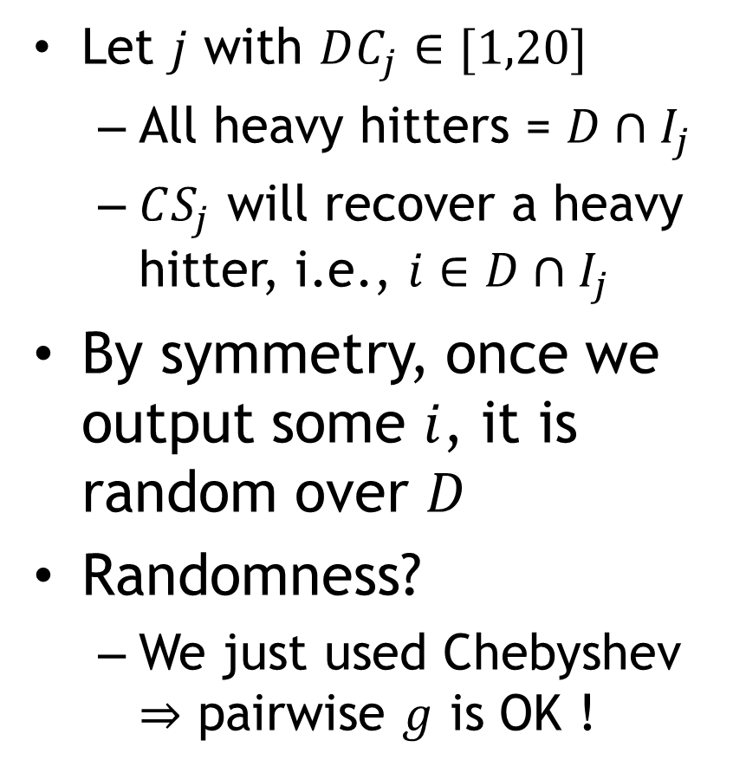
Analysis (cont)
Algorithm DynSampleBasic:
Initialize:
hash function $g:\left[n\right]→[n]$
$h(i)=$ # tail zeros in $g(i)$
CountSketch sketches $CS_{j}$, $j∈[L]$
DistinctCount sketches ${DC}_{j}$, $j∈[L]$
Process(int $i$, real $δ_{i}$):
Let $j=h(i)$
Add $(i,δ_{i})$ to $CS_{j}$ and $DC_{j}$
Estimator:
Let j be s.t. $DC_{j}∈[1,20]$
If no such j, FAIL
$i=$ random heavy hitter from $CS_{j}$
Return $i$
  Let $j$ with $DC_{j}∈[1,20]$
  All heavy hitters = $D∩I_{j}$
  $CS_{j}$ will recover a heavy hitter, i.e., $i∈D∩I_{j}$
By symmetry, once we output some $i$, it is random over $D$
Randomness?
  We just used Chebyshev $⇒$ pairwise $g$ is OK !

Slide 9
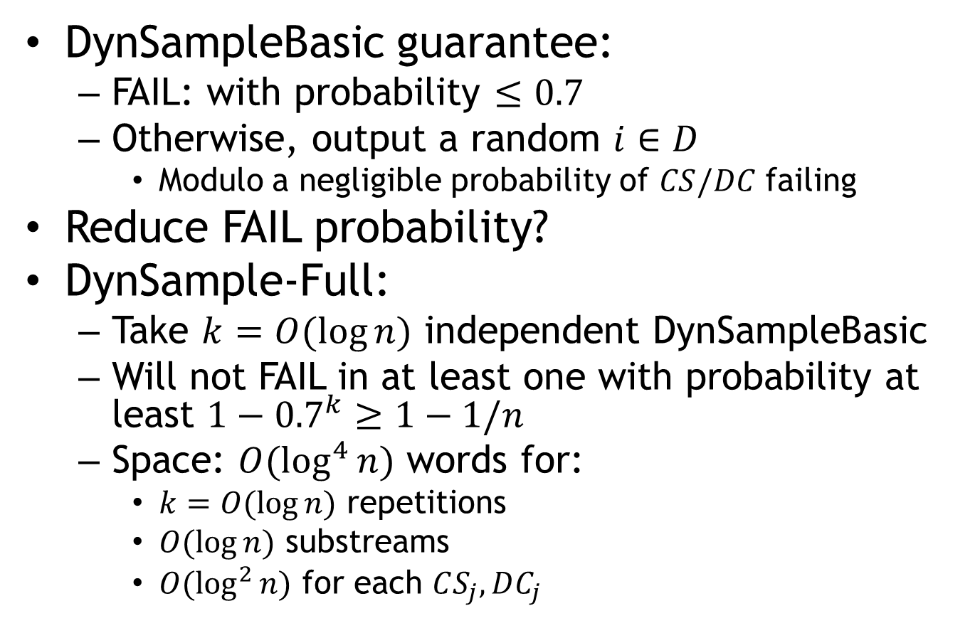
Dynamic Sampling: overall
DynSampleBasic guarantee:
  FAIL: with probability $≤0.7$
  Otherwise, output a random $i∈D$
    Modulo a negligible probability of $CS/DC$ failing
Reduce FAIL probability?
DynSample-Full:
  Take $k=O(\log{n})$ independent DynSampleBasic
  Will not FAIL in at least one with probability at least $1−{0.7}^{k}≥1−1/n$
  Space: $O(\log^{4}{n})$ words for:
    $k=O(\log{n})$ repetitions
    $O(\log{n})$ substreams
    $O(\log^{2}{n})$ for each $CS_{j},DC_{j}$

Slide 10
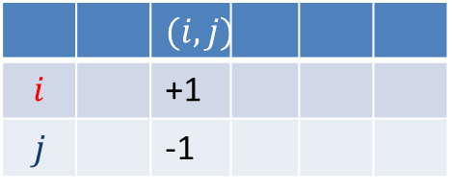
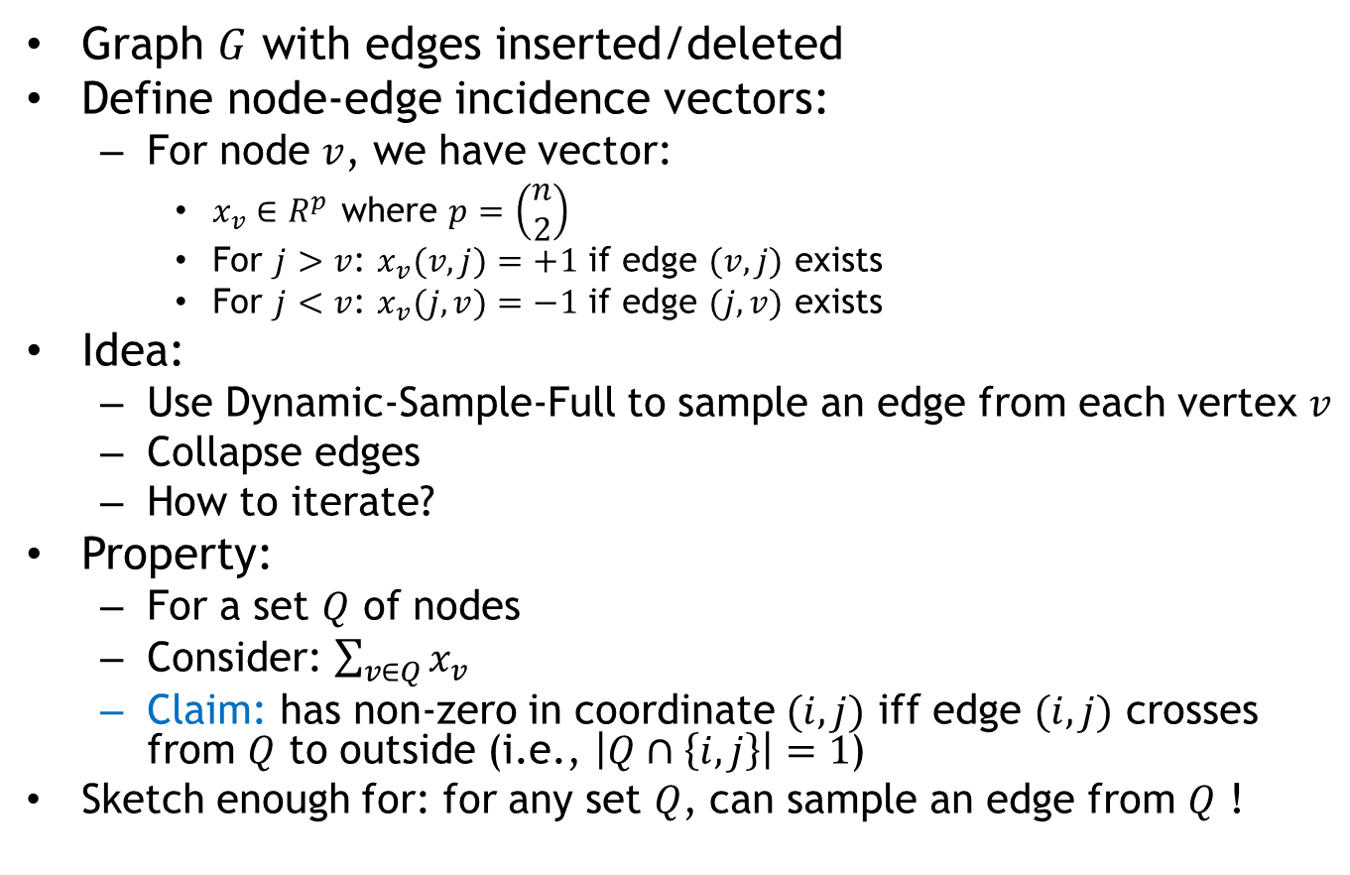
Back to Dynamic Graphs
 |  | $$(i,j)$$
$$i$$ |  | +1
$$j$$ |  | -1
Graph $G$ with edges inserted/deleted
Define node-edge incidence vectors:
  For node $v$, we have vector:
    $x_{v}∈R^{p}$ where $p=\left(\begin{matrix}n \\ 2\end{matrix}\right)$
    For $j>v$: $x_{v}(v,j)=+1$ if edge $(v,j)$ exists
    For $j<v$: $x_{v}(j,v)=−1$ if edge $(j,v)$ exists
Idea:
  Use Dynamic-Sample-Full to sample an edge from each vertex $v$
  Collapse edges
  How to iterate?
Property:
  For a set $Q$ of nodes
  Consider: $\sum_{v∈Q}{x_{v}}$
  Claim: has non-zero in coordinate $(i,j)$ iff edge $(i,j)$ crosses from $Q$ to outside (i.e., $\left|Q∩\left\{i,j\right\}\right|=1$)
  Sketch enough for: for any set $Q$, can sample an edge from $Q$ !

Slide 11
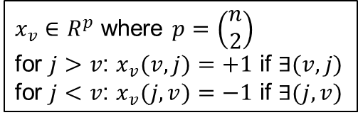
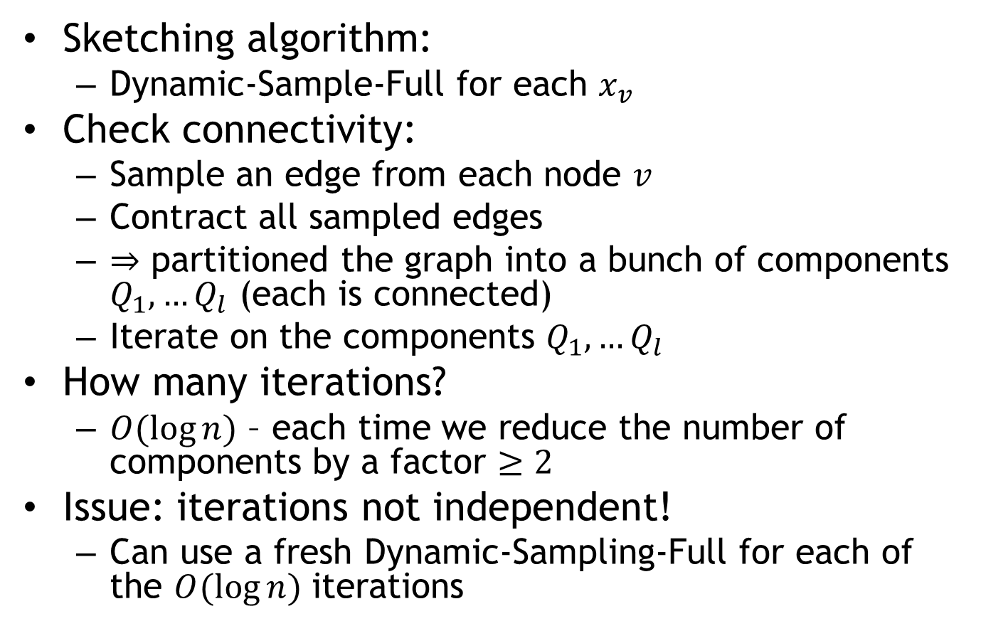
Dynamic Connectivity
$x_{v}∈R^{p}$ where $p=\left(\begin{matrix}n \\ 2\end{matrix}\right)$
for $j>v$: $x_{v}(v,j)=+1$ if $∃(v,j)$
for $j<v$: $x_{v}(j,v)=−1$ if $∃(j,v)$
Sketching algorithm:
  Dynamic-Sample-Full for each $x_{v}$
Check connectivity:
  Sample an edge from each node $v$
  Contract all sampled edges
  $⇒$ partitioned the graph into a bunch of components $Q_{1},…Q_{l}$ (each is connected)
  Iterate on the components $Q_{1},…Q_{l}$
How many iterations?
  $O(\log{n})$ – each time we reduce the number of components by a factor $≥2$
Issue: iterations not independent!
  Can use a fresh Dynamic-Sampling-Full for each of the $O(\log{n})$ iterations

Slide 12
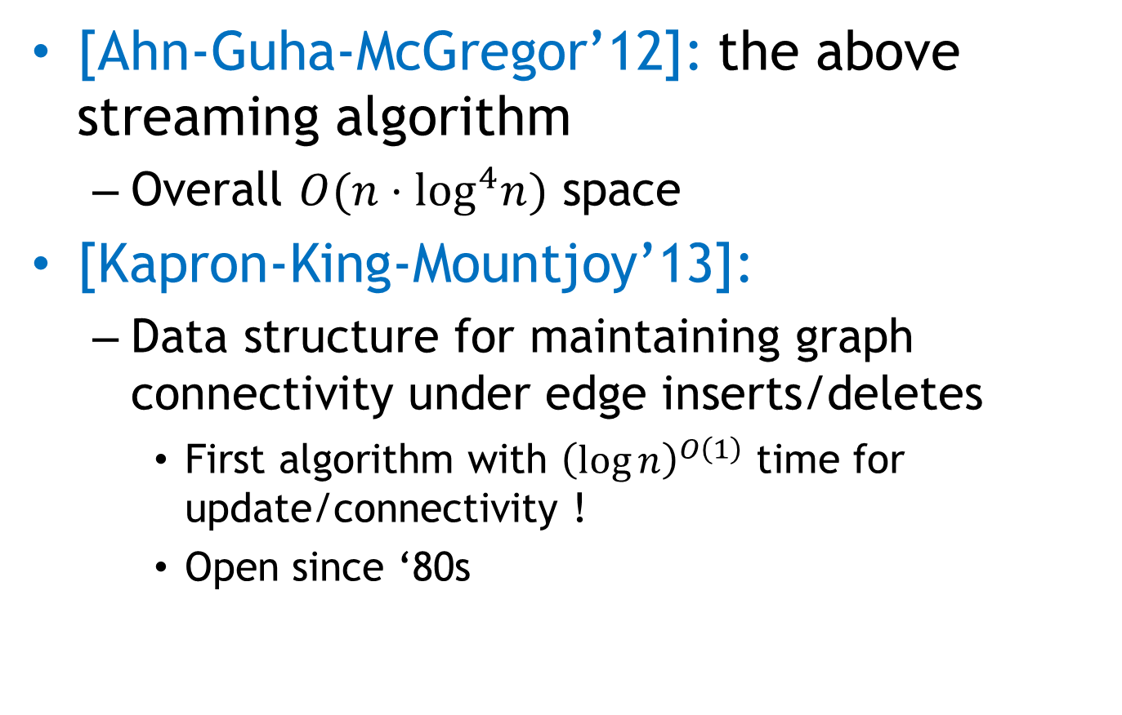
A little history
[Ahn-Guha-McGregor’12]: the above streaming algorithm
  Overall $O(n⋅\log^{4}n)$ space
[Kapron-King-Mountjoy’13]:
  Data structure for maintaining graph connectivity under edge inserts/deletes
    First algorithm with ${\left(\log{n}\right)}^{O\left(1\right)}$ time for update/connectivity !
    Open since ‘80s

Slide 13
Section 2:
Dimension Reduction & Sketching

Slide 14
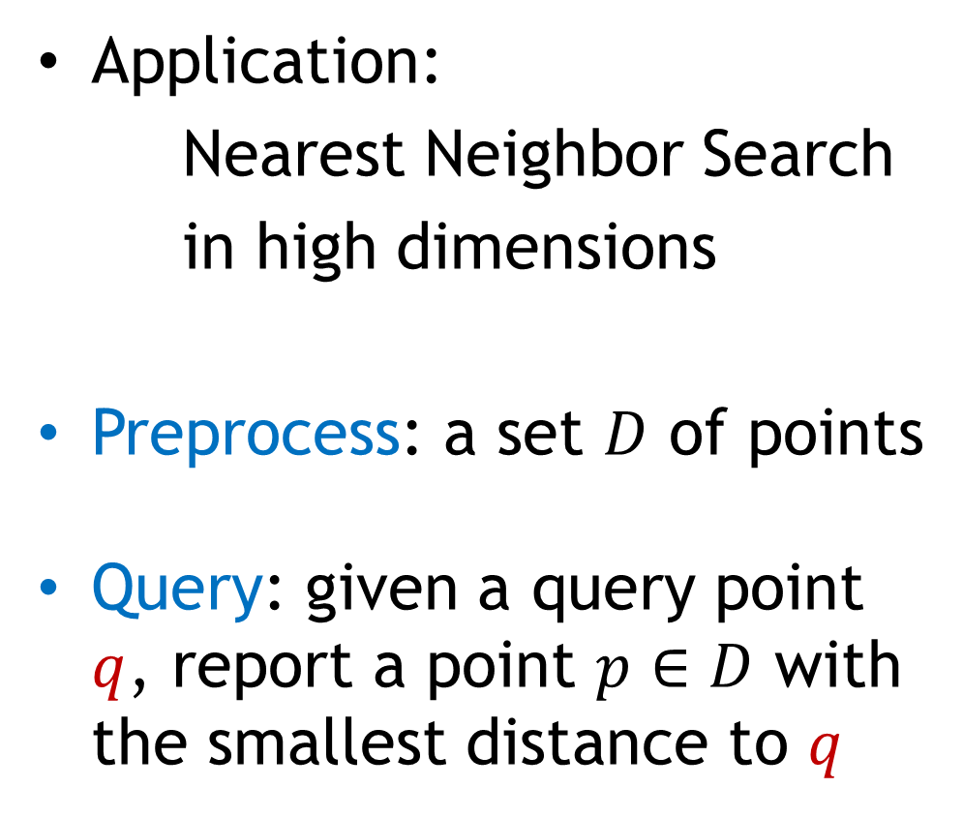

Why?
Application:
Nearest Neighbor Search
in high dimensions
Preprocess: a set $D$ of points
Query: given a query point $q$, report a point $p∈D$ with the smallest distance to $q$
$$p$$
$$q$$

Slide 15
Motivation
Generic setup:
  Points model objects (e.g. images)
  Distance models (dis)similarity measure
Application areas:
  machine learning: k-NN rule
  speech/image/video/music recognition, vector quantization, bioinformatics, etc…
Distance can be:
  Euclidean, Hamming
000000
011100
010100
000100
010100
011111
000000
001100
000100
000100
110100
111111
$$p$$
$$q$$

Slide 16
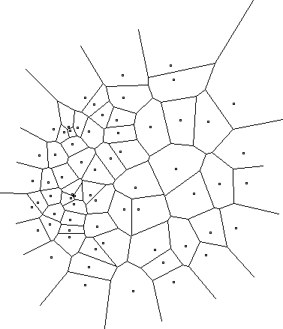
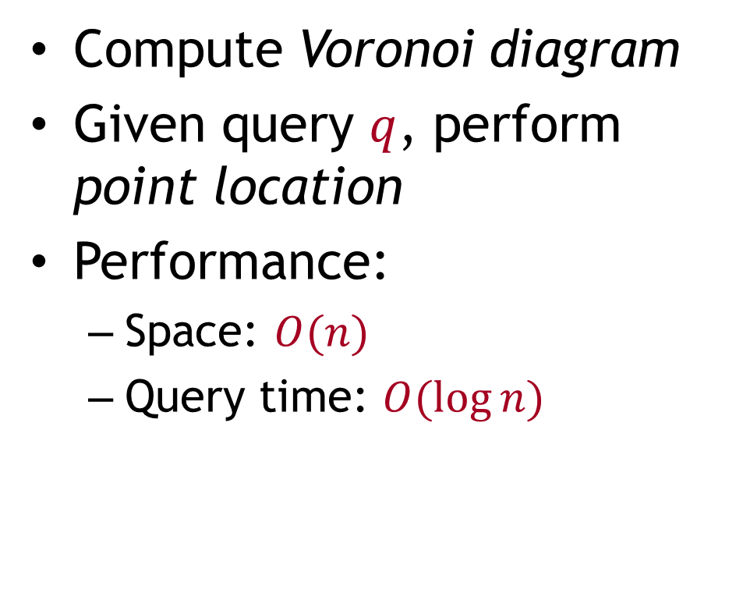
Low-dimensional: easy
Compute Voronoi diagram
Given query $q$, perform point location
Performance:
  Space: $O(n)$
  Query time: $O(\log{n})$

Slide 17
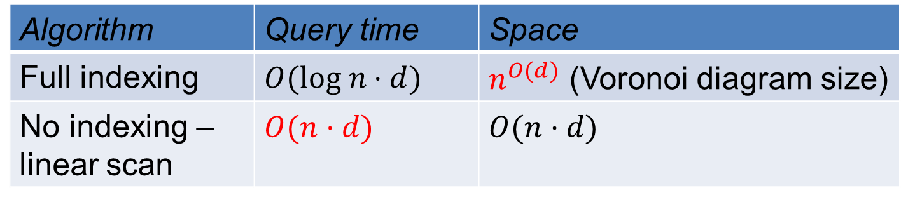

High-dimensional case
All exact algorithms degrade rapidly with the dimension $d$
Algorithm | Query time | Space
Full indexing | $$O(log n⋅d)$$ | $n^{O(d)}$ (Voronoi diagram size)
No indexing – linear scan | $$O(n⋅d)$$ | $$O(n⋅d)$$

Slide 18
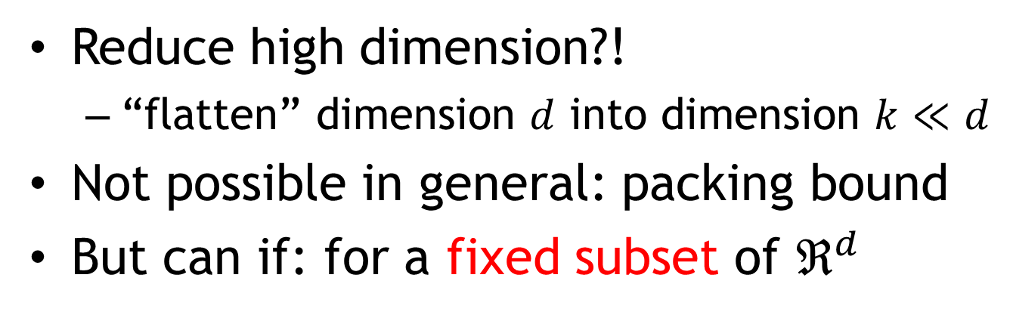
Dimension Reduction
Reduce high dimension?!
  “flatten” dimension $d$ into dimension $k≪d$
Not possible in general: packing bound
But can if: for a fixed subset of $ℜ^{d}$

