Slide 1
Lecture 6:
Counting triangles
Dynamic graphs & sampling
Notes:
Left to the title, a presenter can insert his/her own image pertinent to the presentation.

Slide 2
Plan
Problem 3: Counting triangles
Streaming for dynamic graphs
Scriber?

Slide 3

Streaming for Graphs
Graph $G$
  $n$ vertices
  $m$ edges
Stream:
list of edges
(e.g., on a hard drive)
( , )
( , )
( , )
( , )
( , )
( , )

Slide 4
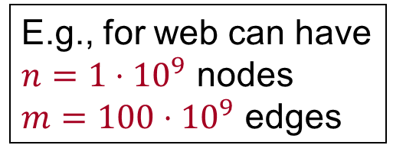
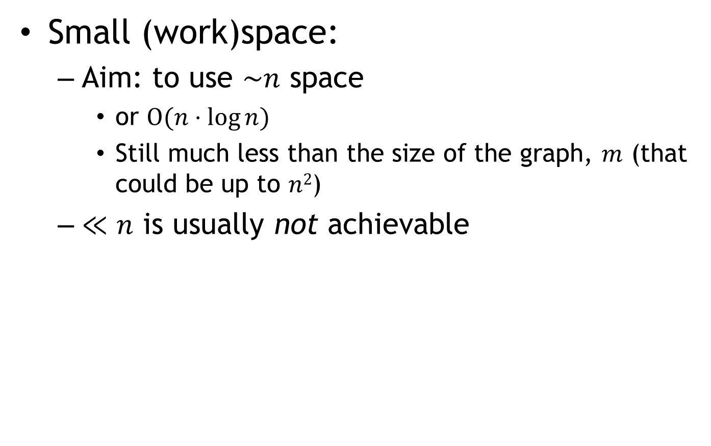
Streaming for Graphs
E.g., for web can have
$n=1⋅{10}^{9}$ nodes
$m=100⋅{10}^{9}$ edges
Small (work)space:
  Aim: to use $\sim n$ space
    or $O(n⋅\log{n})$
    Still much less than the size of the graph, $m$ (that could be up to $n2$)
  $≪n$ is usually not achievable
( , )
( , )
( , )
( , )
( , )
( , )

Slide 5
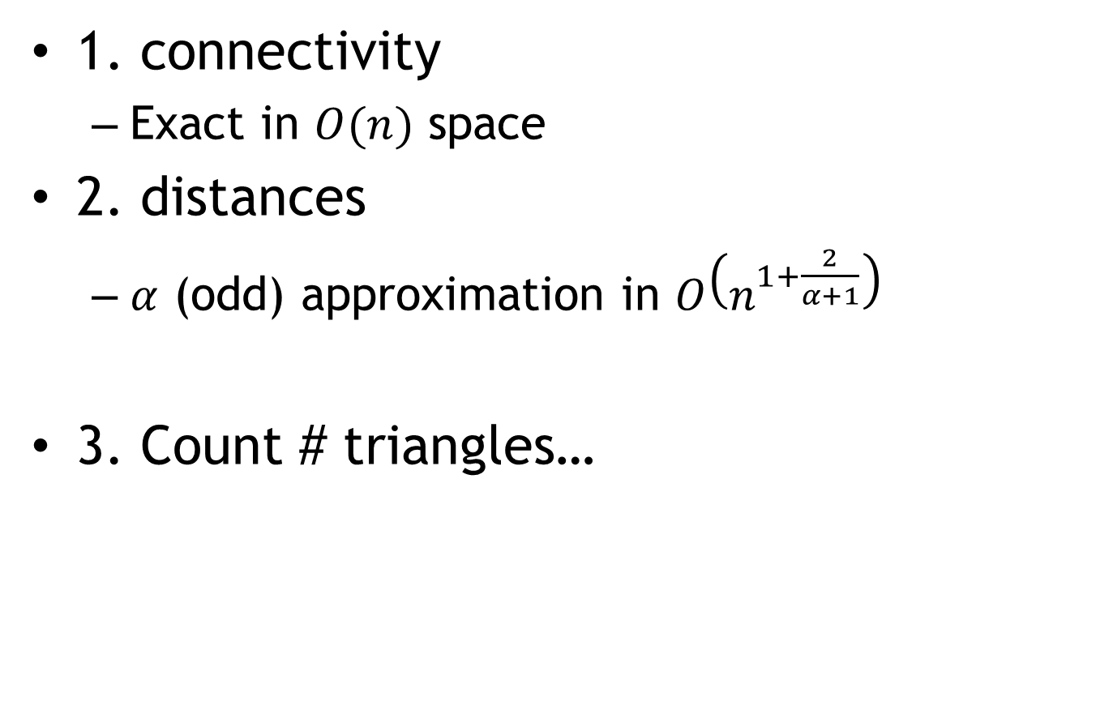
Problems
1. connectivity
  Exact in $O(n)$ space
2. distances
  $α$ (odd) approximation in $O\left(n^{1+\frac{2}{α+1}}\right)$
3. Count # triangles…

Slide 6
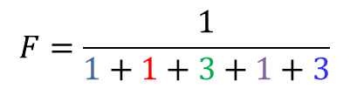
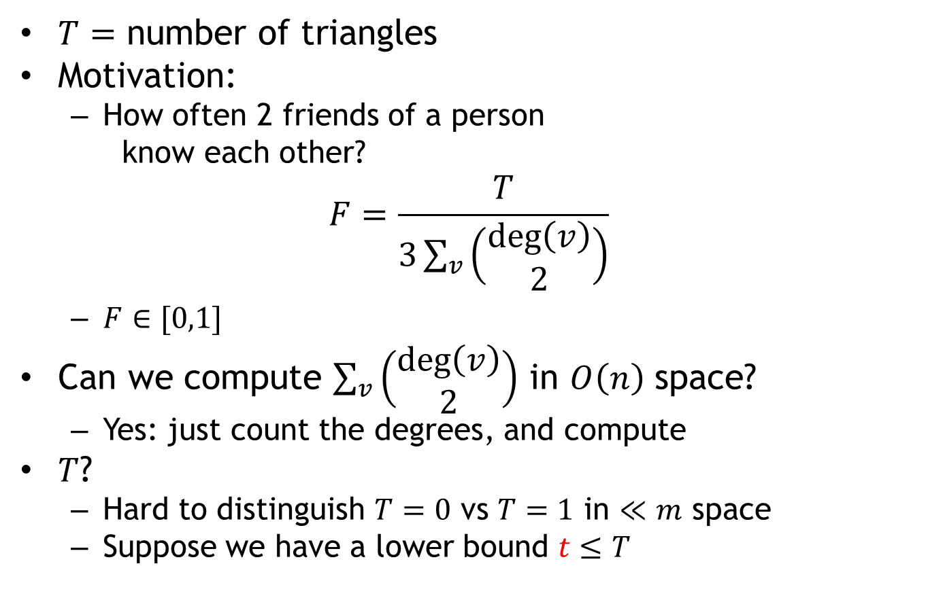
Problem 3: triangle counting
$T=$ number of triangles
Motivation:
  How often 2 friends of a person
  know each other?
$$F=\frac{T}{3\sum_{v}{\left(\begin{matrix}\deg\left(v\right) \\ 2\end{matrix}\right)}}$$
  $F∈[0,1]$
Can we compute $\sum_{v}{\left(\begin{matrix}\deg\left(v\right) \\ 2\end{matrix}\right)}$ in $O\left(n\right)$ space?
  Yes: just count the degrees, and compute
$T$?
  Hard to distinguish $T=0$ vs $T=1$ in $≪m$ space
  Suppose we have a lower bound $t≤T$
$$F=\frac{1}{1+1+3+1+3}$$

Slide 7
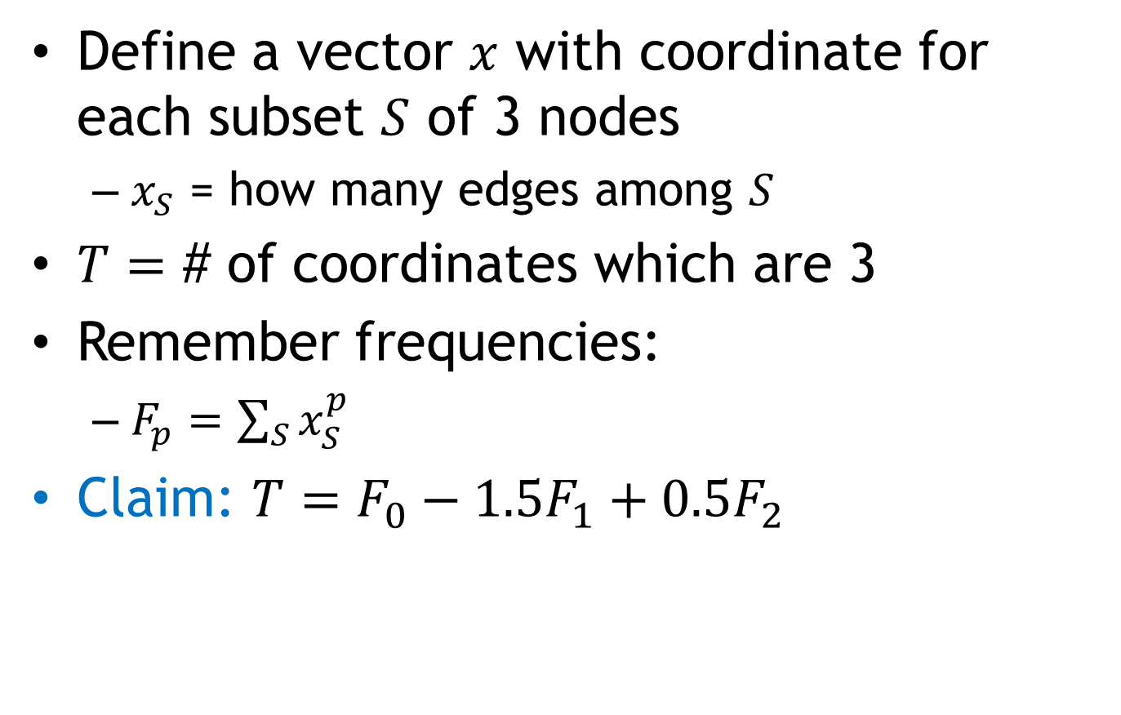
Triangle counting: Approach
Define a vector $x$ with coordinate for each subset $S$ of 3 nodes
  $x_{S}$ = how many edges among $S$
$T=$ # of coordinates which are 3
Remember frequencies:
  $F_{p}=\sum_{S}{x_{S}^{p}}$
Claim: $T=F_{0}−1.5F_{1}+0.5F_{2}$
2 | 1 | 3 | 2 | …

Slide 8
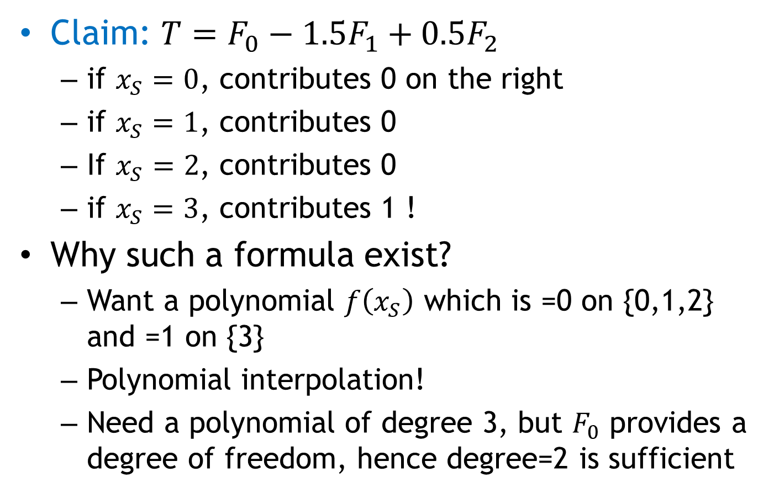
Triangle counting: Approach
Claim: $T=F_{0}−1.5F_{1}+0.5F_{2}$
  if $x_{S}=0$, contributes 0 on the right
  if $x_{S}=1$, contributes 0
  If $x_{S}=2$, contributes 0
  if $x_{S}=3$, contributes 1 !
Why such a formula exist?
  Want a polynomial $f\left(x_{S}\right)$ which is =0 on {0,1,2} and =1 on {3}
  Polynomial interpolation!
  Need a polynomial of degree 3, but $F_{0}$ provides a degree of freedom, hence degree=2 is sufficient

Slide 9
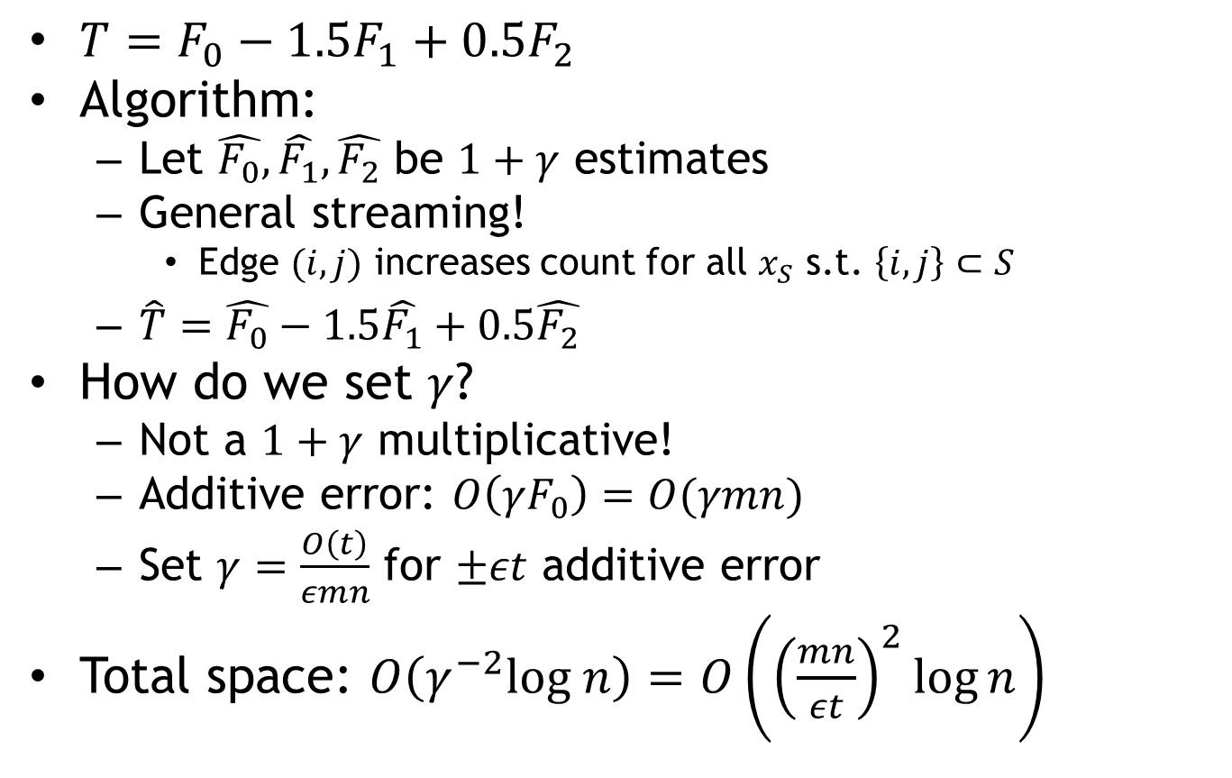
Triangle Counting: Algorithm
$T=F_{0}−1.5F_{1}+0.5F_{2}$
Algorithm:
  Let $\hat{F_{0}},\hat{F_{1}},\hat{F_{2}}$ be $1+γ$ estimates
  General streaming!
    Edge $(i,j)$ increases count for all $x_{S}$ s.t. $\left\{i,j\right\}⊂S$
  $\hat{T}=\hat{F_{0}}−1.5\hat{F_{1}}+0.5\hat{F_{2}}$
How do we set $γ$?
  Not a $1+γ$ multiplicative!
  Additive error: $O\left(γF_{0}\right)=O(γmn)$
  Set $γ=\frac{O\left(t\right)}{εmn}$ for $±εt$ additive error
Total space: $O\left(γ^{−2}log n\right)=O\left({\left(\frac{mn}{εt}\right)}^{2}\log{n}\right)$

Slide 10
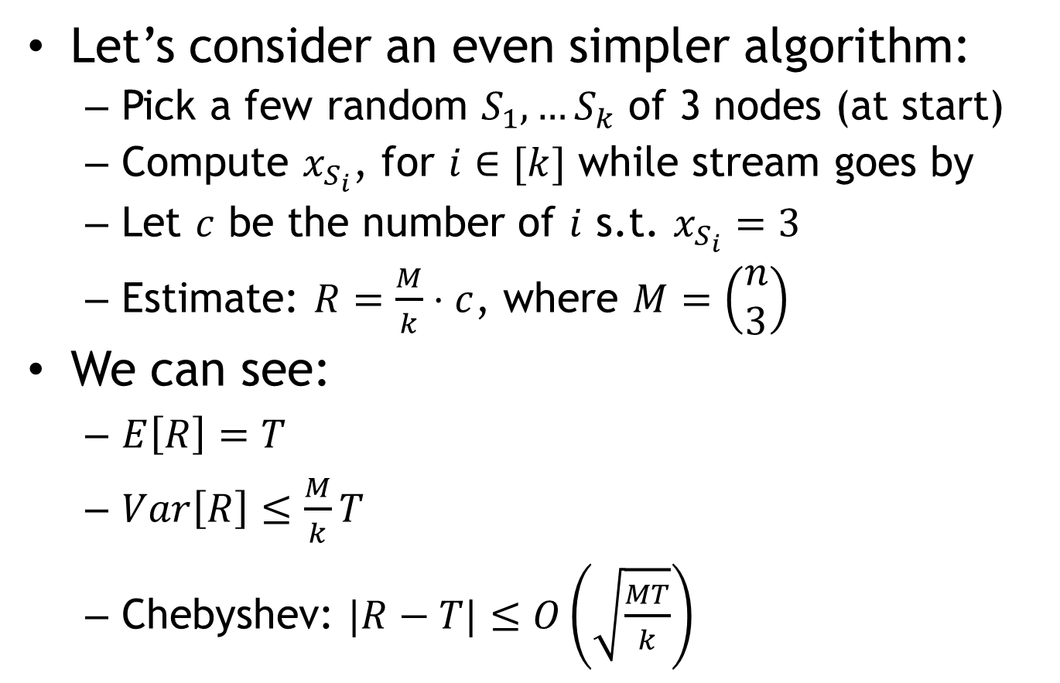
Triangle Counting: Algorithm 2
Let’s consider an even simpler algorithm:
  Pick a few random $S_{1},…S_{k}$ of 3 nodes (at start)
  Compute $x_{S_{i}}$, for $i∈[k]$ while stream goes by
  Let $c$ be the number of $i$ s.t. $x_{S_{i}}=3$
  Estimate: $R=\frac{M}{k}⋅c$, where $M=\left(\begin{matrix}n \\ 3\end{matrix}\right)$
We can see:
  $E\left[R\right]=T$
  $Var\left[R\right]≤\frac{M}{k}T$
  Chebyshev: $|R−T|≤O\left(\sqrt{\frac{MT}{k}}\right)$

Slide 11

Triangle Counting: Algorithm 2+
$|R−T|≤O\left(\sqrt{\frac{MT}{k}}\right)$
Need $k=\frac{O(1)}{ε^{2}}⋅\frac{M}{t}$
  where $M=O\left(n^{3}\right)$
Better?
  Sample $S$
  from set of smaller size
  $M^{′}≪M$!
  for which $x_{S}≥1$
Then obtain:
  Chebyshev: $|R−T|≤O\left(\sqrt{\frac{M^{′}T}{k}}\right)$
Need $k=\frac{O(1)}{ε^{2}}⋅\frac{M^{′}}{t}=O\left(\frac{1}{ε^{2}}⋅\frac{mn}{t}\right)$
  since $M′=O\left(mn\right)$

Slide 12
Sampling in Graphs
Setting 1:
  Suppose we just have positive updates
  Not linear
Setting 2:
  General steaming: also negative updates…
  Why? Dynamic graphs

Slide 13
Dynamic Graphs
Stream contains both insertions and deletions of edges
  Use 1: a log of updates to the graph
    [Ahn-Guha-McGregor’12]: “hyperlinks can be removed and tiresome friends can be de-friended”
  Use 2: graph is distributed over a number of computers
    Then want linear sketches
    Generally: dynamic streams ⬄ linear sketches
  Use 3: if time-efficient, then it’s a data structure!

Slide 14
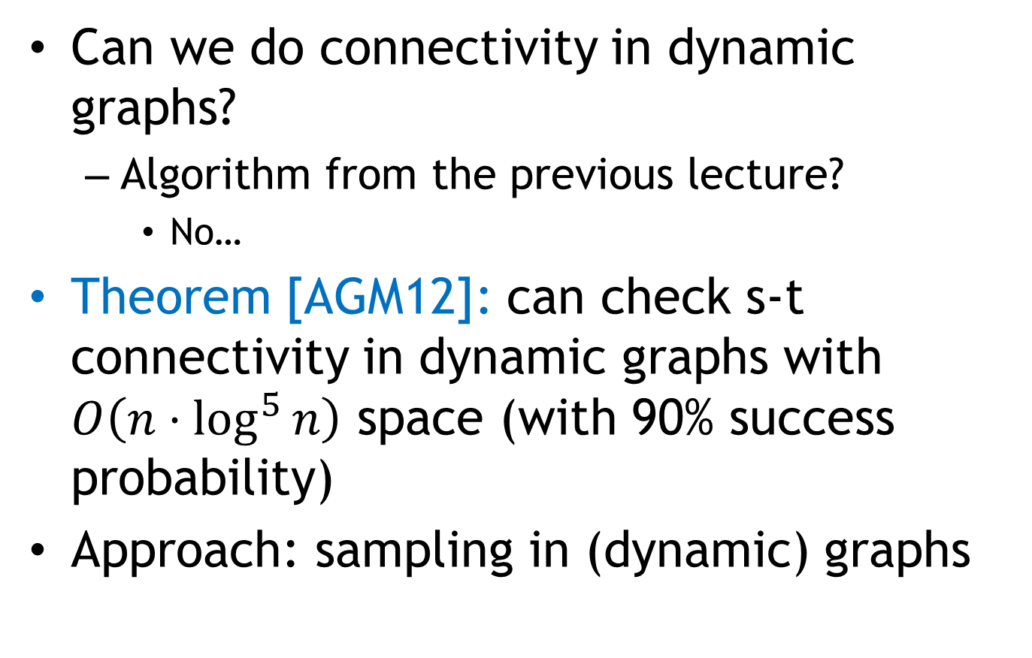
Revisit Problem 1: Connectivity
Can we do connectivity in dynamic graphs?
  Algorithm from the previous lecture?
    No…
Theorem [AGM12]: can check s-t connectivity in dynamic graphs with $O\left(n⋅\log^{5}{n}\right)$ space (with 90% success probability)
Approach: sampling in (dynamic) graphs

Slide 15
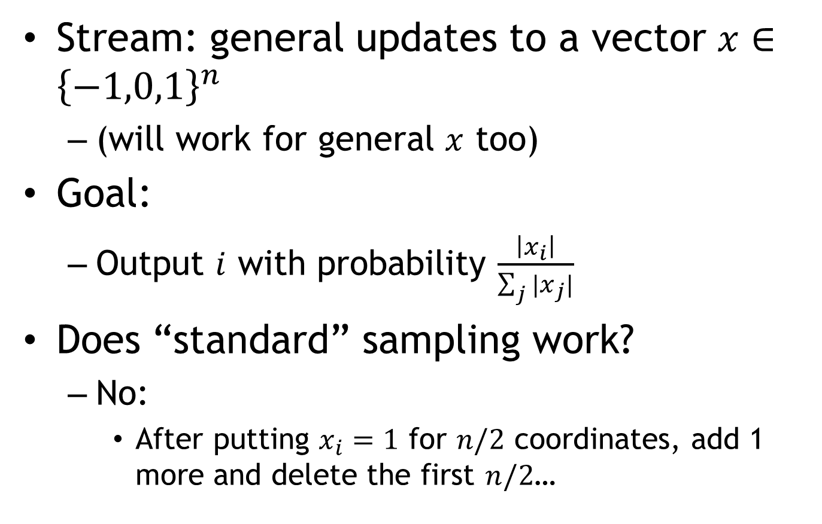
Sub-Problem: dynamic sampling
Stream: general updates to a vector $x∈{\left\{−1,0,1\right\}}^{n}$
  (will work for general $x$ too)
Goal:
  Output $i$ with probability $\frac{\left|x_{i}\right|}{\sum_{j}{|x_{j}|}}$
Does “standard” sampling work?
  No:
    After putting $x_{i}=1$ for $n/2$ coordinates, add 1 more and delete the first $n/2$…

Slide 16
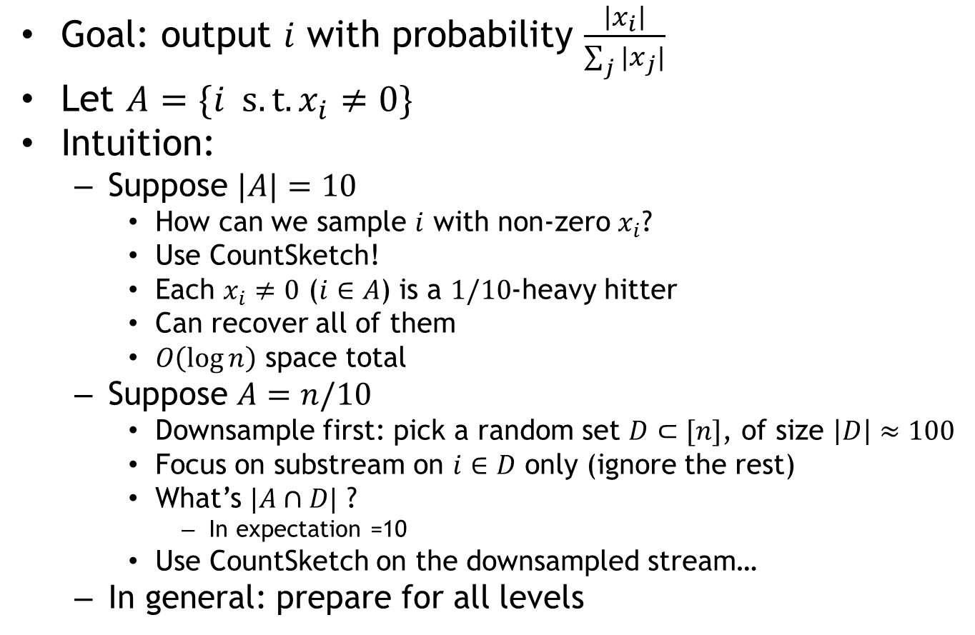
Dynamic Sampling
Goal: output $i$ with probability $\frac{\left|x_{i}\right|}{\sum_{j}{|x_{j}|}}$
Let $A=\{i s.t. x_{i}≠0\}$
Intuition:
  Suppose $|A|=10$
    How can we sample $i$ with non-zero $x_{i}$?
    Use CountSketch!
    Each $x_{i}≠0$ ($i∈A$) is a $1/10$-heavy hitter
    Can recover all of them
    $O\left(\log{n}\right)$ space total
  Suppose $A=n/10$
    Downsample first: pick a random set $D⊂[n]$, of size $\left|D\right|≈100$
    Focus on substream on $i∈D$ only (ignore the rest)
    What’s $|A∩D|$ ?
      In expectation =10
    Use CountSketch on the downsampled stream…
  In general: prepare for all levels

