Slide 1
Lecture 15:
Least Square Regression
Metric Embeddings
COMS E6998-9 F15
Notes:
Left to the title, a presenter can insert his/her own image pertinent to the presentation.

Slide 2
Administrivia, Plan
PS2:
  Pick up after class
120->144 auto extension
Plan:
  Least Squares Regression (finish)
  Metric Embeddings
    “reductions for distances”

Slide 3
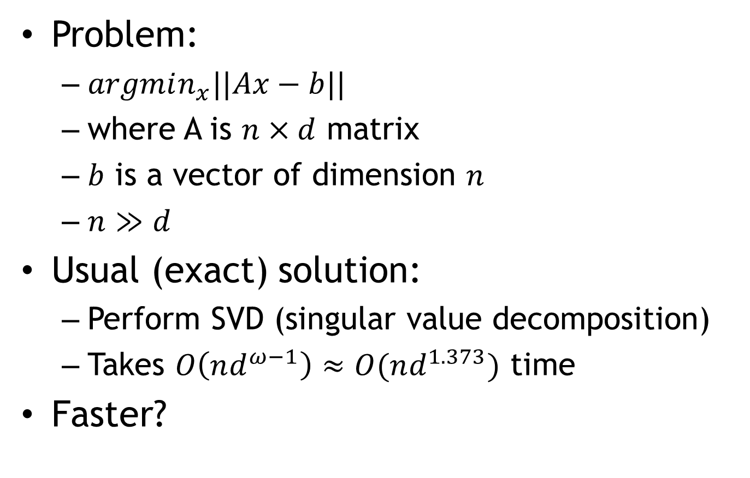
Least Square Regression
Problem:
  $argmin_{x}||Ax−b||$
  where A is $n×d$ matrix
  $b$ is a vector of dimension $n$
  $n≫d$
Usual (exact) solution:
  Perform SVD (singular value decomposition)
  Takes $O\left(nd^{ω−1}\right)≈O(nd^{1.373})$ time
Faster?

Slide 4
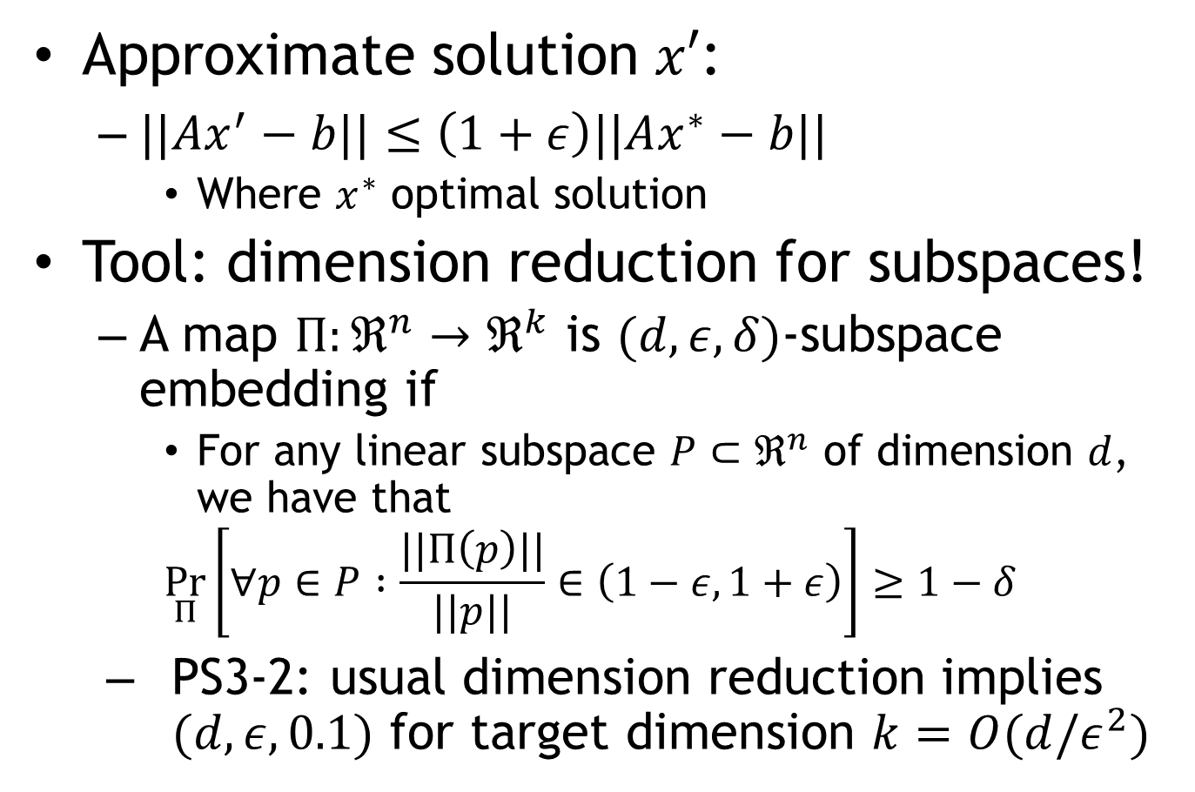
Approximate LSR
Approximate solution $x′$:
  $||Ax^{′}−b||≤\left(1+ε\right)||Ax^{∗}−b||$
    Where $x^{∗}$ optimal solution
Tool: dimension reduction for subspaces!
  A map $Π:ℜ^{n}→ℜ^{k}$ is $(d,ε,δ)$-subspace embedding if
    For any linear subspace $P⊂ℜ^{n}$ of dimension $d$, we have that
    $$\underset{Π}{Pr}\left[∀p∈P :\frac{||Π\left(p\right)||}{||p||}∈\left(1−ε,1+ε\right)\right]≥1−δ$$
  PS3-2: usual dimension reduction implies $(d,ε,0.1)$ for target dimension $k=O(d/ε^{2})$

Slide 5
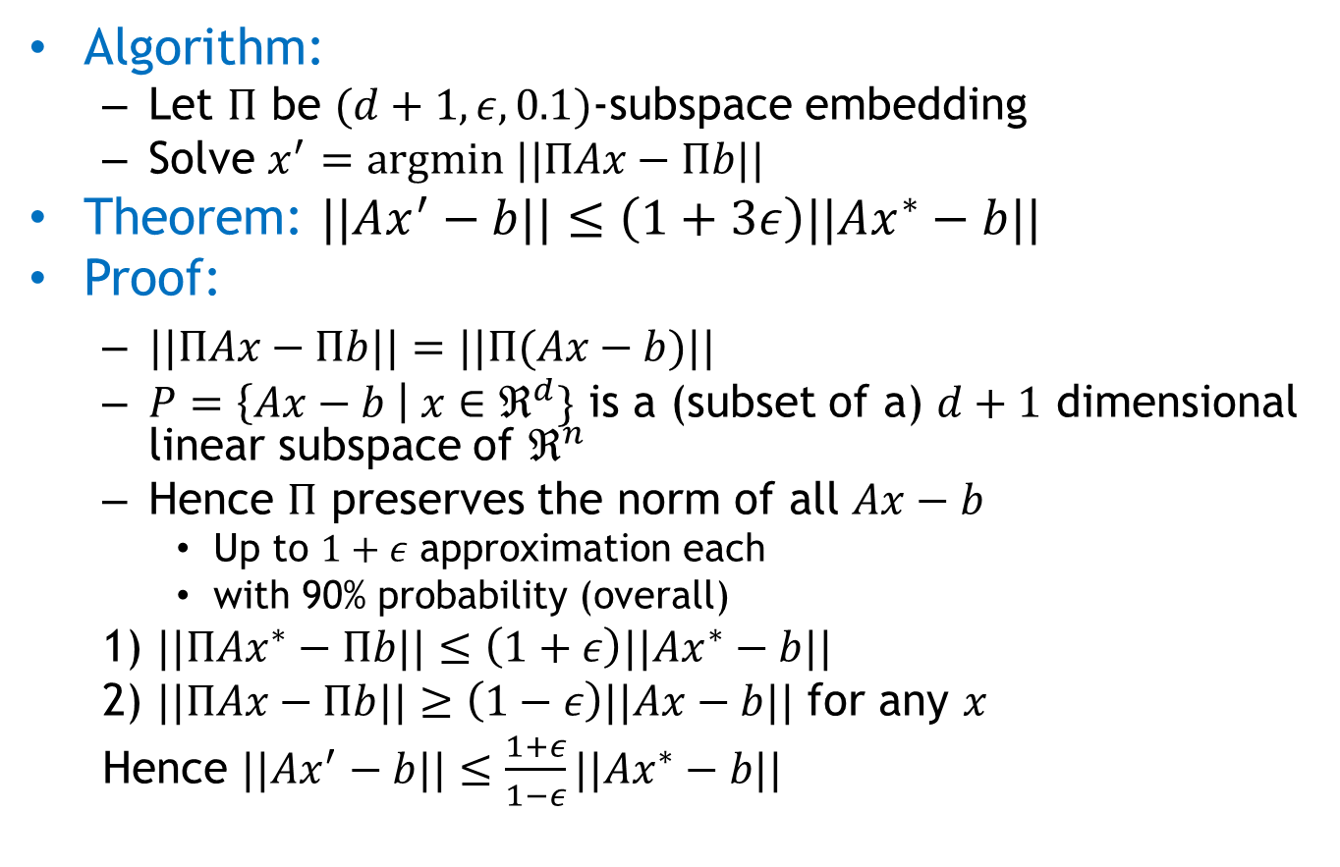
Approximate Algorithm
Algorithm:
  Let $Π$ be $(d+1,ε,0.1)$-subspace embedding
  Solve $x^{′}=argmin ||ΠAx−Πb||$
Theorem: $||Ax^{′}−b||≤\left(1+3ε\right)||Ax^{∗}−b||$
Proof:
  $||ΠAx−Πb||=||Π(Ax−b)||$
  $P=\left\{Ax−b \right| x∈ℜ^{d}\}$ is a (subset of a) $d+1$ dimensional linear subspace of $ℜ^{n}$
  Hence $Π$ preserves the norm of all $Ax−b$
    Up to $1+ε$ approximation each
    with 90% probability (overall)
  1) $||ΠAx^{∗}−Πb||≤\left(1+ε\right)||Ax^{∗}−b||$
  2) $||ΠAx−Πb||≥\left(1−ε\right)||Ax−b||$ for any $x$
  Hence $||Ax^{′}−b||≤\frac{1+ε}{1−ε}||Ax^{∗}−b||$

Slide 6
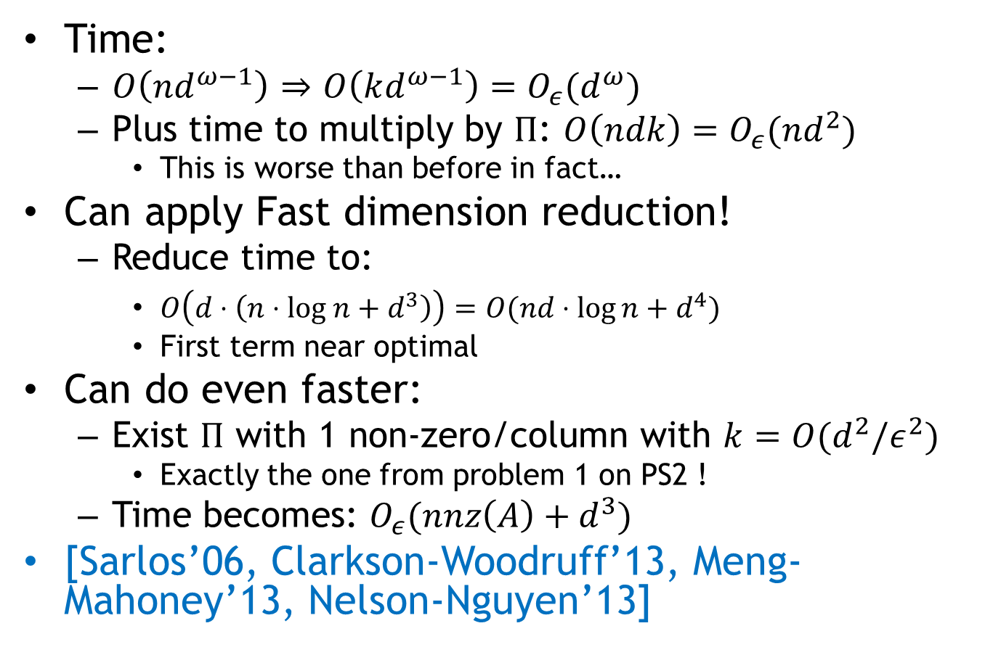
Approx LSR algorithms
Time:
  $O\left(nd^{ω−1}\right)$ $⇒$ $O\left(kd^{ω−1}\right)=O_{ε}(d^{ω})$
  Plus time to multiply by $Π$: $O\left(ndk\right)=O_{ε}(nd^{2})$
    This is worse than before in fact…
Can apply Fast dimension reduction!
  Reduce time to:
    $O\left(d⋅\left(n⋅log n+d^{3}\right)\right)=O(nd⋅\log{n}+d^{4})$
    First term near optimal
Can do even faster:
  Exist $Π$ with 1 non-zero/column with $k=O(d^{2}/ε^{2})$
    Exactly the one from problem 1 on PS2 !
  Time becomes: $O_{ε}(nnz\left(A\right)+d^{3})$
[Sarlos’06, Clarkson-Woodruff’13, Meng-Mahoney’13, Nelson-Nguyen’13]

Slide 7
Metric embeddings

Slide 8
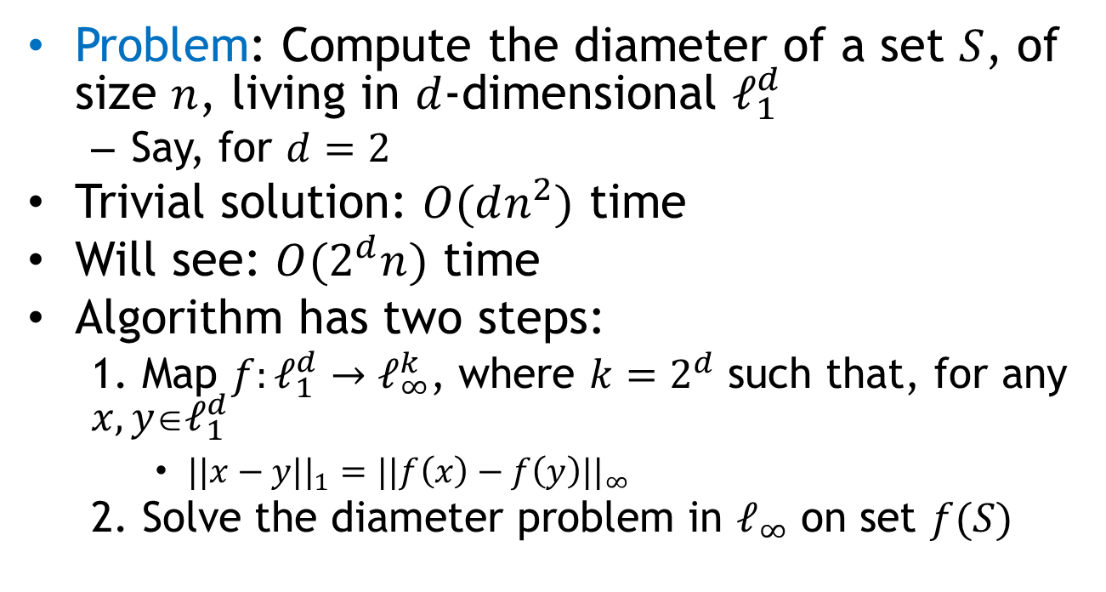
Definition by example
Problem: Compute the diameter of a set $S$, of size $n$, living in $d$-dimensional $ℓ_{1}^{d}$
  Say, for $d=2$
Trivial solution: $O(dn^{2})$ time
Will see: $O(2^{d}n)$ time
Algorithm has two steps:
  1. Map $f:ℓ_{1}^{d}→ℓ_{∞}^{k}$, where $k=2^{d}$ such that, for any $x,yℓ_{1}^{d}$
    $||x−y||_{1}=||f\left(x\right)−f\left(y\right)||_{∞}$
  2. Solve the diameter problem in $ℓ_{∞}$ on set $f(S)$

Slide 9
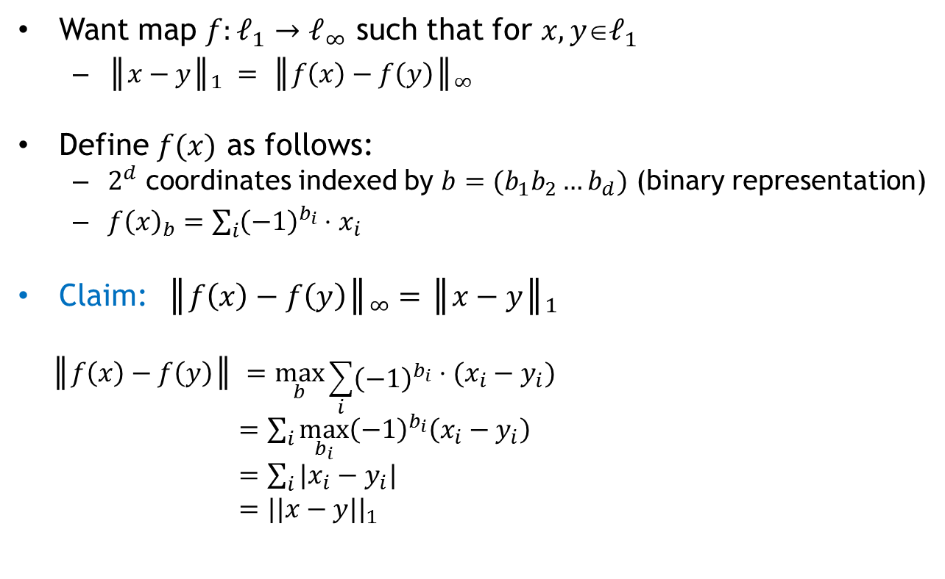

Step 1: Map from $ℓ_{1}$ to $ℓ_{∞}$
Want map $f:ℓ_{1}→ℓ_{∞}$ such that for $x,yℓ_{1}$
  $║x−y║_{1} = ║f\left(x\right)−f\left(y\right)║_{∞}$
Define $f(x)$ as follows:
  $2^{d}$ coordinates indexed by $b=(b_{1}b_{2}…b_{d})$ (binary representation)
  $f{\left(x\right)}_{b}=\sum_{i}{{\left(−1\right)}^{b_{i}}⋅x_{i}}$
Claim: $║f\left(x\right)−f\left(y\right)║_{∞}=║x−y║_{1}$
  $$║f\left(x\right)−f\left(y\right)║ =\max_{b}{\sum_{i}{{\left(−1\right)}^{b_{i}}}⋅(x_{i}−y_{i})}$$
  $=\sum_{i}{\max_{b_{i}}{\left(−1\right)}^{b_{i}}\left(x_{i}−y_{i}\right)}$
  $=\sum_{i}{|x_{i}−y_{i}|}$
  $=||x−y||_{1}$

Slide 10
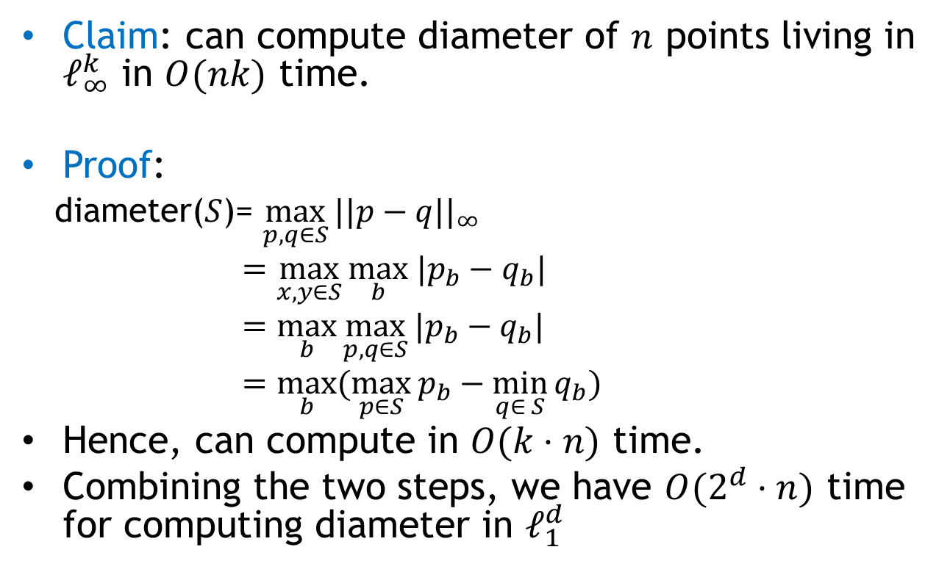

Step 2: Diameter in $ℓ_{∞}$
Claim: can compute diameter of $n$ points living in $ℓ_{∞}^{k}$ in $O(nk)$ time.
Proof:
  diameter($S$)= $\max_{p,q∈S}{||p−q||_{∞}}$
  $=\max_{x,y∈S}{\max_{b} |p_{b}−q_{b}|}$
  $=\max_{b}\max_{p,q∈S}{|p_{b}−q_{b}|}$
  $=\max_{b}{(\max_{p∈S}{p_{b}}−\min_{q∈ S}{q_{b}})}$
Hence, can compute in $O(k⋅n)$ time.
Combining the two steps, we have $O(2^{d}⋅n)$ time for computing diameter in $ℓ_{1}^{d}$

Slide 11

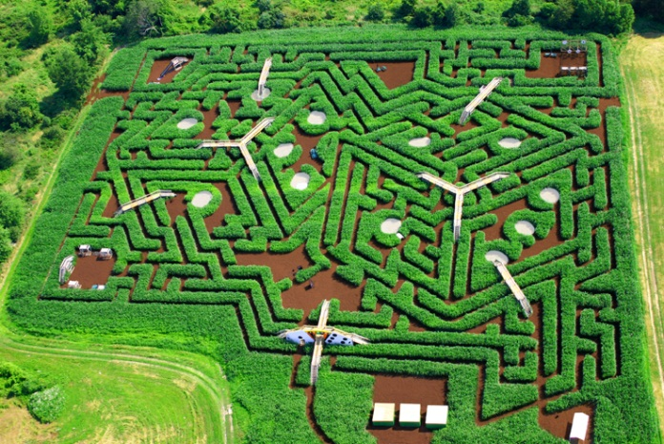
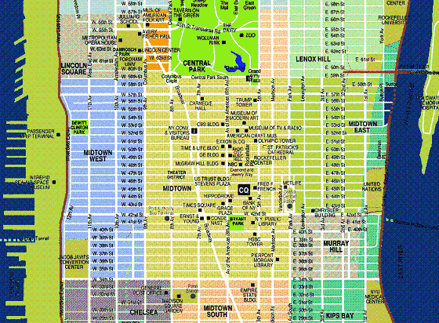
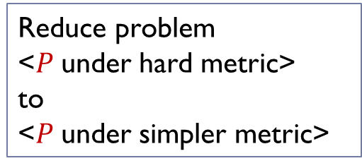



General Theory: embeddings
General motivation: given distance (metric) $M$, solve a computational problem $P$ under $M$
Hamming distance, $ℓ_{1}$
Compute distance between two points
Euclidean distance (ℓ₂)
Nearest Neighbor Search
Edit distance between two strings
Diameter/Close-pair of set S
Earth-Mover (transportation) Distance
Clustering, MST, etc
$$f$$
Reduce problem
<$P$under hard metric>
to
<$P$under simpler metric>

Slide 12
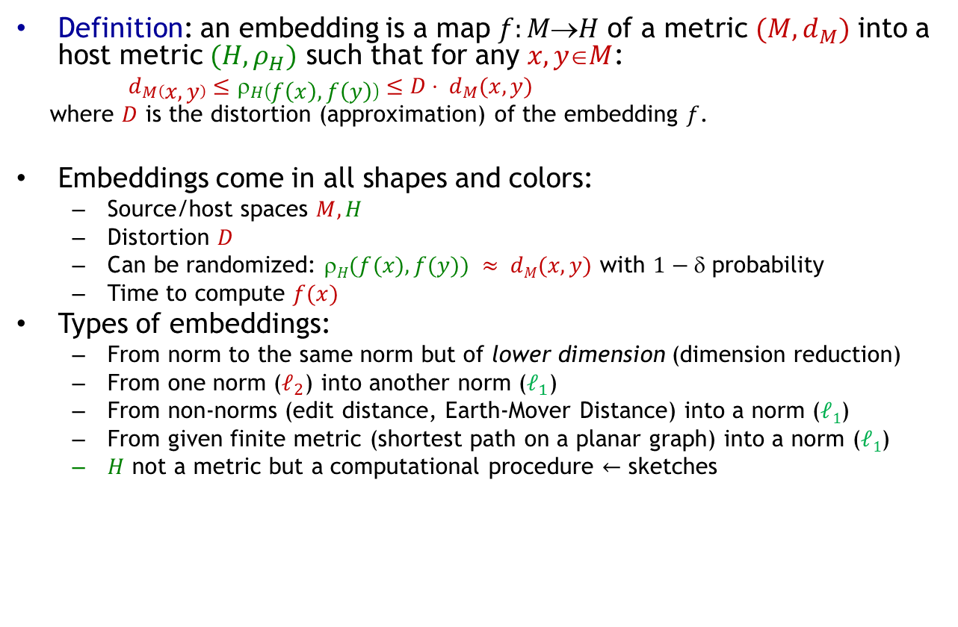
Embeddings: landscape
Definition: an embedding is a map $f:MH$ of a metric $(M, d_{M})$ into a host metric $(H, ρ_{H})$ such that for any $x,yM$:
  $d_{M}\left(x,y\right)≤ρ_{H}\left(f\left(x\right), f\left(y\right)\right)≤D⋅ d_{M}(x,y)$
  where $D$ is the distortion (approximation) of the embedding $f$.
Embeddings come in all shapes and colors:
  Source/host spaces $M, H$
  Distortion $D$
  Can be randomized: $H(f(x), f(y)) ≈ dM(x,y)$ with $1−$ probability
  Time to compute $f(x)$
Types of embeddings:
  From norm to the same norm but of lower dimension (dimension reduction)
  From one norm ($ℓ_{2}$) into another norm ($ℓ_{1}$)
  From non-norms (edit distance, Earth-Mover Distance) into a norm ($ℓ1$)
  From given finite metric (shortest path on a planar graph) into a norm ($ℓ1$)
  $H$ not a metric but a computational procedure $←$ sketches

Slide 13
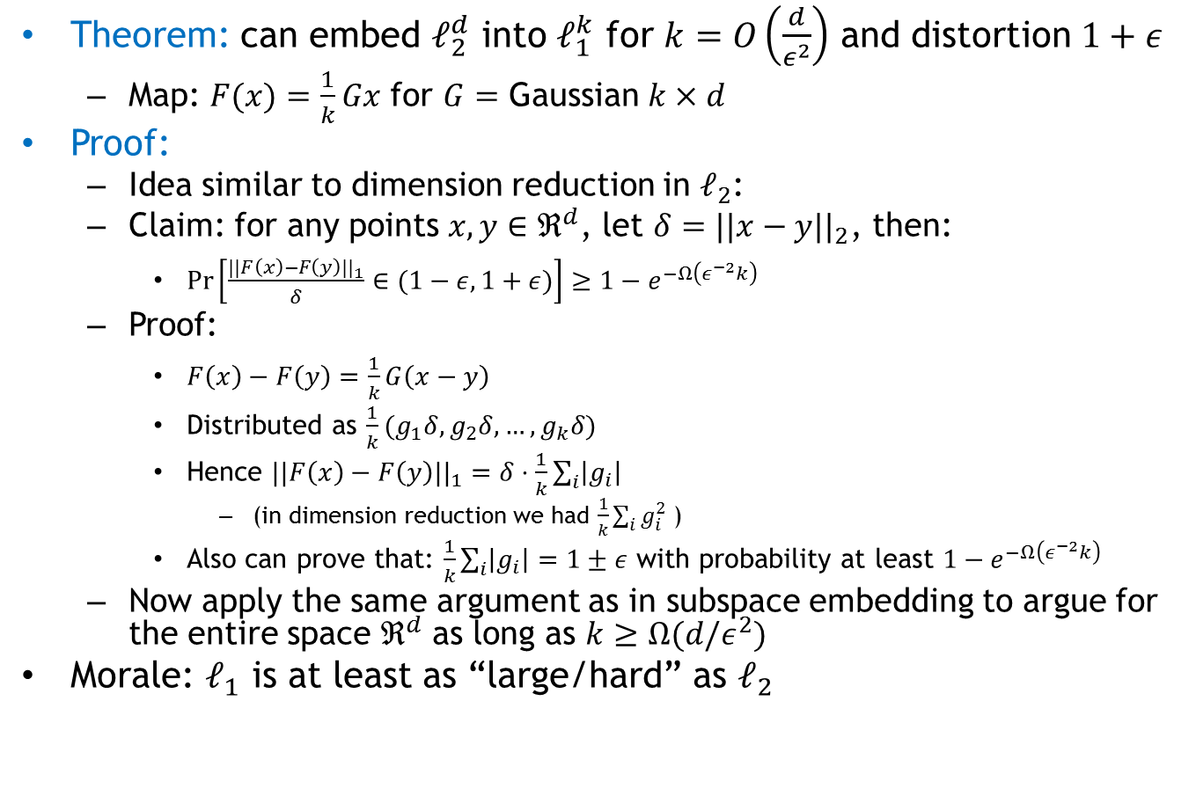
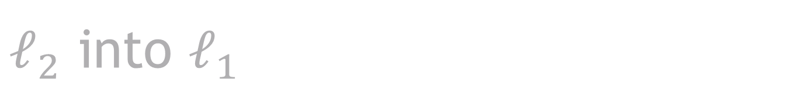
$ℓ_{2}$ into $ℓ_{1}$
Theorem: can embed $ℓ_{2}^{d}$ into $ℓ_{1}^{k}$ for $k=O\left(\frac{d}{ε^{2}}\right)$ and distortion $1+ε$
  Map: $F(x)=\frac{1}{k}Gx$ for $G=$ Gaussian $k×d$
Proof:
  Idea similar to dimension reduction in $ℓ_{2}$:
  Claim: for any points $x,y∈ℜ^{d}$, let $δ=||x−y||_{2}$, then:
    $Pr\left[\frac{||F\left(x\right)−F\left(y\right)||_{1}}{δ}∈(1−ε,1+ε)\right]≥1−e^{−Ω\left(ε^{−2}k\right)}$
  Proof:
    $F\left(x\right)−F\left(y\right)=\frac{1}{k}G\left(x−y\right)$
    Distributed as $\frac{1}{k}(g_{1}δ,g_{2}δ,…,g_{k}δ)$
    Hence $||F\left(x\right)−F\left(y\right)||_{1}=δ⋅\frac{1}{k}\sum_{i}{\left|g_{i}\right|}$
      (in dimension reduction we had $\frac{1}{k}\sum_{i}{g_{i}^{2}}$ )
    Also can prove that: $\frac{1}{k}\sum_{i}{\left|g_{i}\right|}=1±ε$ with probability at least $1−e^{−Ω\left(ε^{−2}k\right)}$
  Now apply the same argument as in subspace embedding to argue for the entire space $ℜ^{d}$ as long as $k≥Ω(d/ε^{2})$
Morale: $ℓ_{1}$ is at least as “large/hard” as $ℓ_{2}$

Slide 14
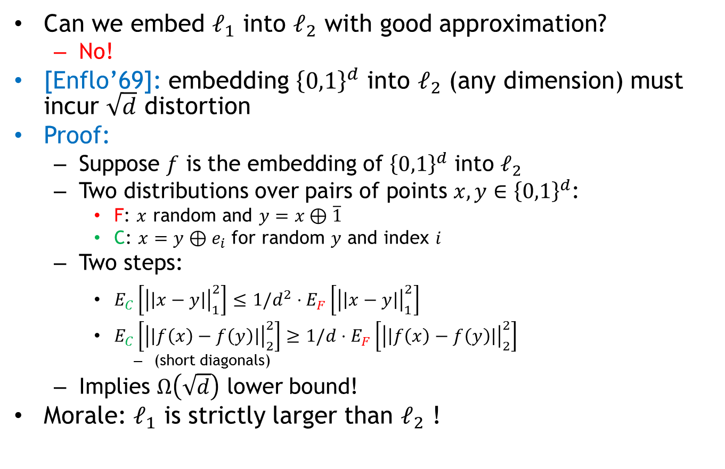
Converse?
Can we embed $ℓ_{1}$ into $ℓ_{2}$ with good approximation?
  No!
[Enflo’69]: embedding ${\left\{0,1\right\}}^{d}$ into $ℓ_{2}$ (any dimension) must incur $\sqrt{d}$ distortion
Proof:
  Suppose $f$ is the embedding of ${\left\{0,1\right\}}^{d}$ into $ℓ_{2}$
  Two distributions over pairs of points $x,y∈{\left\{0,1\right\}}^{d}$:
    F: $x$ random and $y=x⊕\overline{1}$
    C: $x=y⊕e_{i}$ for random $y$ and index $i$
  Two steps:
    $E_{C}\left[{\left|\left|x−y\right|\right|}_{1}^{2}\right]≤1/d^{2}⋅E_{F}\left[{\left|\left|x−y\right|\right|}_{1}^{2}\right]$
    $E_{C}\left[{\left|\left|f\left(x\right)−f\left(y\right)\right|\right|}_{2}^{2}\right]≥1/d⋅E_{F}\left[{\left|\left|f\left(x\right)−f\left(y\right)\right|\right|}_{2}^{2}\right]$
      (short diagonals)
  Implies $Ω\left(\sqrt{d}\right)$ lower bound!
Morale: $ℓ_{1}$ is strictly larger than $ℓ_{2}$ !

Slide 15
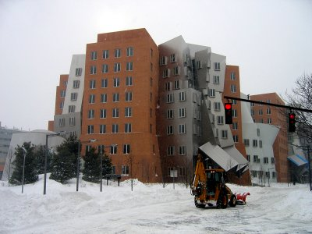
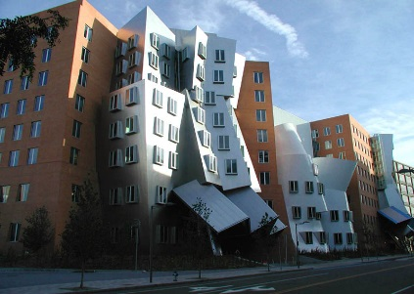

Other distances?
E.g, Earth-Mover Distance
Definition:
  Given two sets $A, B$of points in a metric space
  $EMD(A,B)$= min cost bipartite matching between $A$and $B$
Which metric space?
  Can be plane, $ℓ_{2}, ℓ_{1}$…
Applications in image vision
Images courtesy of Kristen Grauman

