Slide 1
Lecture 12:
More LSH
Data-dependent hashing
Notes:
Left to the title, a presenter can insert his/her own image pertinent to the presentation.

Slide 2
Announcements & Plan
PS3:
  Released tonight, due next Fri 7pm
Class projects: think of teams!
I’m away until Wed
  Office hours on Thu after class
Kevin will teach on Tue
Evaluation on courseworks next week
LSH: better space
Data-dependent hashing
  Scriber?

Slide 3
Time-Space Trade-offs (Euclidean)
space
query
time
Space | Time | Comment | Reference
$$≈n$$ | $$n^{σ}$$ | $$σ=2.09/c$$ | [Ind’01, Pan’06]
low
high
 |  | $$σ=O(1/c^{2})$$ | [AI’06]
$$n^{1+ρ}$$ | $$n^{ρ}$$ | $$ρ=1/c$$ | [IM’98, DIIM’04]
medium
medium
 |  | $$ρ=1/c^{2}$$ | [AI’06]
 |  | $$ρ≥1/c^{2}$$ | [MNP’06, OWZ’11]
$$n^{1+o({1/c}^{2})}$$ | ω(1) memory lookups | [PTW’08, PTW’10]
1 mem lookup
$$n^{4/ε^{2} }$$ | $$O(d log n)$$ | $$c=1+ε$$ | [KOR’98, IM’98, Pan’06]
high
low
$$n^{o(1{/ε}^{2})}$$ | ω(1) memory lookups | [AIP’06]

Slide 4

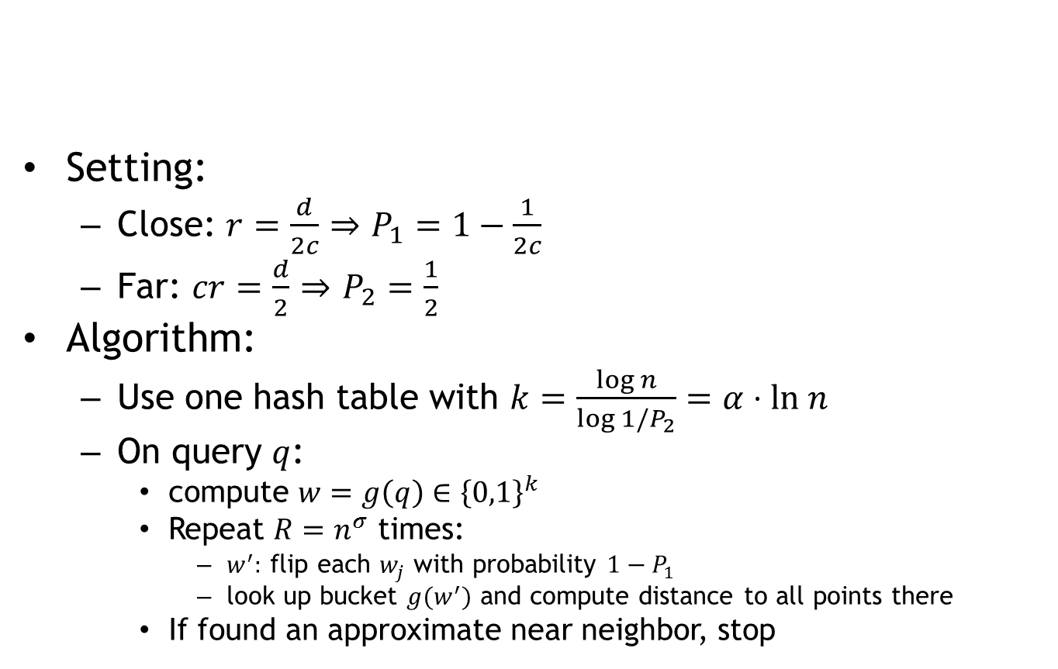
Near-linear Space for ${\left\{0,1\right\}}^{d}$
[Indyk’01, Panigrahy’06]
Setting:
  Close: $r=\frac{d}{2c}$ $⇒$ $P_{1}=1−\frac{1}{2c}$
  Far: $cr=\frac{d}{2}$ $⇒$ $P_{2}=\frac{1}{2}$
Algorithm:
  Use one hash table with $k=\frac{\log{n}}{\log{1/P_{2}}}=α⋅ln n$
  On query $q$:
    compute $w=g\left(q\right)∈{\left\{0,1\right\}}^{k}$
    Repeat ${R=n}^{σ}$ times:
      $w^{′}:$ flip each $w_{j}$ with probability $1−P_{1}$
      look up bucket $g(w^{′})$ and compute distance to all points there
    If found an approximate near neighbor, stop
Sample a few buckets in the same hash table!

Slide 5
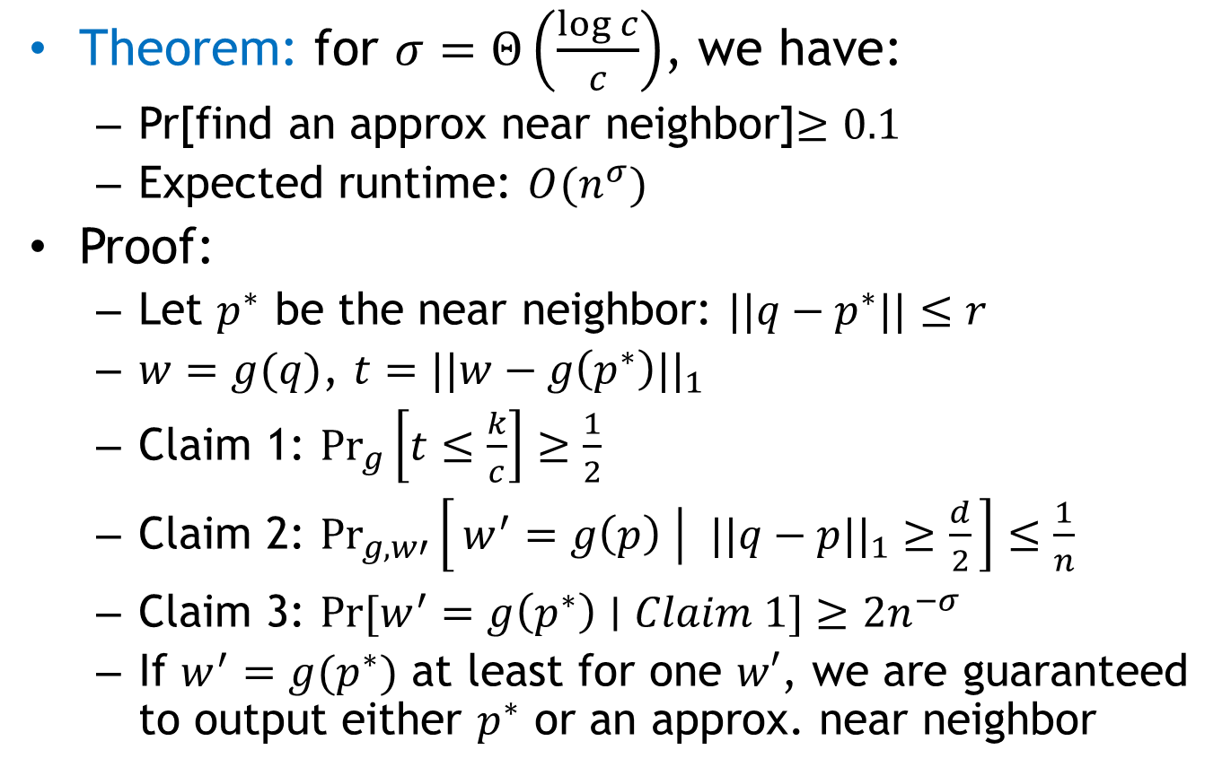
Near-linear Space
Theorem: for $σ=Θ\left(\frac{\log{c}}{c}\right)$, we have:
  Pr[find an approx near neighbor]$≥0.1$
  Expected runtime: $O(n^{σ})$
Proof:
  Let $p^{∗}$ be the near neighbor: $||q−p^{∗}||≤r$
  $w=g(q)$, $t=||w−g\left(p^{∗}\right)||_{1}$
  Claim 1: $\underset{g}{Pr}\left[t≤\frac{k}{c}\right]≥\frac{1}{2}$
  Claim 2: ${\underset{g,w′}{Pr}\left[w^{′}=g\left(p\right) ∣ ||q−p||_{1}≥\frac{d}{2}\right]≤\frac{1}{n}}_{ }$
  Claim 3: $\operatorname{Pr}{[w^{′}=g\left(p^{∗}\right)∣Claim 1]}≥2n^{−σ}$
  If $w^{′}=g(p^{∗})$ at least for one $w′$, we are guaranteed to output either $p^{∗}$ or an approx. near neighbor

Slide 6
Beyond LSH
Space | Time | Exponent | $$c=2$$ | Reference
Hamming
space
$$n^{1+ρ}$$ | $$n^{ρ}$$ | $$ρ=1/c$$ | $$ρ=1/2$$ | [IM’98]
LSH
 |  | $$ρ≥1/c$$ |  | [MNP’06, OWZ’11]
$$n^{1+ρ}$$ | $$n^{ρ}$$ | $$ρ≈\frac{1}{2c−1}$$ | $$ρ=1/3$$ | [AINR’14, AR’15]
Euclidean
space
$$n^{1+ρ}$$ | $$n^{ρ}$$ | $$ρ≈1/c^{2}$$ | $$ρ=1/4$$ | [AI’06]
LSH
 |  | $$ρ≥1/c^{2}$$ |  | [MNP’06, OWZ’11]
$$n^{1+ρ}$$ | $$n^{ρ}$$ | $$ρ≈\frac{1}{2c^{2}−1}$$ | $$ρ=1/7$$ | [AINR’14, AR’15]

Slide 7
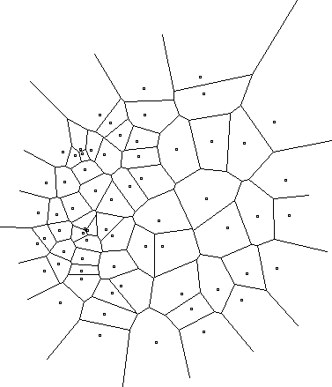
New approach?
A random hash function, chosen after seeing the given dataset
Efficiently computable
Data-dependent hashing
Notes:
Example: Voronoi diagram
but expensive to compute the hash function

Slide 8
Construction of hash function
[A.-Indyk-Nguyen-Razenshteyn’14, A.-Razenshteyn’15]
Warning: hot off the press!
Two components:
  Nice geometric structure
  Reduction to such structure
has better LSH
data-dependent

Slide 9
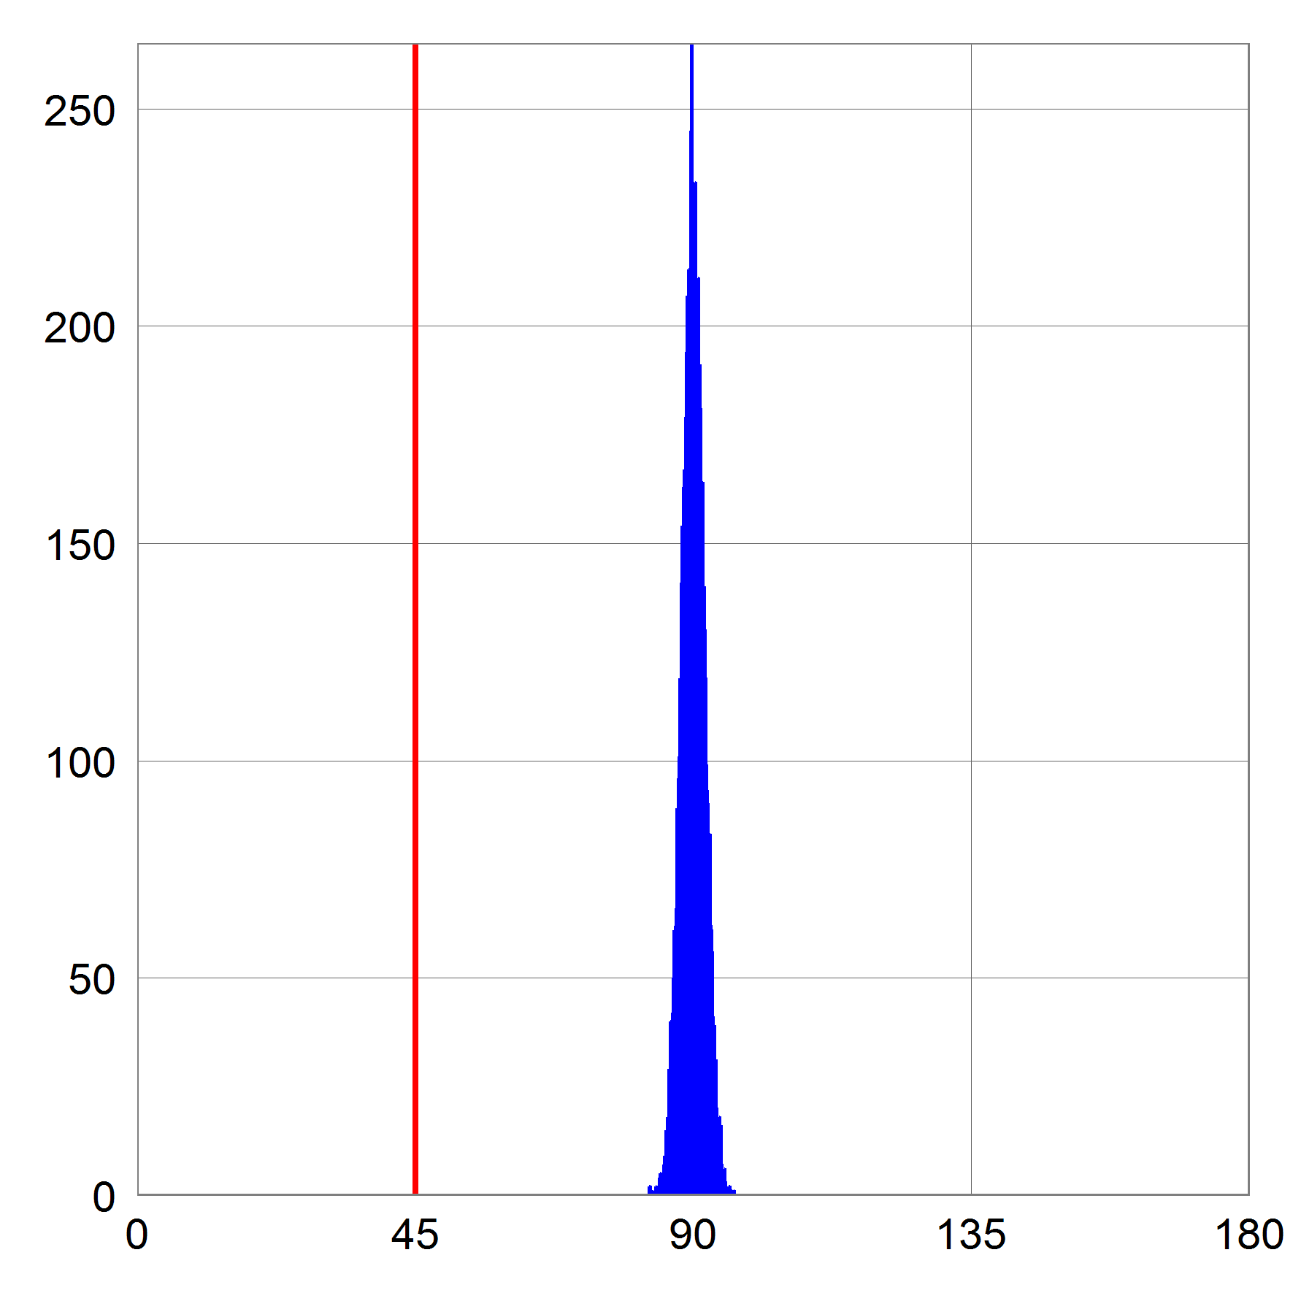



Nice geometric structure
Like a random dataset on a sphere
  s.t. random points at distance $≈cr$
Query:
  At angle 45’ from near-neighbor
$$cr$$
$$cr/\sqrt{2}$$
[Pictures curtesy of Ilya Razenshteyn]

Slide 10
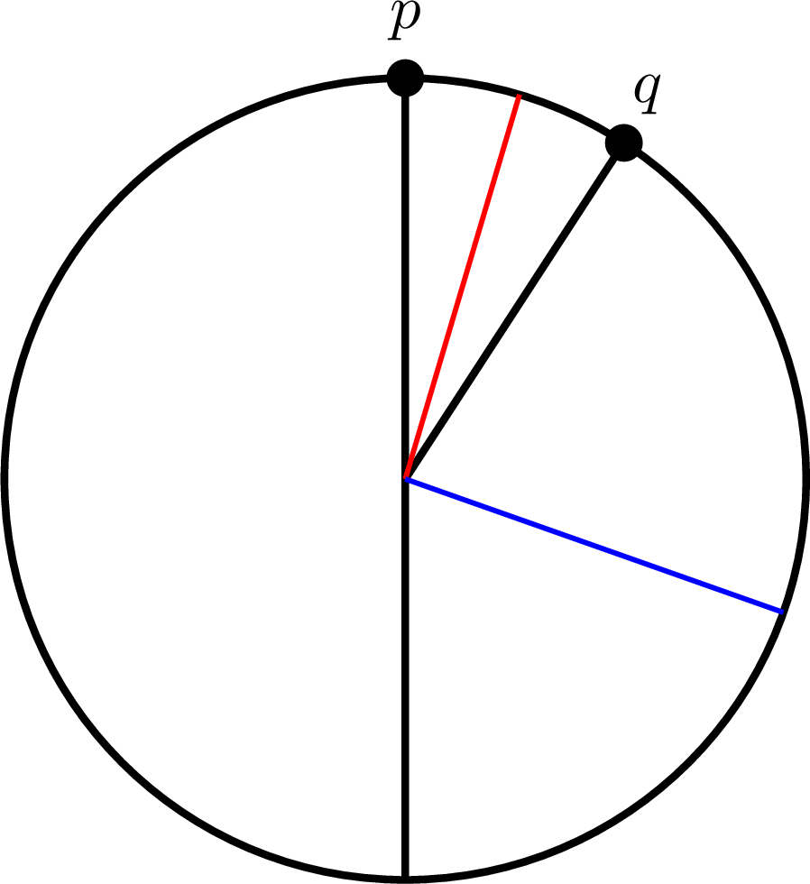
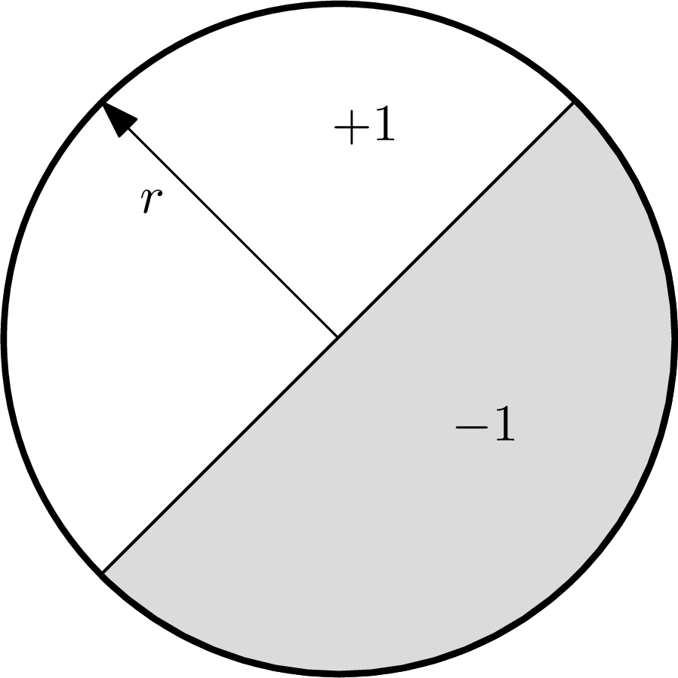
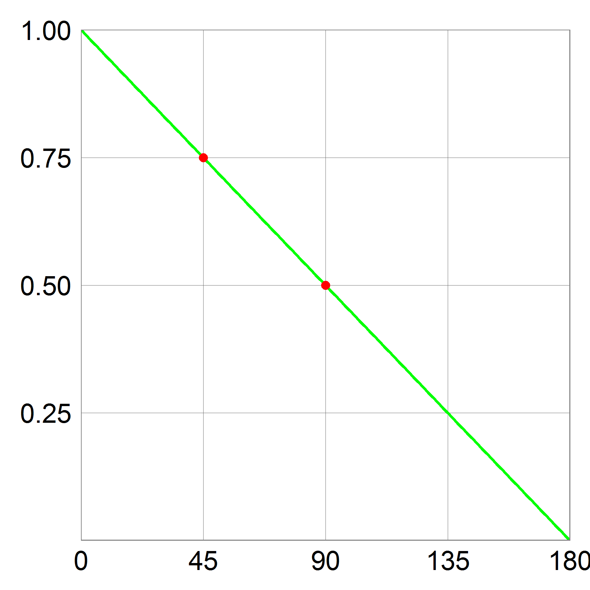
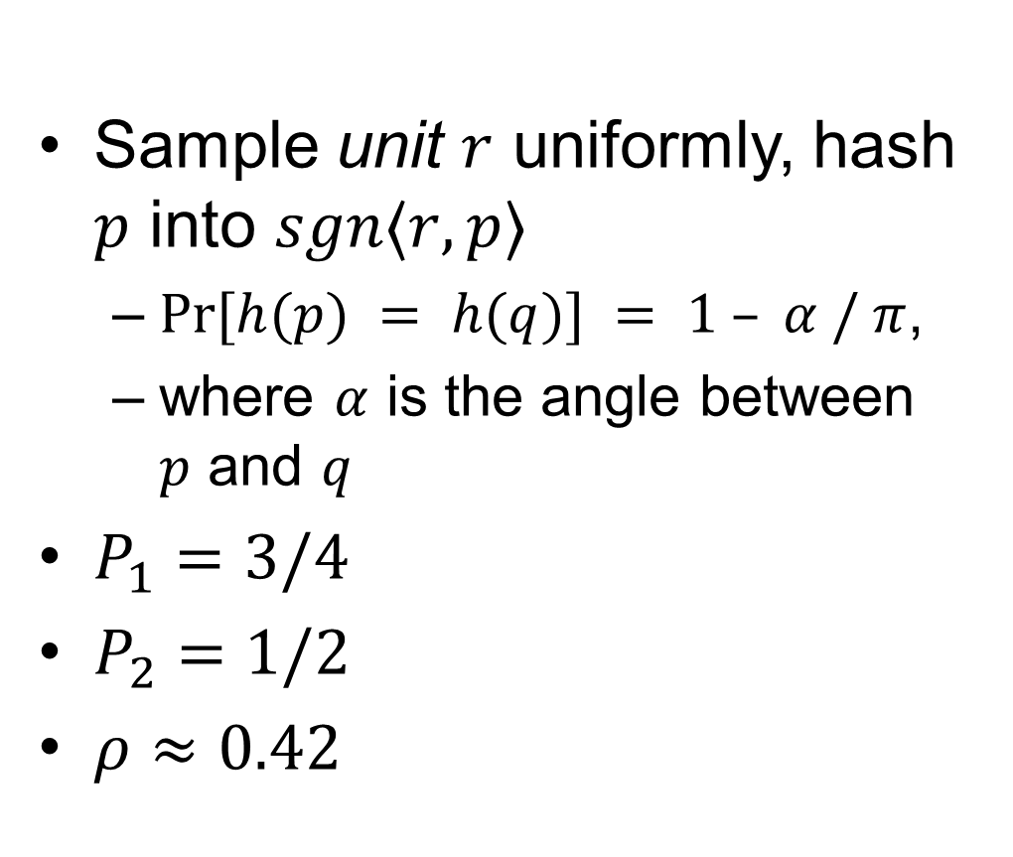
Alg 1: Hyperplanes
[Charikar’02]
Sample unit $r$ uniformly, hash $p$ into $sgn〈r, p〉$
  $Pr⁡[h(p) = h(q)] = 1 – α / π$,
  where $α$ is the angle between $p$ and $q$
$P_{1}=3/4$
$P_{2}=1/2$
$ρ≈0.42$

Slide 11
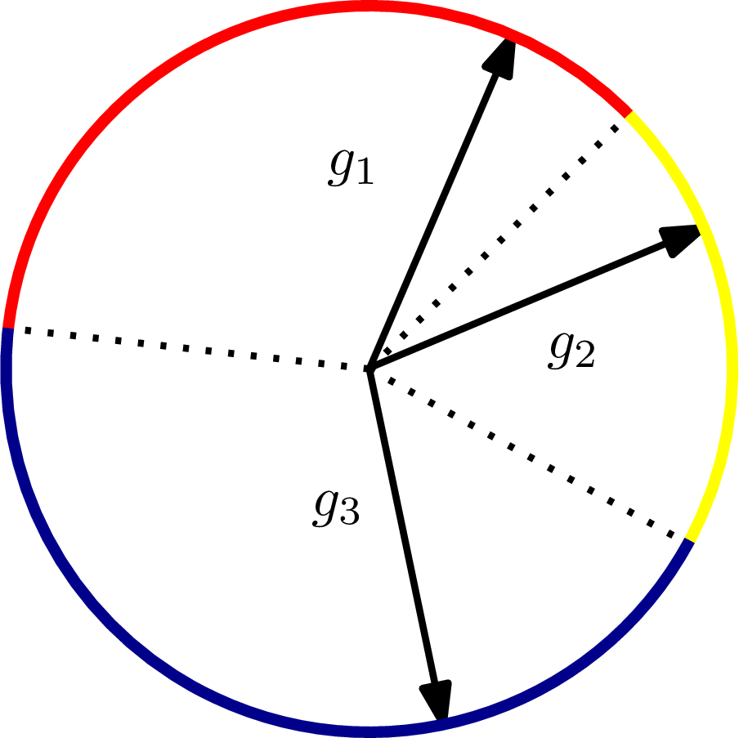
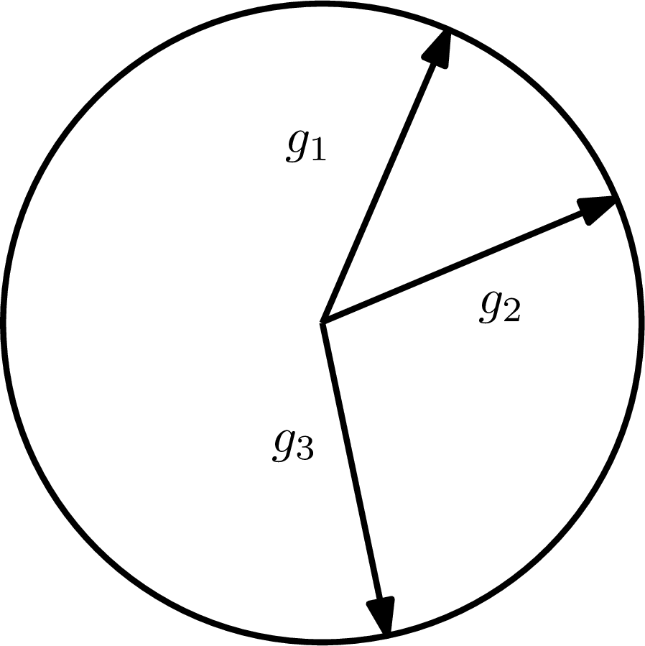
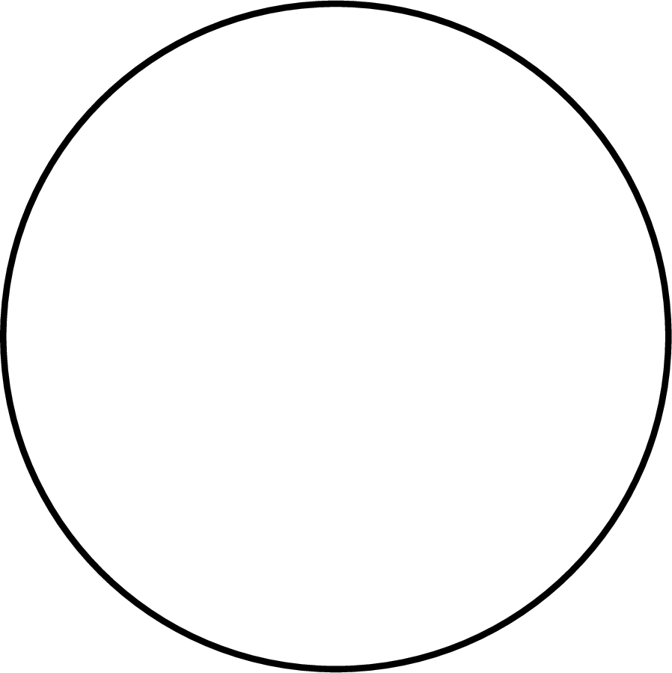
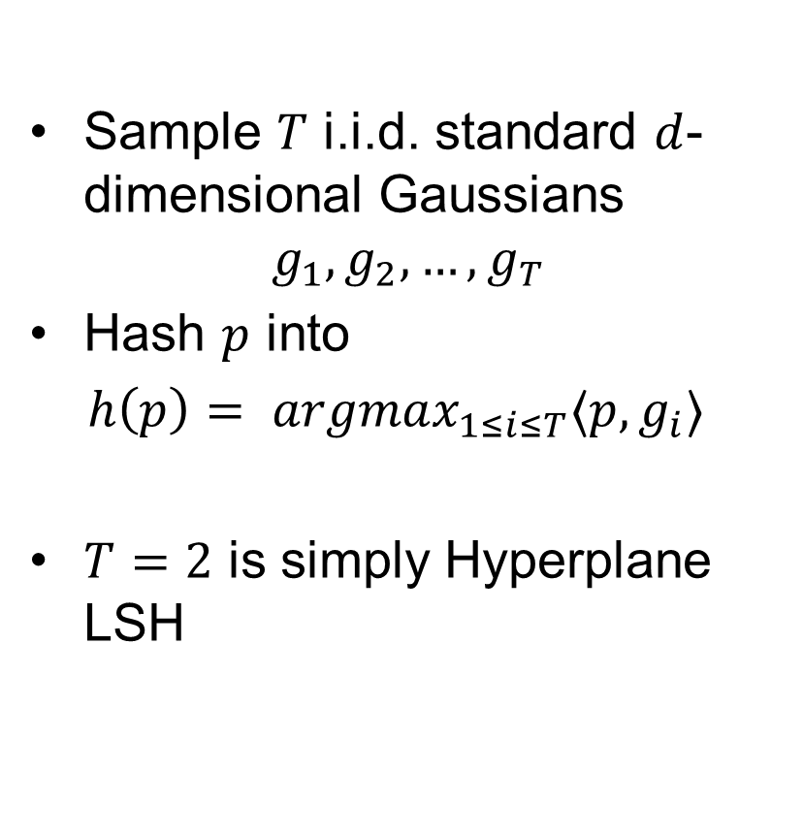
Alg 2: Voronoi
[A.-Indyk-Nguyen-Razenshteyn’14] based on [Karger-Motwani-Sudan’94]
Sample $T$ i.i.d. standard $d$-dimensional Gaussians
$$g_{1}, g_{2}, …, g_{T}$$
Hash $p$ into
$h\left(p\right)= argmax_{1≤i≤T}〈p, g_{i}〉$
$T=2$ is simply Hyperplane LSH

Slide 12
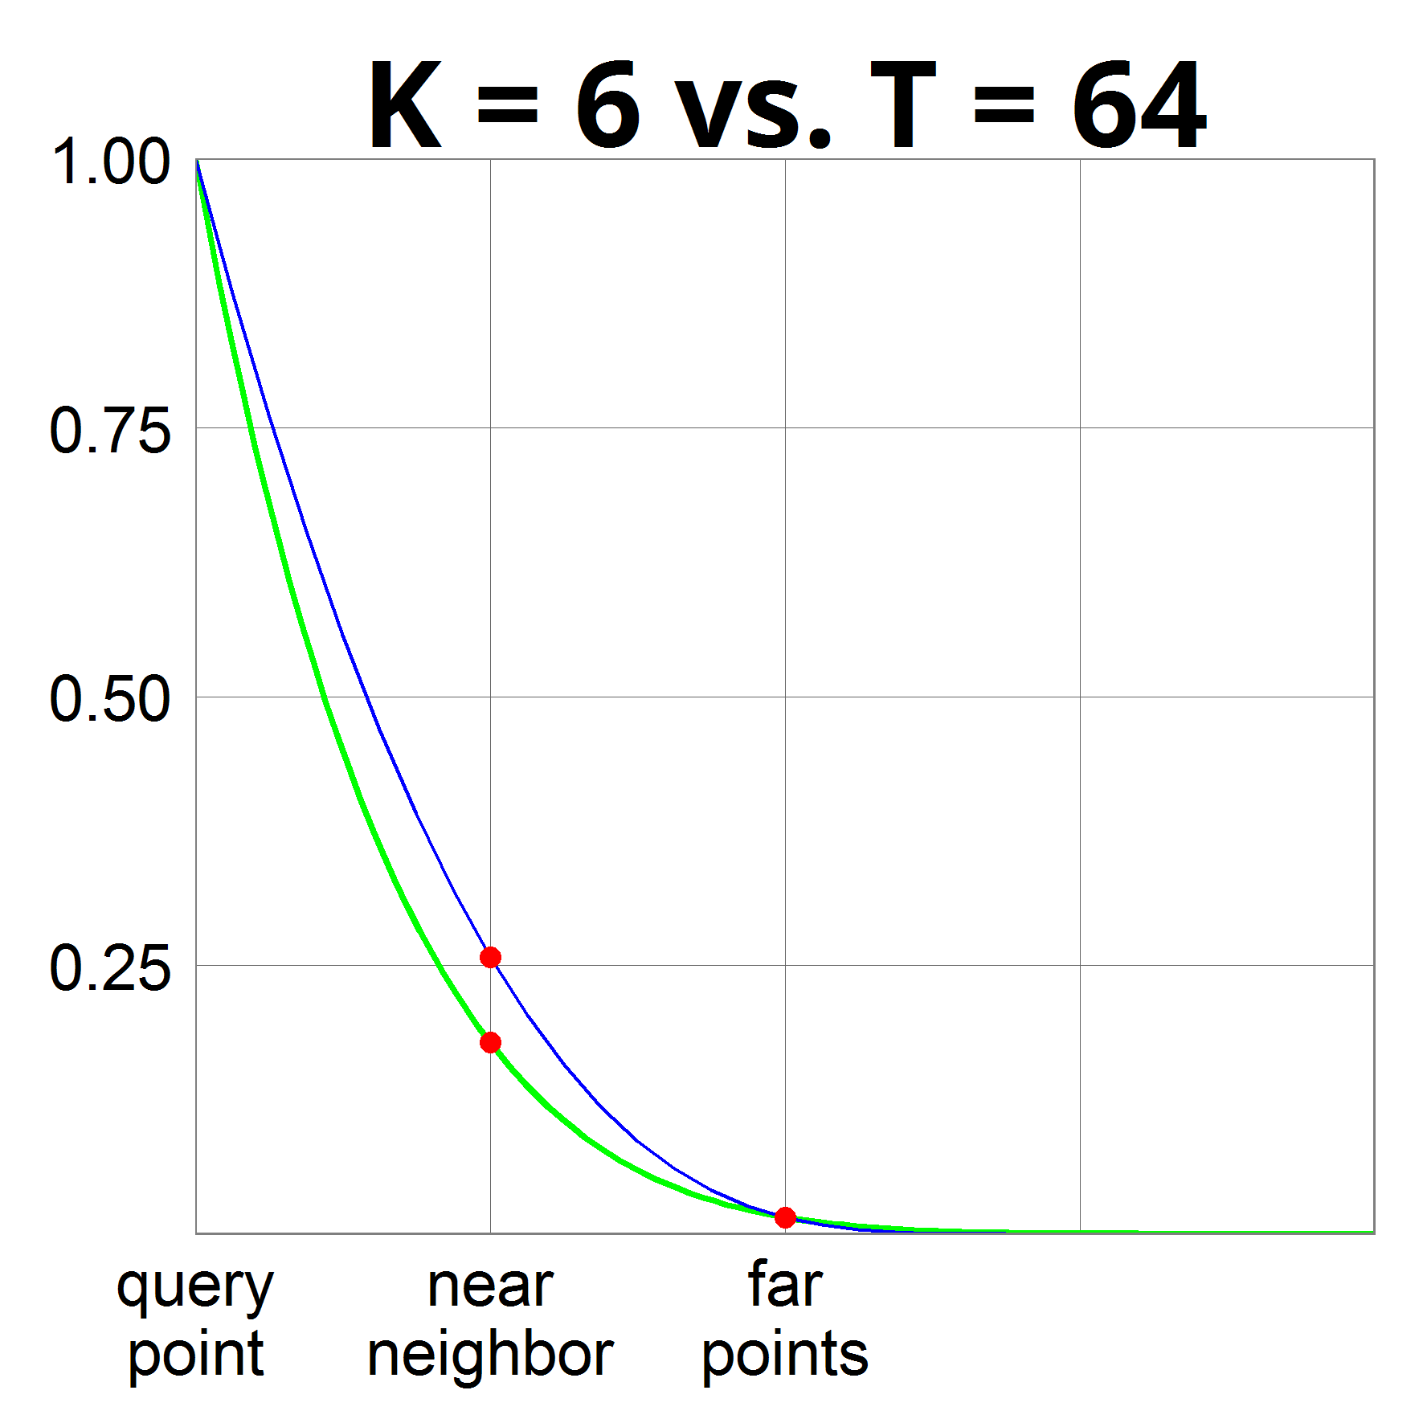
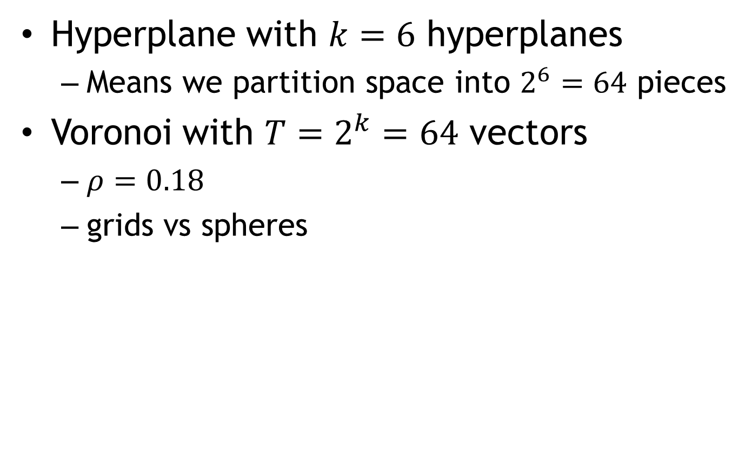
Hyperplane vs Voronoi
Hyperplane with $k=6$ hyperplanes
  Means we partition space into $2^{6}=64$ pieces
Voronoi with $T=2^{k}=64$ vectors
  $ρ=0.18$
  grids vs spheres

Slide 13
NNS: conclusion
1. Via sketches
2. Locality Sensitive Hashing
  Random space partitions
  Better space bound
    Even near-linear!
  Data-dependent hashing even better
    Used in practice a lot these days

Slide 14
The following was not presented in the lecture

Slide 15
Reduction to nice structure (HL)
Idea:
  iteratively decrease the radius of minimum enclosing ball
Algorithm:
  find dense clusters
    with smaller radius
    large fraction of points
  recurse on dense clusters
  apply VoronoiLSH on the rest
    recurse on each “cap”
    eg, dense clusters might reappear
Why ok?
Why ok?
no dense clusters
like “random dataset” with radius=$100cr$
even better!
radius = $100cr$
radius = $99cr$
*picture not to scale & dimension

Slide 16
Hash function
Described by a tree (like a hash table)
radius = $100cr$
*picture not to scale&dimension

Slide 17


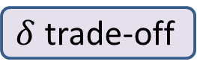
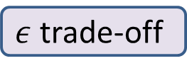
Dense clusters
$$\left(\sqrt{2}−ε\right)R$$
Current dataset: radius $R$
A dense cluster:
  Contains $n^{1−δ}$ points
  Smaller radius: $\left(1−Ω\left(ε^{2}\right)\right)R$
After we remove all clusters:
  For any point on the surface, there are at most $n^{1−δ}$ points within distance $\left(\sqrt{2}−ε\right)R$
  The other points are essentially orthogonal !
When applying Cap Carving with parameters $(P_{1},P_{2})$:
  Empirical number of far pts colliding with query: $nP_{2}+n^{1−δ}$
  As long as $nP_{2}≫n^{1−δ}$, the “impurity” doesn’t matter!
$ε$ trade-off
$δ$ trade-off
?

Slide 18

Tree recap
During query:
  Recurse in all clusters
  Just in one bucket in VoronoiLSH
Will look in >1 leaf!
How much branching?
  Claim: at most ${\left(n^{δ}+1\right)}^{O(1/ε^{2})}$
  Each time we branch
    at most $n^{δ}$ clusters ($+1$)
    a cluster reduces radius by $Ω(ε^{2})$
    cluster-depth at most $100/Ω\left(ε^{2}\right)$
Progress in 2 ways:
  Clusters reduce radius
  CapCarving nodes reduce the # of far points (empirical $P_{2}$)
A tree succeeds with probability $≥n^{−\frac{1}{2c^{2}−1}−o(1)}$
$δ$ trade-off

Slide 19
Fast preprocessing
$$\left(\sqrt{2}−ε\right)R$$
How to find the dense clusters fast?
Step 1: reduce to $O(n^{2})$ time.
  Enough to consider centers that
  are data points
Step 2: reduce to near-linear time.
  Down-sample!
  Ok because we want clusters of size $n^{1−δ}$
  After downsampling by a factor of $\sqrt{n}$, a cluster is still somewhat heavy.

Slide 20
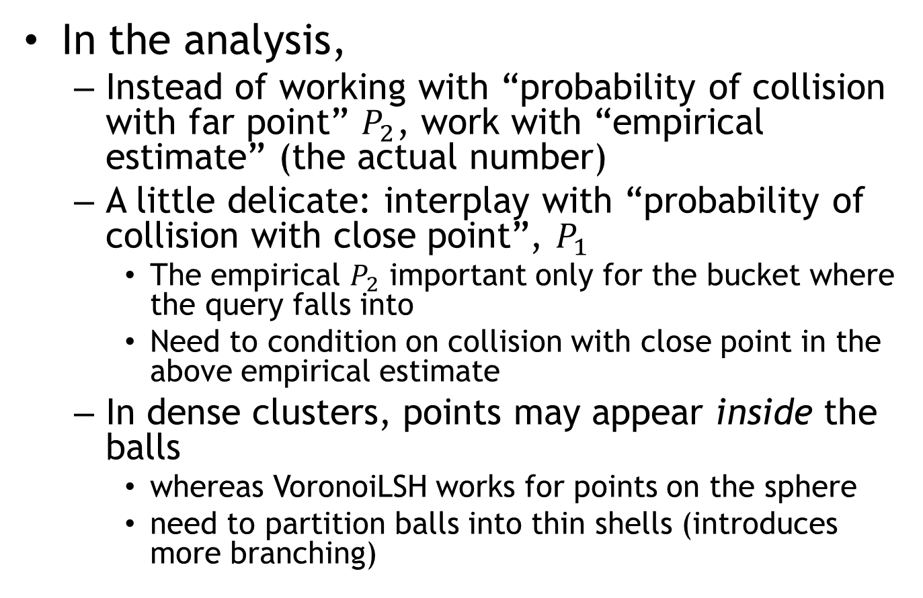
Other details
In the analysis,
  Instead of working with “probability of collision with far point” $P_{2}$, work with “empirical estimate” (the actual number)
  A little delicate: interplay with “probability of collision with close point”, $P_{1}$
    The empirical $P_{2}$ important only for the bucket where the query falls into
    Need to condition on collision with close point in the above empirical estimate
  In dense clusters, points may appear inside the balls
    whereas VoronoiLSH works for points on the sphere
    need to partition balls into thin shells (introduces more branching)

