Slide 1
Lecture 11:
Nearest Neighbor Search
Notes:
Left to the title, a presenter can insert his/her own image pertinent to the presentation.

Slide 2
Plan
Distinguished Lecture
  Quantum Computing
  Oct 19, 11:30am, Davis Aud in CEPSR
Nearest Neighbor Search
Scriber?

Slide 3


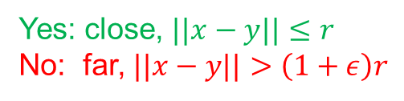
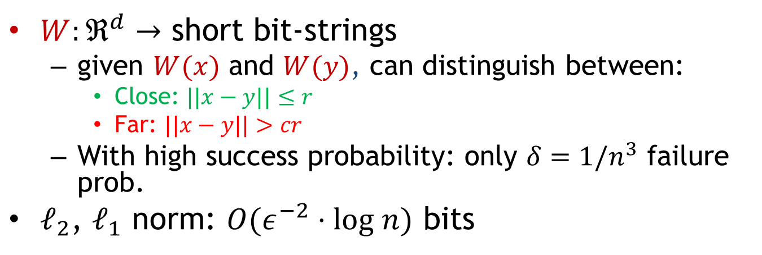



Sketching
$W:ℜ^{d}$ $→$ short bit-strings
  given $W(x)$ and $W(y)$, can distinguish between:
    Close: $||x−y||≤r$
    Far: $||x−y||>cr$
  With high success probability: only $δ=1/n^{3}$ failure prob.
$ℓ_{2}$, $ℓ_{1}$ norm: $O(ε^{−2}⋅log n)$ bits
$$x$$
$$y$$
$$W$$
$$W$$
010110
010101
Is $||W\left(x\right)−W\left(y\right)||≤t$ ?
Yes: close, $||x−y||≤r$
No: far, $||x−y||>\left(1+ε\right)r$

Slide 4
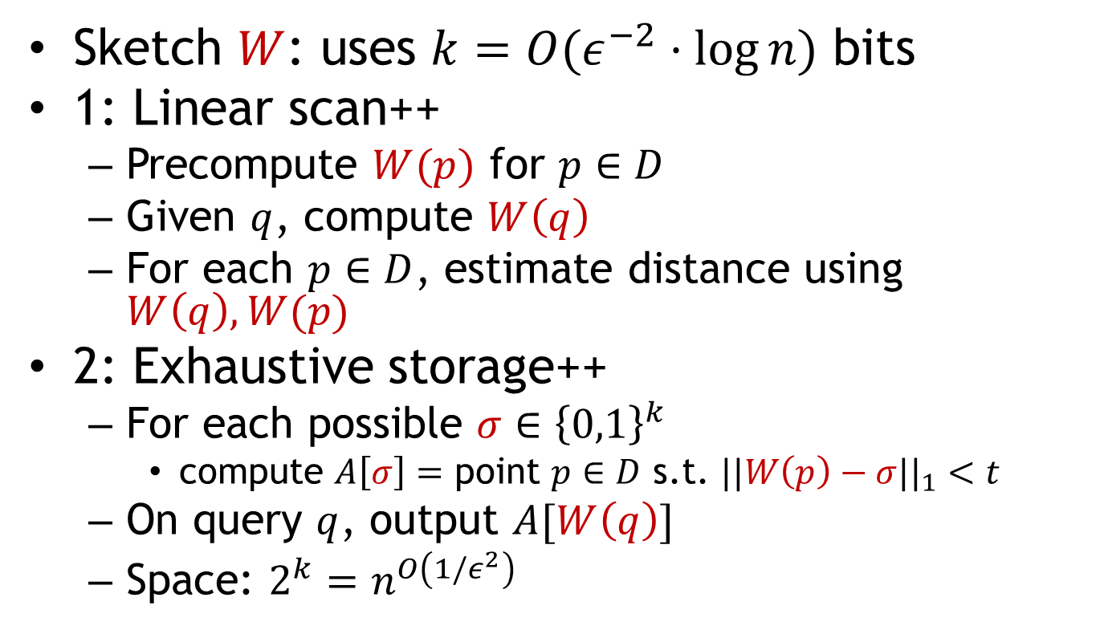
NNS: approaches
Sketch $W$: uses $k=O(ε^{−2}⋅\log{n})$ bits
1: Linear scan++
  Precompute $W(p)$ for $p∈D$
  Given $q$, compute $W\left(q\right)$
  For each $p∈D$, estimate distance using $W\left(q\right), W(p)$
2: Exhaustive storage++
  For each possible $σ∈{\left\{0,1\right\}}^{k}$
    compute $A\left[σ\right]=$ point $p∈D$ s.t. $||W\left(p\right)−σ||_{1}<t$
  On query $q$, output $A[W\left(q\right)]$
  Space: $2^{k}=n^{O\left(1/ε^{2}\right)}$
Near-linear space and sub-linear query time?

Slide 5


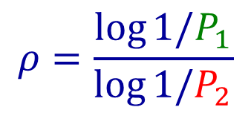


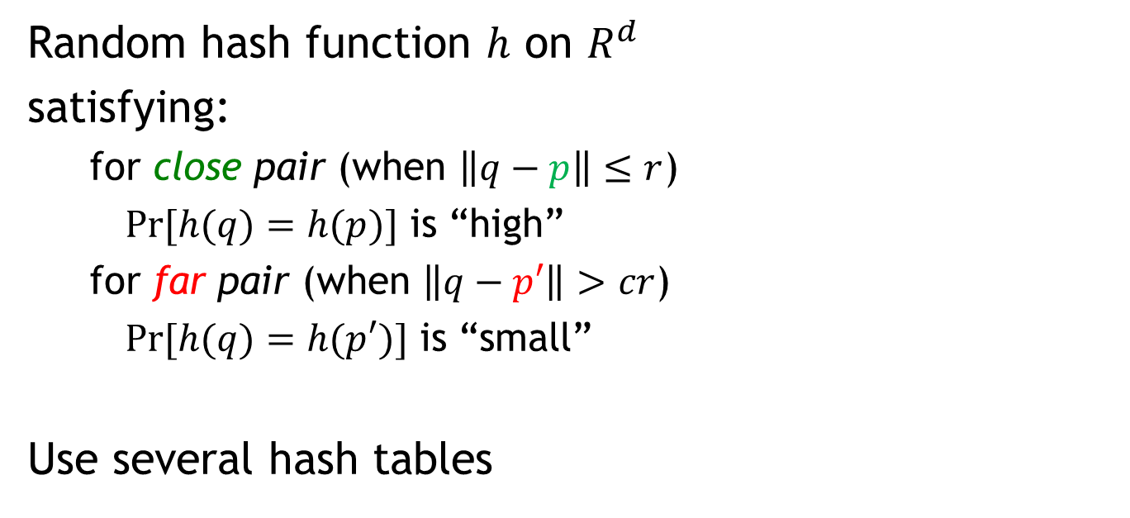





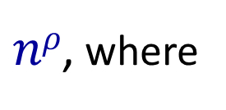



Locality Sensitive Hashing
[Indyk-Motwani’98]
Random hash function $h$ on $R^{d}$
satisfying:
  for close pair (when $\left\|q−p\right\|≤r$)
  $Pr⁡[h(q)=h(p)]$ is “high”
  for far pair (when $\left\|q−p′\right\|>cr$)
  $Pr⁡[h(q)=h(p′)]$ is “small”
Use several hash tables
$$q$$
$$p′$$
$$p$$
$$q$$
$$P1=$$
“not-so-small”
$$P2=$$
$$Pr⁡[h(q)=h(p)]$$
$$ρ=\frac{\log{1/P_{1}}}{\log{1/P_{2}}}$$
$nρ$, where
1
$$P1$$
$$P2$$
$$\left\|q−p\right\|$$
$$r$$
$$cr$$

Slide 6
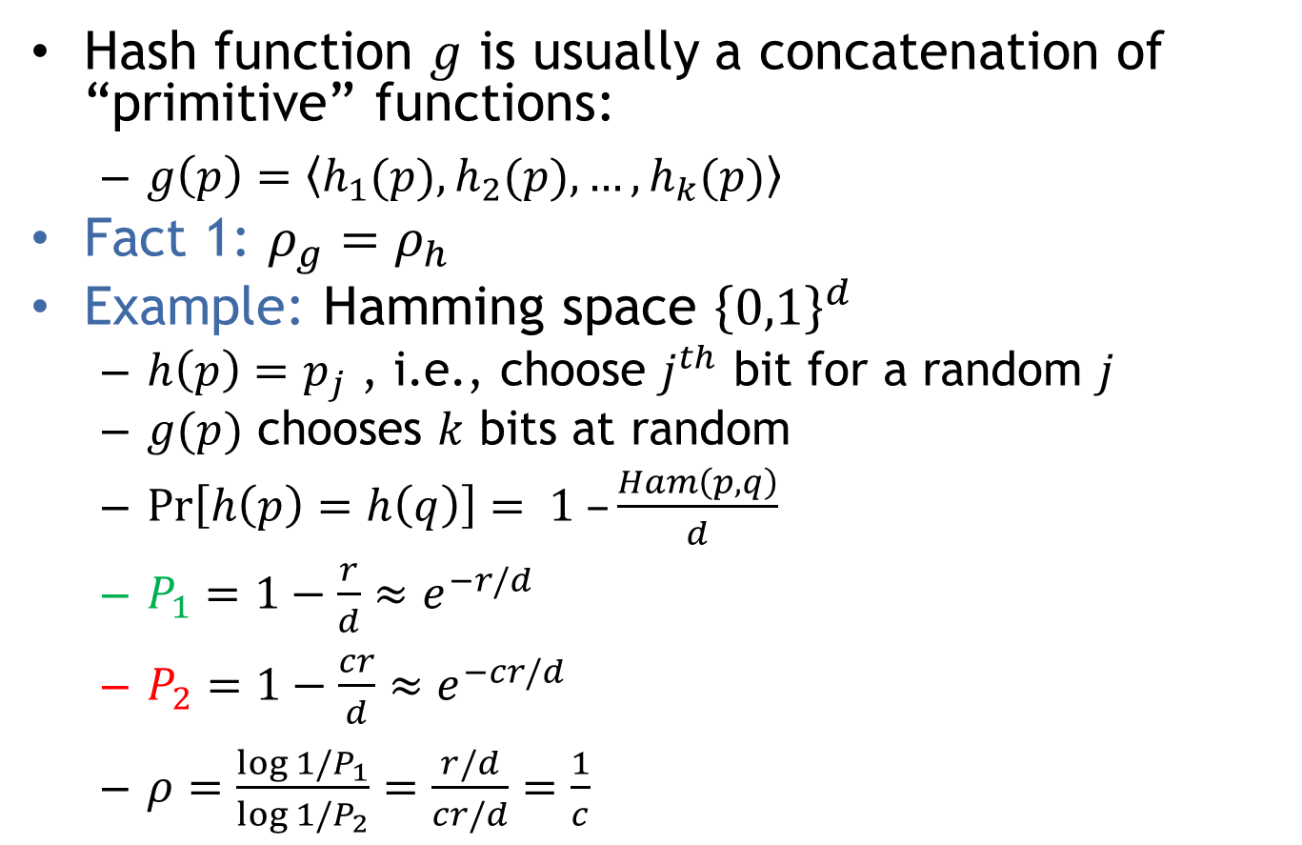
LSH for Hamming space
Hash function $g$ is usually a concatenation of “primitive” functions:
  $g\left(p\right)=\left\langle h_{1}(p),h_{2}(p),…,h_{k}(p)\right\rangle$
Fact 1: $ρ_{g}=ρ_{h}$
Example: Hamming space ${\left\{0,1\right\}}^{d}$
  $h\left(p\right)=p_{j}$ , i.e., choose $j^{th}$ bit for a random $j$
  $g(p)$ chooses $k$ bits at random
  $\operatorname{Pr}\left[h\left(p\right)=h\left(q\right)\right]= 1 –\frac{Ham\left(p,q\right)}{d}$
  $P_{1}=1−\frac{r}{d}≈e^{−r/d}$
  $P_{2}=1−\frac{cr}{d}≈e^{−cr/d}$
  $ρ=\frac{\log{1/P_{1}}}{\log{1/P_{2}}}=\frac{r/d}{cr/d}=\frac{1}{c}$
$$Pr⁡[h(q)=h(p)]$$
1
$$P1$$
$$P2$$
$$\left\|q−p\right\|$$
$$r$$
$$cr$$

Slide 7
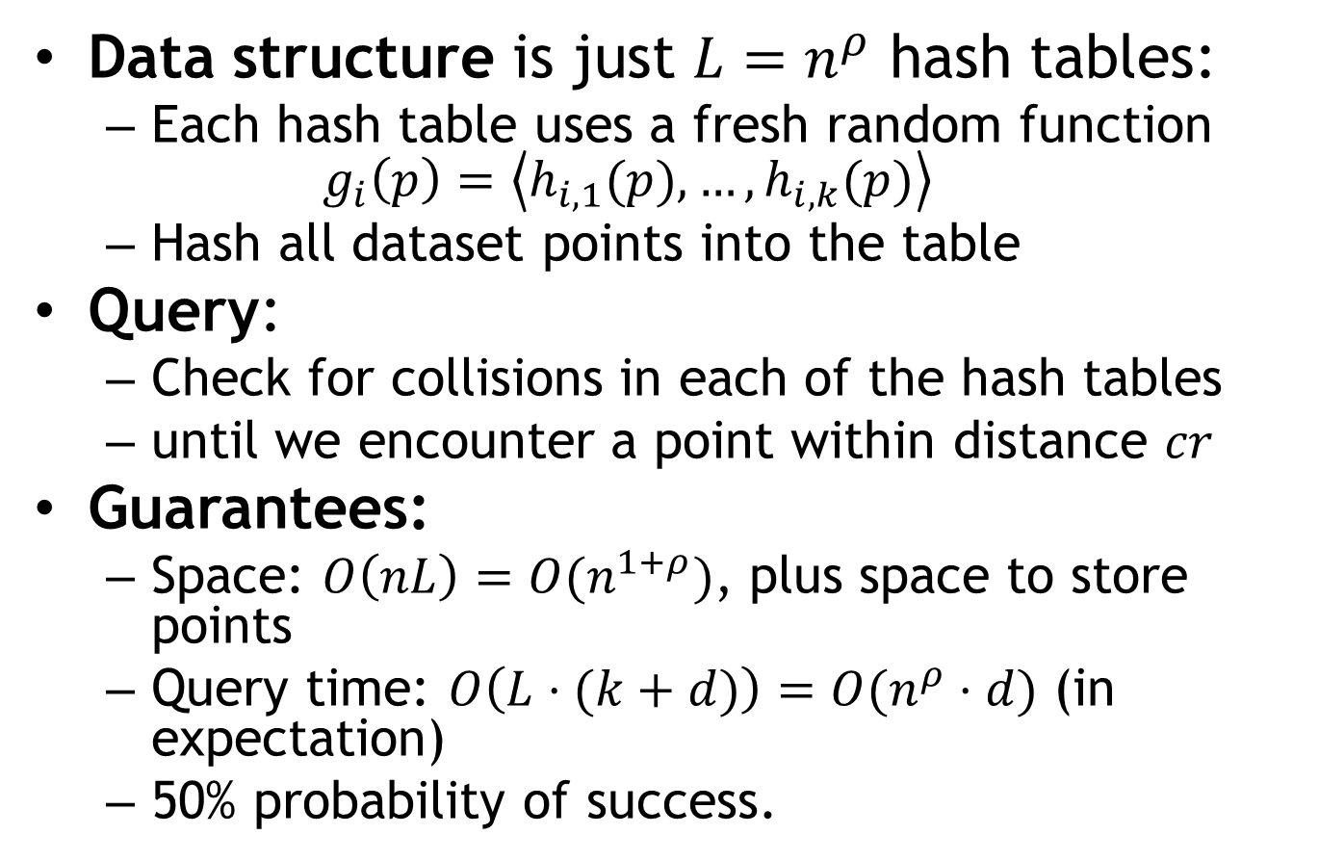
Full Algorithm
Data structure is just $L=n^{ρ}$ hash tables:
  Each hash table uses a fresh random function $g_{i}\left(p\right)=\left\langle h_{i,1}(p),…,h_{i,k}(p)\right\rangle$
  Hash all dataset points into the table
Query:
  Check for collisions in each of the hash tables
  until we encounter a point within distance $cr$
Guarantees:
  Space: $O\left(nL\right)=O(n^{1+ρ})$, plus space to store points
  Query time: $O\left(L⋅(k+d)\right)=O(n^{ρ}⋅d)$ (in expectation)
  50% probability of success.

Slide 8


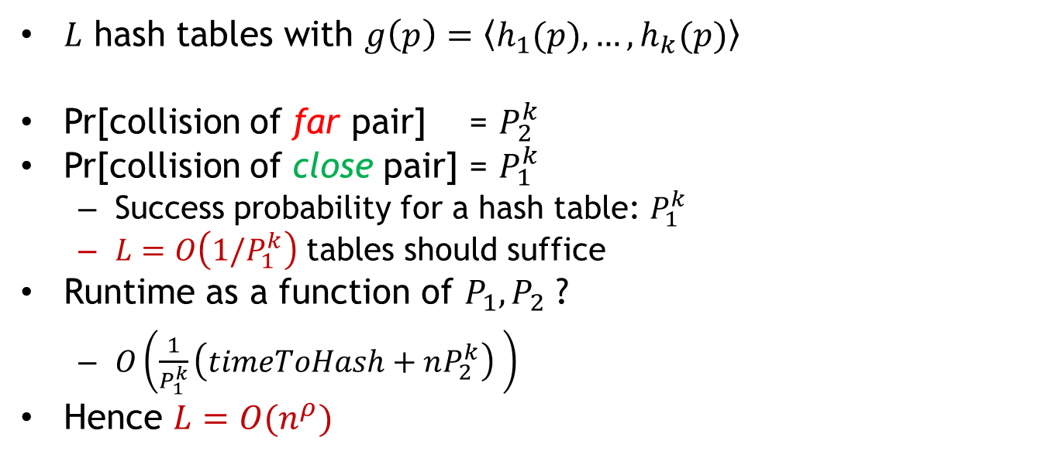









Choice of parameters $k,L$ ?
$L$ hash tables with $g\left(p\right)=\left\langle h_{1}(p),…,h_{k}(p)\right\rangle$
Pr[collision of far pair] = $P_{2}^{k}$
Pr[collision of close pair] = $P_{1}^{k}$
  Success probability for a hash table: $P_{1}^{k}$
  $L=O\left(1/P_{1}^{k}\right)$ tables should suffice
Runtime as a function of $P_{1},P_{2}$ ?
  $O\left(\frac{1}{P_{1}^{k}}\left(timeToHash+nP_{2}^{k}\right) \right)$
Hence $L=O(n^{ρ})$
set $k$ s.t.
$$=1/n$$
$$={\left(P_{2}^{ρ}\right)}^{k}={1/n}^{ρ}$$
$$P_{1}$$
$$P_{1}^{2}$$
$$P_{2}$$
$$k=1$$
$$P_{2}^{2}$$
$$k=2$$
$$r$$
$$cr$$

Slide 9
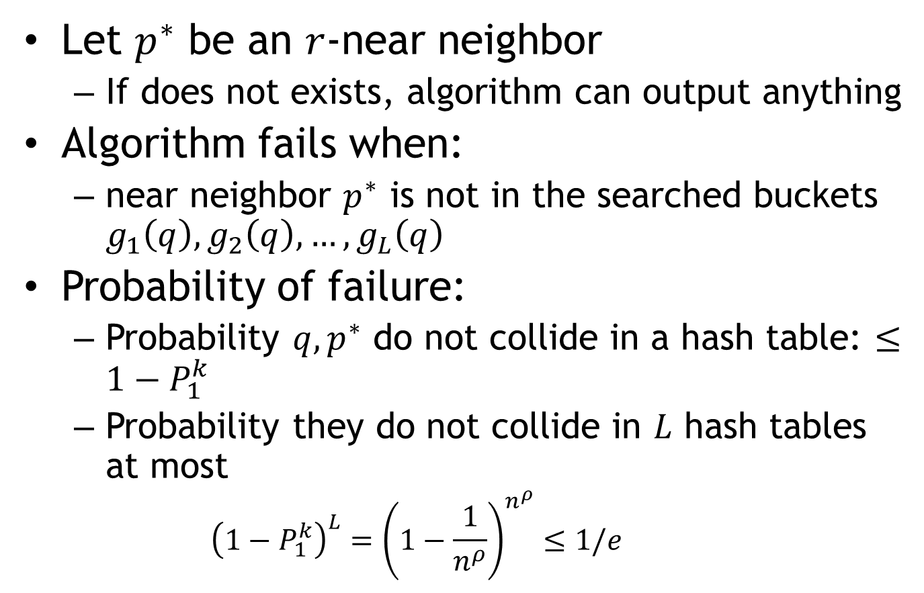
Analysis: correctness
Let $p^{∗}$ be an $r$-near neighbor
  If does not exists, algorithm can output anything
Algorithm fails when:
  near neighbor $p^{∗}$ is not in the searched buckets $g_{1}\left(q\right), g_{2}\left(q\right), …,g_{L}\left(q\right)$
Probability of failure:
  Probability $q,p^{∗}$ do not collide in a hash table: $≤1−P_{1}^{k}$
  Probability they do not collide in $L$ hash tables at most
    $${\left(1−P_{1}^{k}\right)}^{L}={\left(1−\frac{1}{n^{ρ}}\right)}^{n^{ρ}}≤1/e$$

Slide 10
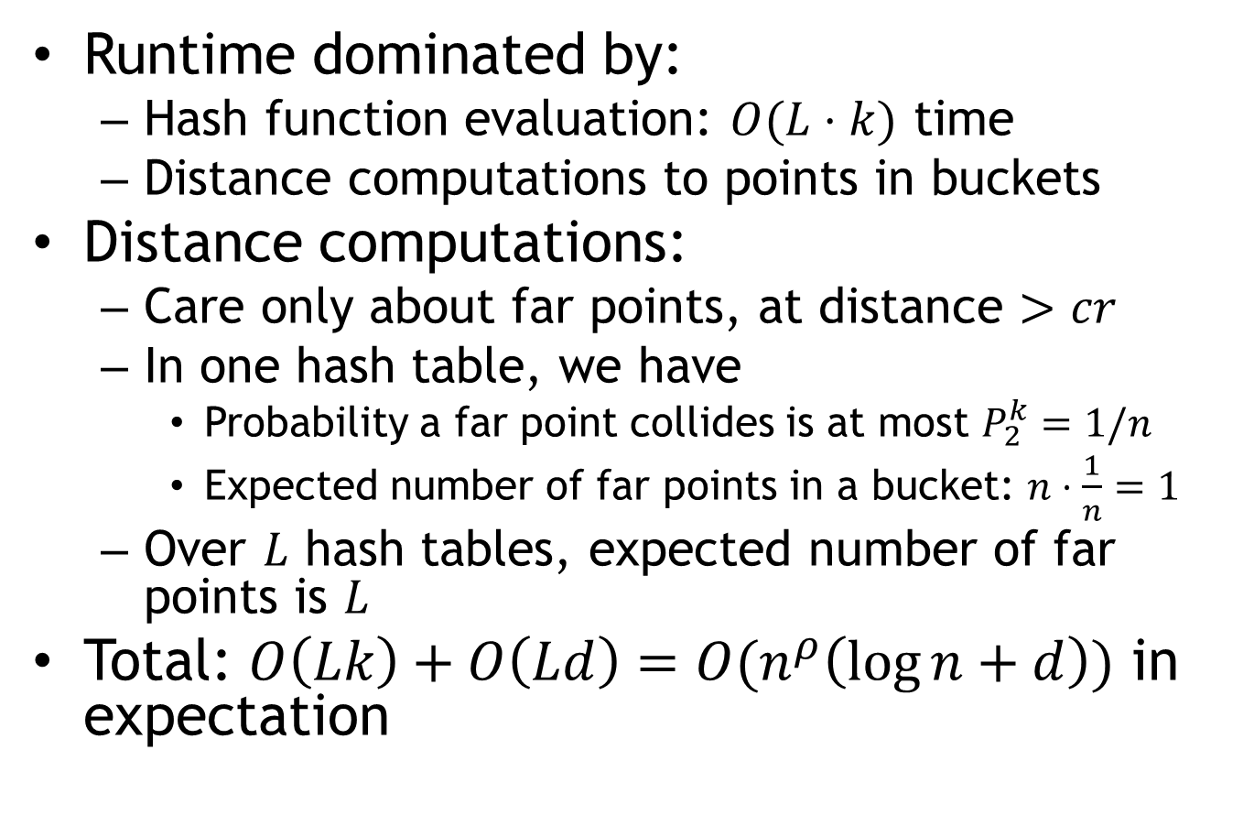
Analysis: Runtime
Runtime dominated by:
  Hash function evaluation: $O(L⋅k)$ time
  Distance computations to points in buckets
Distance computations:
  Care only about far points, at distance $>cr$
  In one hash table, we have
    Probability a far point collides is at most $P_{2}^{k}=1/n$
    Expected number of far points in a bucket: $n⋅\frac{1}{n}=1$
  Over $L$ hash tables, expected number of far points is $L$
Total: $O\left(Lk\right)+O\left(Ld\right)=O(n^{ρ}\left(\log{n}+d\right))$ in expectation

Slide 11
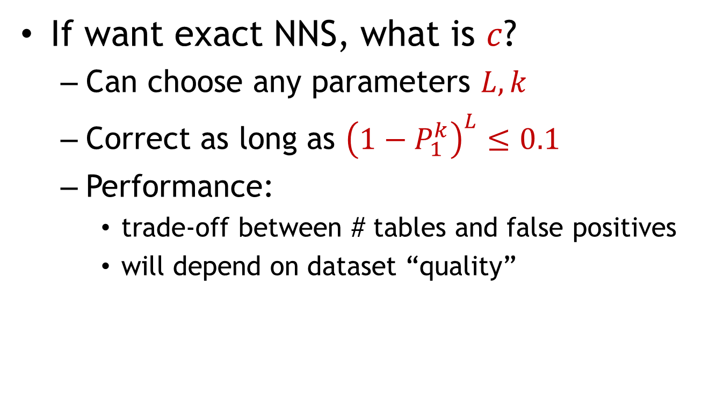

LSH in practice
$$k$$
safety not
guaranteed
If want exact NNS, what is $c$?
  Can choose any parameters $L,k$
  Correct as long as ${\left(1−P_{1}^{k}\right)}^{L}≤0.1$
  Performance:
    trade-off between # tables and false positives
    will depend on dataset “quality”
fewer false
positives
fewer tables
$$L$$

Slide 12
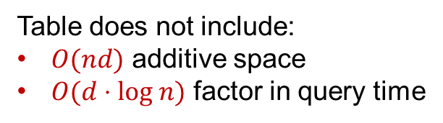
LSH Algorithms
Space | Time | Exponent | $$c=2$$ | Reference
Hamming
space
$$n^{1+ρ}$$ | $$n^{ρ}$$ | $$ρ=1/c$$ | $$ρ=1/2$$ | [IM’98]
 |  | $$ρ≥1/c$$ |  | [MNP’06, OWZ’11]
Euclidean
space
$$n^{1+ρ}$$ | $$n^{ρ}$$ | $$ρ=1/c$$ | $$ρ=1/2$$ | [IM’98, DIIM’04]
 |  | $$ρ≈1/c^{2}$$ | $$ρ=1/4$$ | [AI’06]
 |  | $$ρ≥1/c^{2}$$ |  | [MNP’06, OWZ’11]
Table does not include:
$O(nd)$ additive space
$O(d⋅log n)$ factor in query time
Notes:
Other ways to use LSH

Slide 13
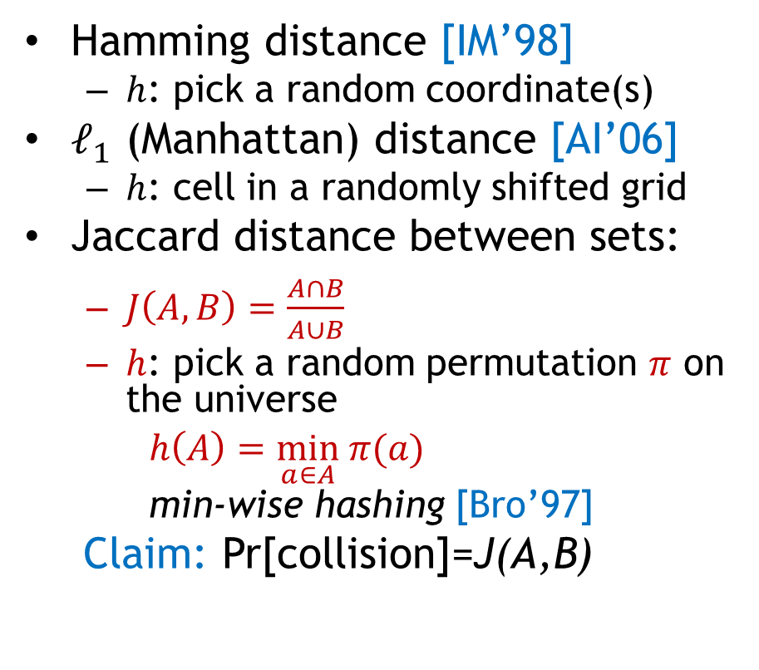

LSH Zoo ($ℓ_{1}$)
To be or not to be
To sketch or not to sketch
Hamming distance [IM’98]
  $h$: pick a random coordinate(s)
$ℓ_{1}$ (Manhattan) distance [AI’06]
  $h$: cell in a randomly shifted grid
Jaccard distance between sets:
  $J\left(A,B\right)=\frac{A∩B}{A∪B}$
  $h$: pick a random permutation $π$ on the universe
  $h\left(A\right)=\min_{a∈A} π(a)$
  min-wise hashing [Bro’97]
Claim: Pr[collision]=J(A,B)
sketch
sketch
not
not
not
not
be
or
to
be
or
to
1
…01111…
…11101…
1
…21102…
…01122…
{be,not,or,to}
{not,or,to,
sketch}
be
to
$π$=be,to,sketch,or,not

Slide 14



LSH for Euclidean distance
[Datar-Immorlica-Indyk-Mirrokni’04]
LSH function $h(p)$:
  pick a random line $ℓ$, and quantize
  project point into $ℓ$
  $h\left(p\right)=\left\lfloor \frac{p⋅ℓ}{w}+b\right\rfloor$
    $ℓ$ is a random Gaussian vector
    $b$ random in $[0,1]$
    $w$ is a parameter (e.g., 4)
Claim: $ρ=1/c$
$$ℓ$$
$$p$$

