Slide 1
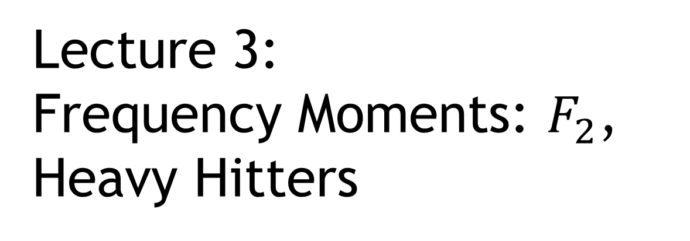
Lecture 3:
Frequency Moments: $F_{2}$,
Heavy Hitters
COMS E6998-9 F15
Notes:
Left to the title, a presenter can insert his/her own image pertinent to the presentation.

Slide 2
Administrivia, Plan
Piazza: sign-up!
PS1 releazed
Scriber?
Plan:
  Frequency Moments
  Heavy Hitters

Slide 3


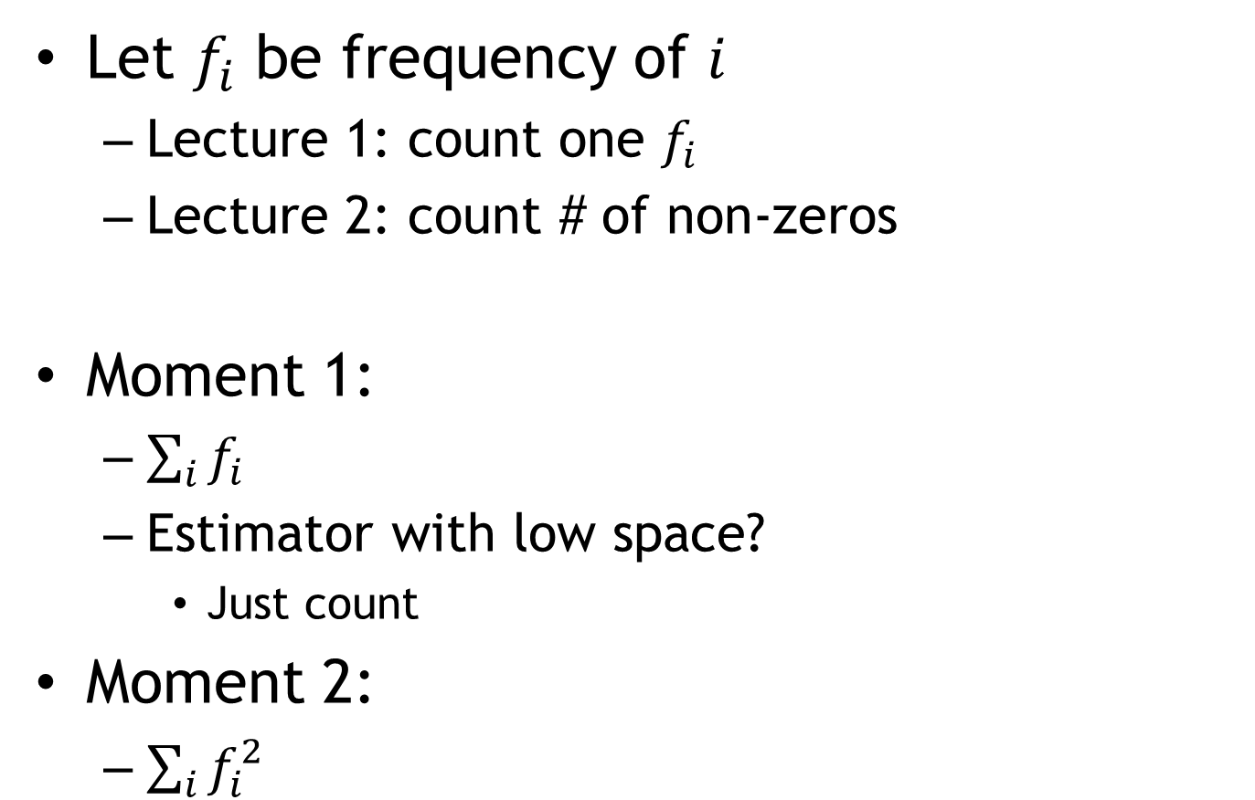

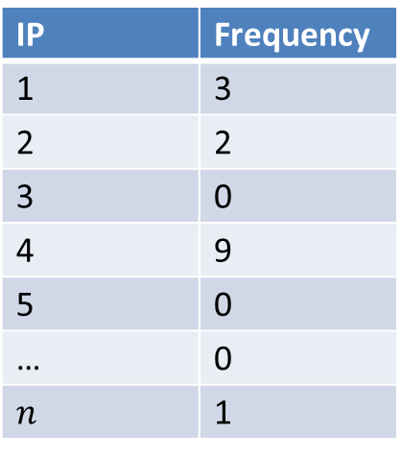
Part 1: Frequency Moments
Let $f_{i}$ be frequency of $i$
  Lecture 1: count one $f_{i}$
  Lecture 2: count # of non-zeros
Moment 1:
  $\sum_{i}{f_{i}}$
  Estimator with low space?
    Just count
Moment 2:
  $\sum_{i}{f_{i}^{2}}$
IP | Frequency
1 | 3
2 | 2
3 | 0
4 | 9
5 | 0
… | 0
$$n$$ | 1
  $$\sum_{i}{f_{i}}=15$$
  $$\sum_{i}{f_{i}^{2}}=95$$

Slide 4
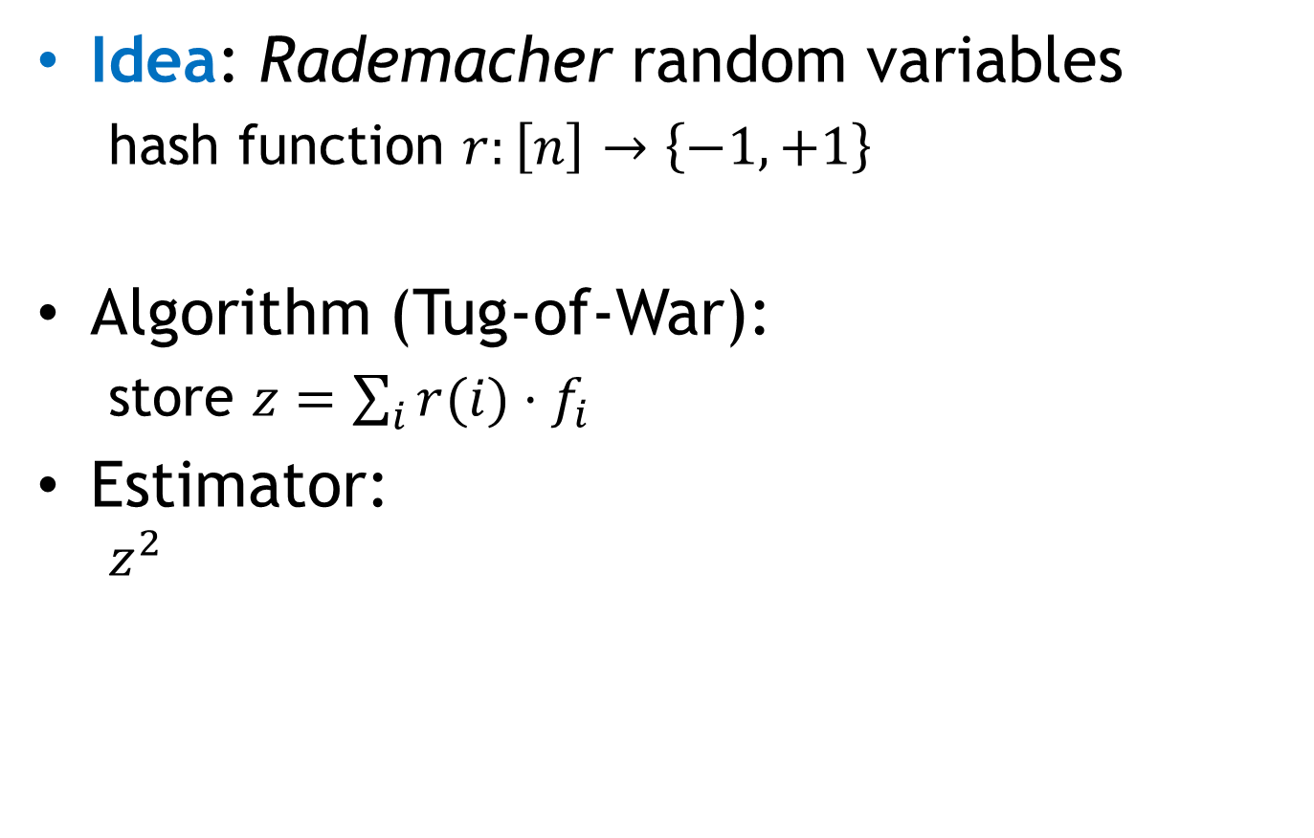


2nd Moment: $F_{2}$
[Alon-Matias-Szegedy 1996]
Idea: Rademacher random variables
  hash function $r:\left[n\right]→\left\{−1,+1\right\}$
Algorithm (Tug-of-War):
  store $z=\sum_{i}{r(i)}⋅f_{i}$
Estimator:
  $$z^{2}$$
Algorithm TOW ($F_{2}$):
Init: $z=0$
when see element $i$:
$z=z+r(i)$
Estimator:
$z^{2}$

Slide 5

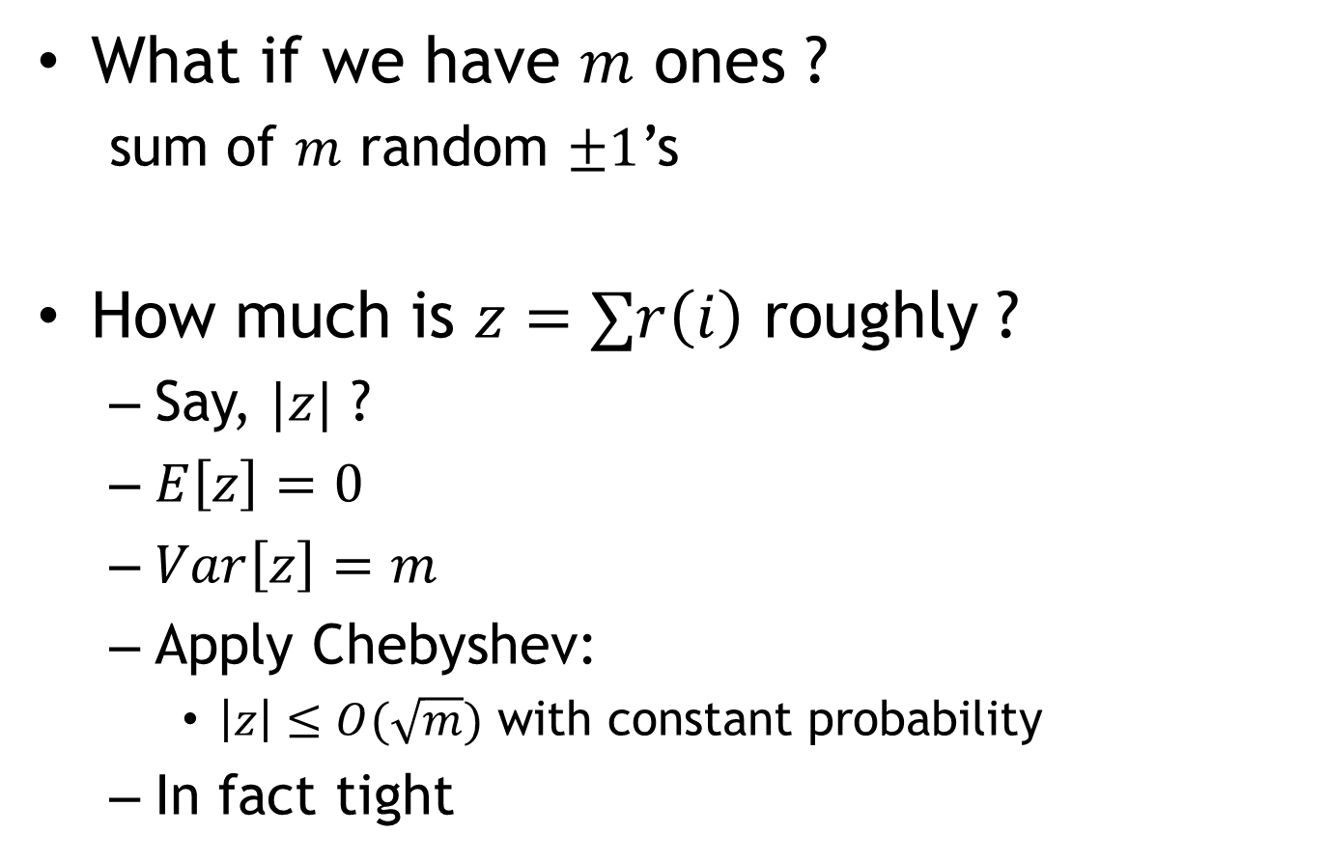
Rademacher r.v.
Algorithm TOW ($F_{2}$):
Init: $z=0$
when see element $i$:
$z=z+r(i)$
Estimator:
$z^{2}$
What if we have $m$ ones ?
  sum of $m$ random $±1$’s
How much is $z=∑r\left(i\right)$ roughly ?
  Say, $|z|$ ?
  $E\left[z\right]=0$
  $Var\left[z\right]=m$
  Apply Chebyshev:
    $\left|z\right|≤O(\sqrt{m})$ with constant probability
  In fact tight

Slide 6
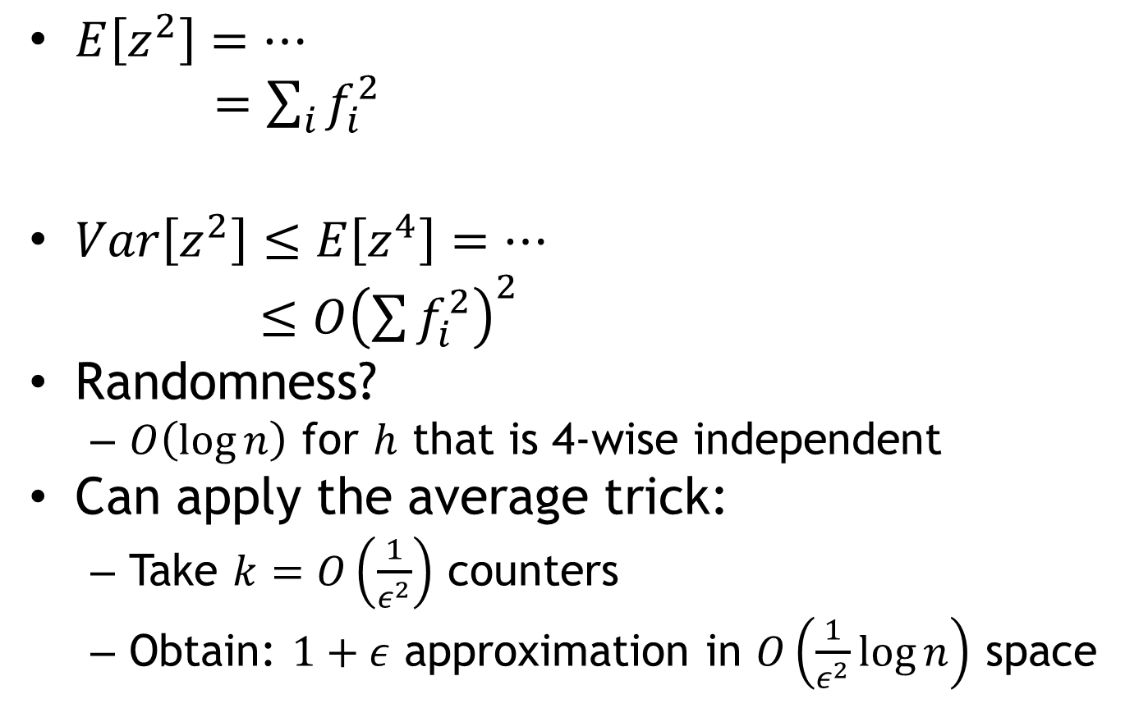
Analysis
Algorithm TOW ($F_{2}$):
Init: $z=0$
when see element $i$:
$z=z+r(i)$
Estimator:
$z^{2}$
$E\left[z^{2}\right]=…$
$=\sum_{i}{f_{i}^{2}}$
$Var\left[z^{2}\right]≤E\left[z^{4}\right]=…$
$≤O{\left(\sum{f_{i}^{2}}\right)}^{2}$
Randomness?
  $O\left(\log{n}\right)$ for $h$ that is 4-wise independent
Can apply the average trick:
  Take $k=O\left(\frac{1}{ε^{2}}\right)$ counters
  Obtain: $1+ε$ approximation in $O\left(\frac{1}{ε^{2}}\log{n}\right)$ space

Slide 7





Linearity
Algorithm TOW ($F_{2}$):
Init: $z=0$
when see element $i$:
$z=z+r(i)$
Estimator:
$z^{2}$
Important property
$$f′$$
$$f′′$$
$$z′$$
$$z′′$$
${z=z}^{′}+z′′$ (for ${f=f}^{′}+f′′$)

Slide 8



Similarly for difference!
Estimate for $∑{\left(f_{i}^{′}−f_{i}^{′′}\right)}^{2}$
  ${\left(z^{′}−z^{′′}\right)}^{2}$
How about $∑|f_{i}^{′}−f_{i}^{′′}|$ ?
  will see later in the class
IP | Frequency
131.107.65.14 | 1
18.9.22.69 | 1
35.8.10.140 | 1
IP | Frequency
131.107.65.14 | 1
18.9.22.69 | 2
$$z′$$
$$z′′$$

Slide 9
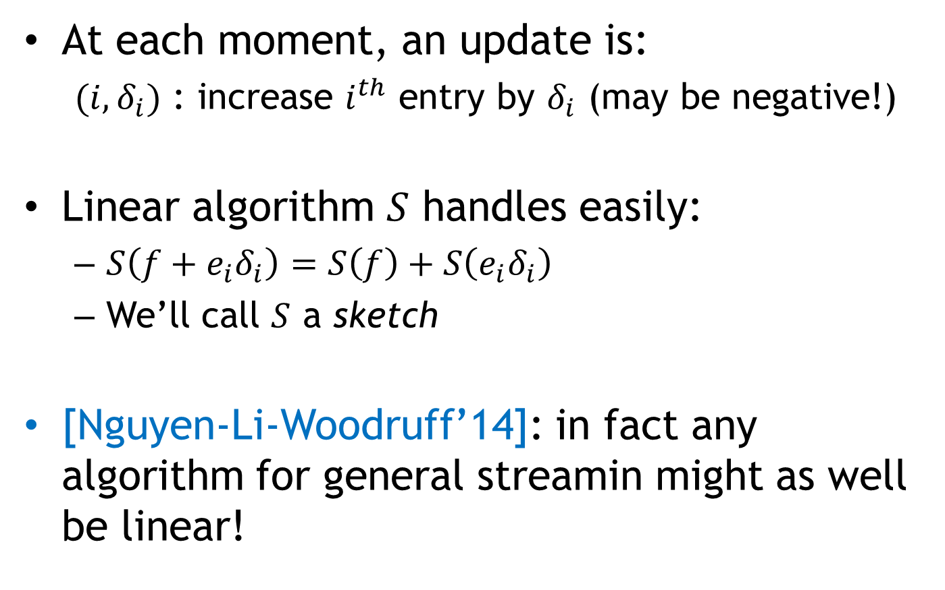
General streaming model
At each moment, an update is:
  ${(i,δ}_{i})$ : increase $i^{th}$ entry by $δ_{i}$ (may be negative!)
Linear algorithm $S$ handles easily:
  $S\left(f+e_{i}δ_{i}\right)=S\left(f\right)+S\left(e_{i}δ_{i}\right)$
  We’ll call $S$ a sketch
[Nguyen-Li-Woodruff’14]: in fact any algorithm for general streamin might as well be linear!

Slide 10
Part 2: Heavy Hitters
How about max frequency?
Impossible to approximate in
sublinear space!
Will settle for an even more
modest goal:
  can detect the max-frequency element if it is very heavy
IP | Frequency
1 | 3
2 | 2
3 | 0
4 | 9
5 | 0
… | 0
$$n$$ | 1

Slide 11



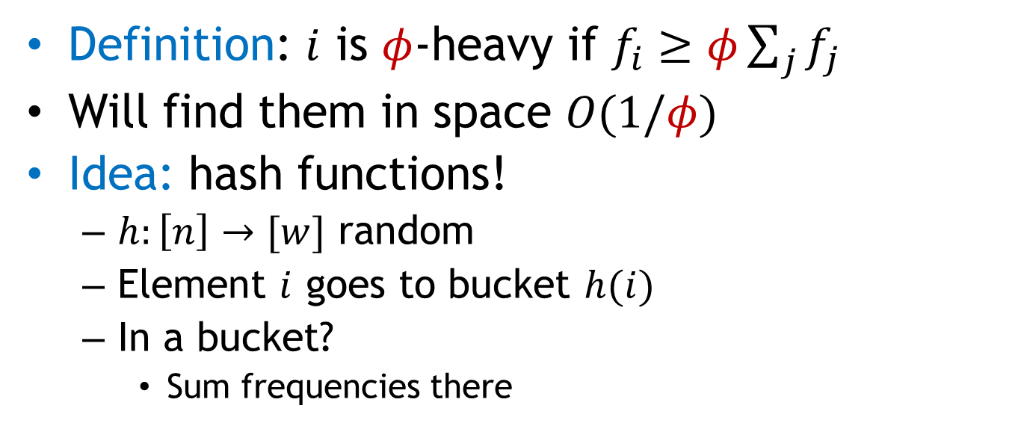
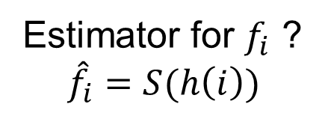





Heavy Hitters: Iteration 1
[Charikar-Chen-FarachColton’04, Cormode-Muthukrishnan’05]
Definition: $i$ is $φ$-heavy if $f_{i}≥φ\sum_{j}{f_{j}}$
Will find them in space $O(1/φ)$
Idea: hash functions!
  $h:\left[n\right]→[w]$ random
  Element $i$ goes to bucket $h(i)$
  In a bucket?
    Sum frequencies there
$$w=O(1/φ)$$
Estimator for $f_{i}$ ?
$${\hat{f}}_{i}=S(h\left(i\right))$$
2
5
7
5
5
11
$$S$$
$$h_{1}(2)$$
$$\hat{f_{2}}=2$$
 | 1
1 | 1
1 | 2
2 | 2
3 | 2
$$\hat{f_{5}}=3$$
$$\hat{f_{7}}=2$$
$$w$$
$$\hat{f_{11}}=2$$

Slide 12
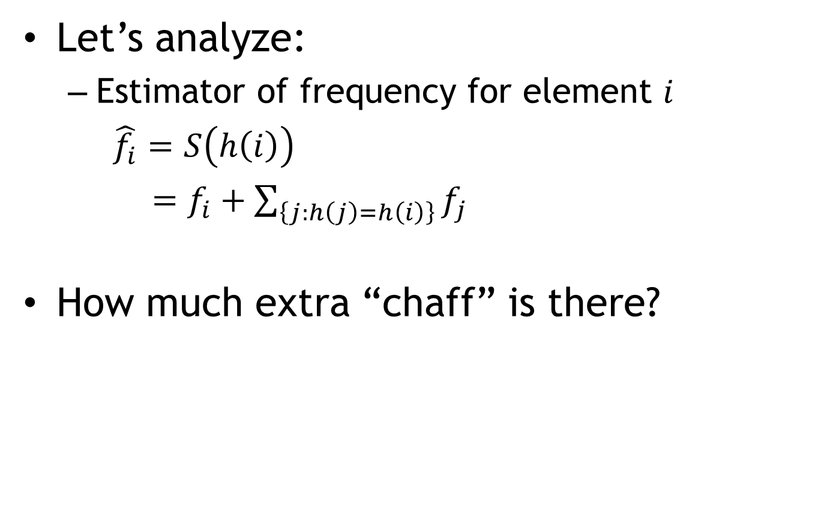
Iteration 1: analysis
Let’s analyze:
  Estimator of frequency for element $i$
  $\hat{f_{i}}=S\left(h\left(i\right)\right)$
  $=f_{i}+\sum_{\left\{j:h\left(j\right)=h\left(i\right)\right\}}{f_{j}}$
How much extra “chaff” is there?
Extra “chaff”
2
7
5
$$S$$
 | 1
1 | 1
1 | 2
2 | 2
3 | 2
$$w$$

Slide 13

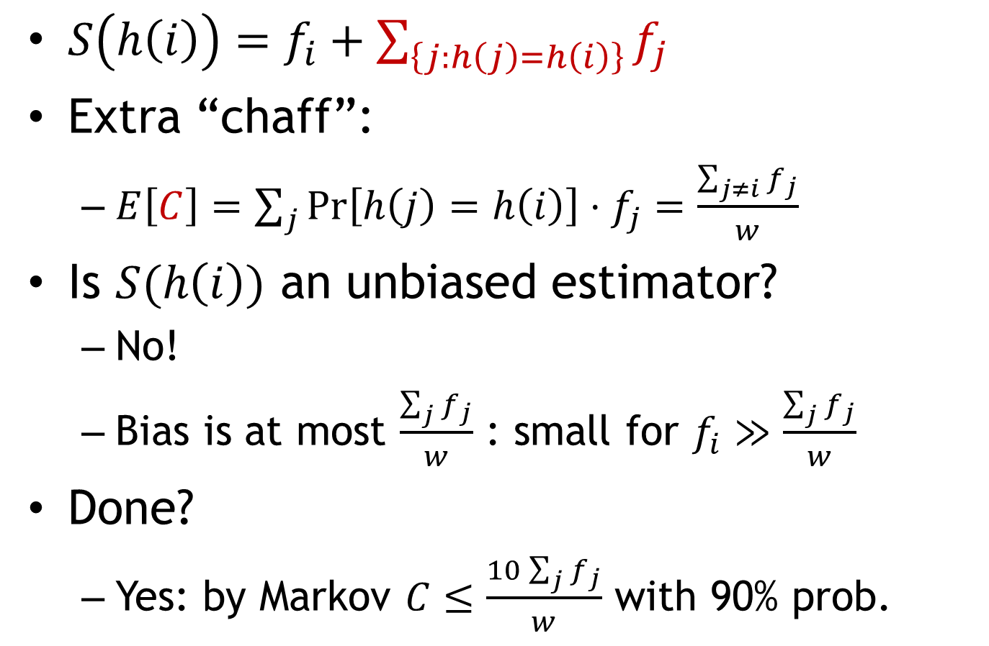
Iteration 1: extra chaff
$S\left(h\left(i\right)\right)=f_{i}+\sum_{\left\{j:h\left(j\right)=h\left(i\right)\right\}}{f_{j}}$
Extra “chaff”:
  $E\left[C\right]=\sum_{j}{\operatorname{Pr}\left[h\left(j\right)=h\left(i\right)\right]⋅f_{j}}=\frac{\sum_{j≠i}{f_{j}}}{w}$
Is $S(h\left(i\right))$ an unbiased estimator?
  No!
  Bias is at most $\frac{\sum_{j}{f_{j}}}{w}$ : small for $f_{i}≫\frac{\sum_{j}{f_{j}}}{w}$
Done?
  Yes: by Markov $C≤\frac{10\sum_{j}{f_{j}}}{w}$ with 90% prob.
$$C$$

Slide 14
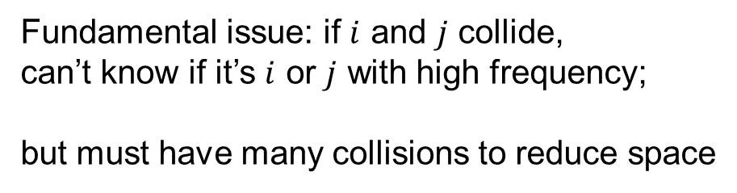
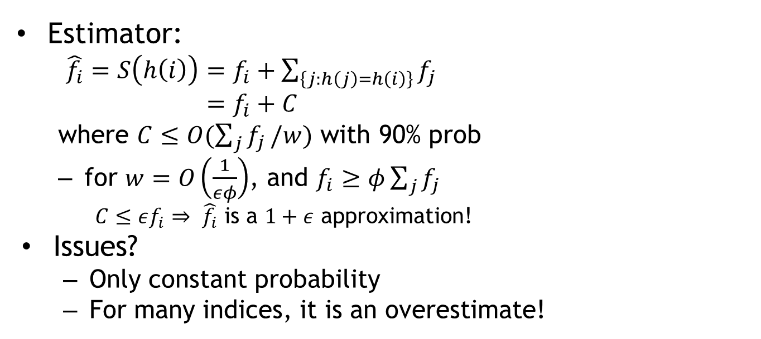
Iteration 1: really done?
Estimator:
  $\hat{f_{i}}=S\left(h\left(i\right)\right)=f_{i}+\sum_{\left\{j:h\left(j\right)=h\left(i\right)\right\}}{f_{j}}$
  $=f_{i}+C$
  where $C≤O(\sum_{j}{f_{j}}/w)$ with 90% prob
  for $w=O\left(\frac{1}{εφ}\right)$, and $f_{i}≥φ\sum_{j}{f_{j}}$
    $C≤εf_{i}$ $⇒$ $\hat{f_{i}}$ is a $1+ε$ approximation!
Issues?
  Only constant probability
  For many indices, it is an overestimate!
2
7
5
Fundamental issue: if $i$ and $j$ collide,
can’t know if it’s $i$ or $j$ with high frequency;
but must have many collisions to reduce space
$$S$$
 | 1
1 | 1
1 | 2
2 | 2
3 | 2
$$w$$

Slide 15



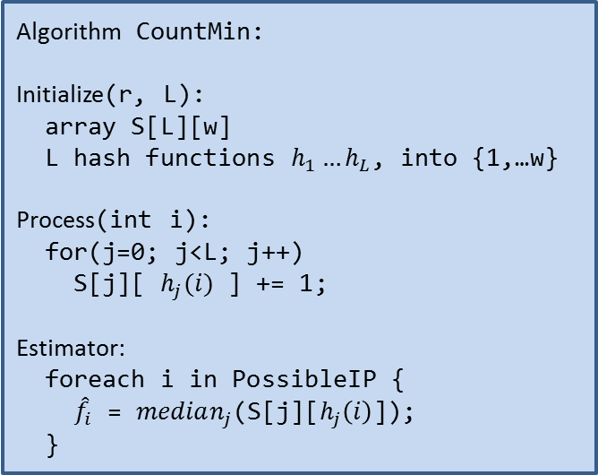
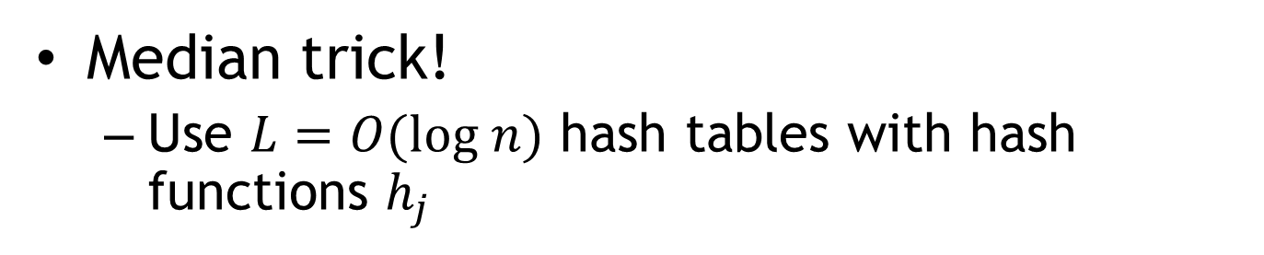






Iteration 2: CountMin
Median trick!
  Use $L=O(log n)$ hash tables with hash functions $h_{j}$
2
5
7
5
5
11
Algorithm CountMin:
Initialize(r, L):
array S[L][w]
L hash functions $h_{1}…h_{L}$, into {1,…w}
Process(int i):
for(j=0; j<L; j++)
S[j][ $h_{j}(i)$ ] += 1;
Estimator:
foreach i in PossibleIP {
${\hat{f}}_{i}$ = $median_{j}$(S[j][$h_{j}\left(i\right)$]);
}
$$h_{3}\left(2\right)$$
$$h_{1}(2)$$
$$h_{2}(2)$$
 | 1
 |  |  | 1
1
1 | 1
 |  |  | 2
1 | 1
1 | 2
 | 1 |  | 2
1 | 1 | 1
2 | 2
 | 1 |  | 3
1 | 2 | 1
3 | 2
 | 1 |  | 4
1 | 3 | 1
$$L$$
$$w$$
$$\hat{f_{2}}=2$$
$$\hat{f_{5}}=3$$
$$\hat{f_{7}}=1$$
$$\hat{f_{11}}=2$$

Slide 16
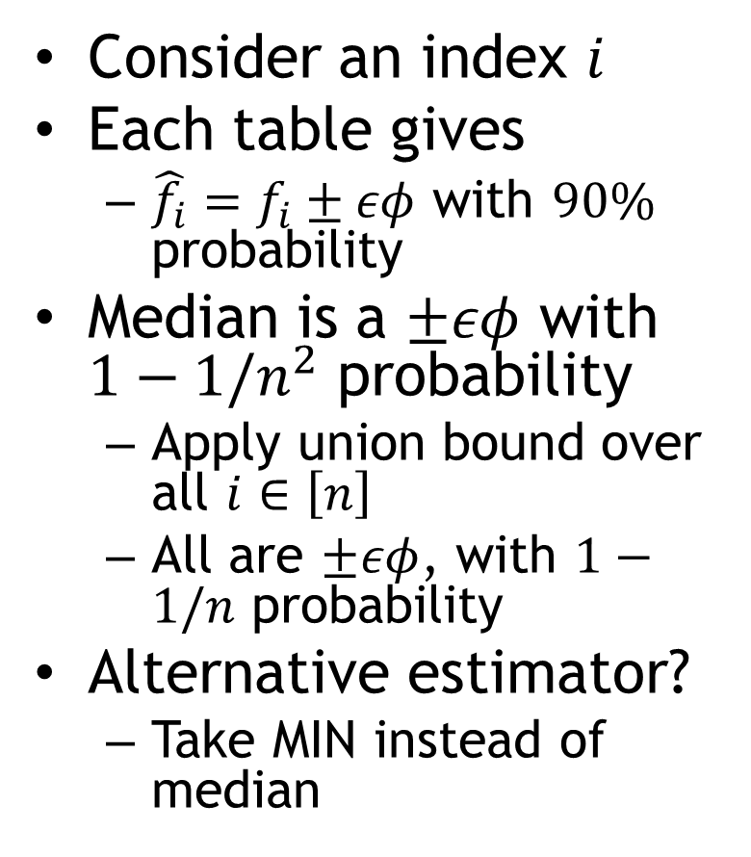
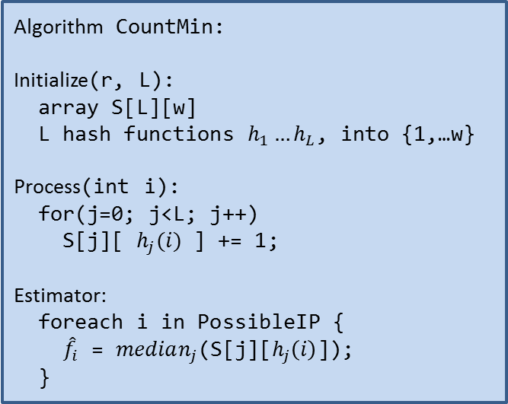
CountMin: analysis
Consider an index $i$
Each table gives
  $\hat{f_{i}}=f_{i}±εφ$ with $90\%$ probability
Median is a $±εφ$ with $1−1/n^{2}$ probability
  Apply union bound over all $i∈\left[n\right]$
  All are $±εφ$, with $1−1/n$ probability
Alternative estimator?
  Take MIN instead of median
Algorithm CountMin:
Initialize(r, L):
array S[L][w]
L hash functions $h_{1}…h_{L}$, into {1,…w}
Process(int i):
for(j=0; j<L; j++)
S[j][ $h_{j}(i)$ ] += 1;
Estimator:
foreach i in PossibleIP {
${\hat{f}}_{i}$ = $median_{j}$(S[j][$h_{j}\left(i\right)$]);
}
min

Slide 17
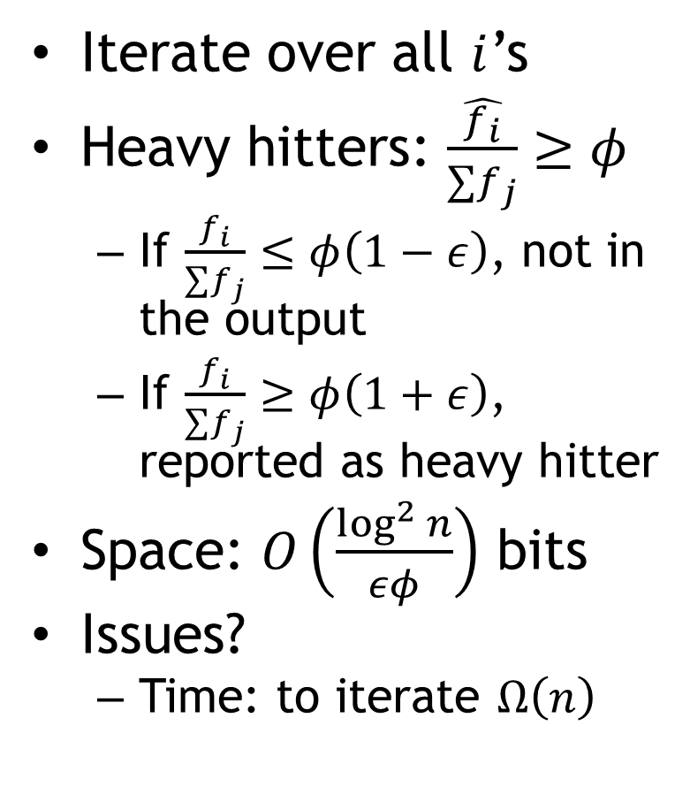
CountMin: overall
Iterate over all $i$’s
Heavy hitters: $\frac{\hat{f_{i}}}{∑f_{j}}≥φ$
  If $\frac{f_{i}}{∑f_{j}}≤φ\left(1−ε\right)$, not in the output
  If $\frac{f_{i}}{∑f_{j}}≥φ\left(1+ε\right)$, reported as heavy hitter
Space: $O\left(\frac{\log^{2}{n}}{εφ}\right)$ bits
Issues?
  Time: to iterate $Ω\left(n\right)$
Algorithm CountMin:
Initialize(r, L):
array S[L][w]
L hash functions $h_{1}…h_{L}$, into {1,…w}
Process(int i):
for(j=0; j<L; j++)
S[j][ $h_{j}(i)$ ] += 1;
Estimator:
foreach i in PossibleIP {
${\hat{f}}_{i}$ = $median_{j}$(S[j][$h_{j}\left(i\right)$]);
}
min

Slide 18



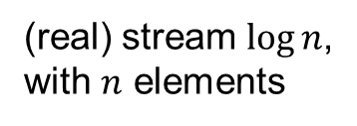

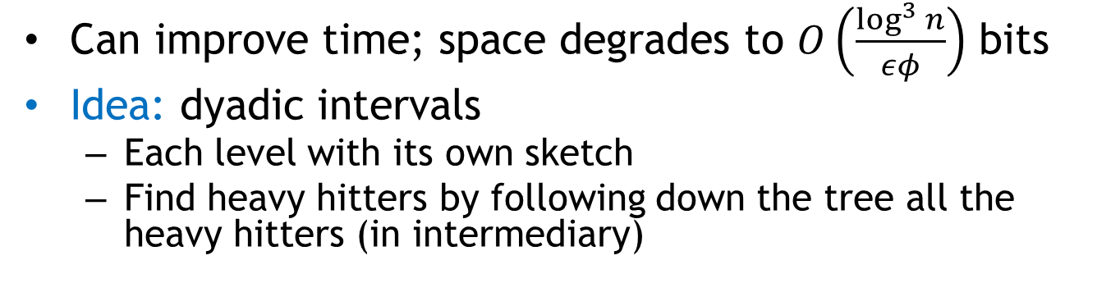
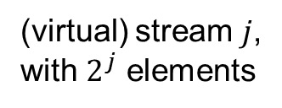

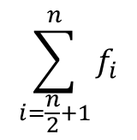

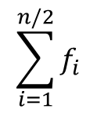

CountMin: time
Can improve time; space degrades to $O\left(\frac{\log^{3}{n}}{εφ}\right)$ bits
Idea: dyadic intervals
  Each level with its own sketch
  Find heavy hitters by following down the tree all the heavy hitters (in intermediary)
$$\sum_{i=1}^{n}{f_{i}}$$
(virtual) stream 1,
with 1 element
$$\sum_{i=1}^{n/2}{f_{i}}$$
$$\sum_{i=\frac{n}{2}+1}^{n}{f_{i}}$$
(virtual) stream 2,
with 2 elements
…
(virtual) stream $j$,
with $2^{j}$ elements
(real) stream $\log{n}$,
with $n$ elements
$$f_{1}$$
$$f_{2}$$
$$f_{3}$$
$$f_{i}$$
$$f_{n}$$

Slide 19
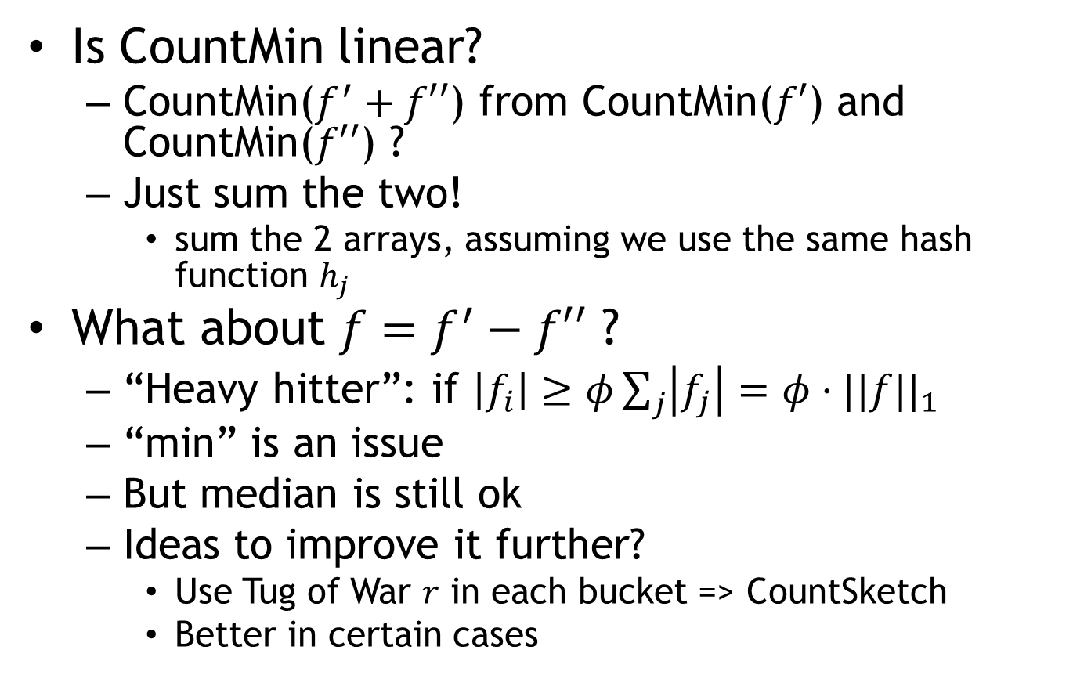
A variant: CountSketch
Is CountMin linear?
  CountMin($f^{′}+f′′$) from CountMin($f′$) and CountMin($f′′$) ?
  Just sum the two!
    sum the 2 arrays, assuming we use the same hash function $h_{j}$
What about $f=f^{′}−f′′$ ?
  “Heavy hitter”: if $\left|f_{i}\right|≥φ\sum_{j}{\left|f_{j}\right|}=φ⋅||f||_{1}$
  “min” is an issue
  But median is still ok
  Ideas to improve it further?
    Use Tug of War $r$ in each bucket => CountSketch
    Better in certain cases

Slide 20
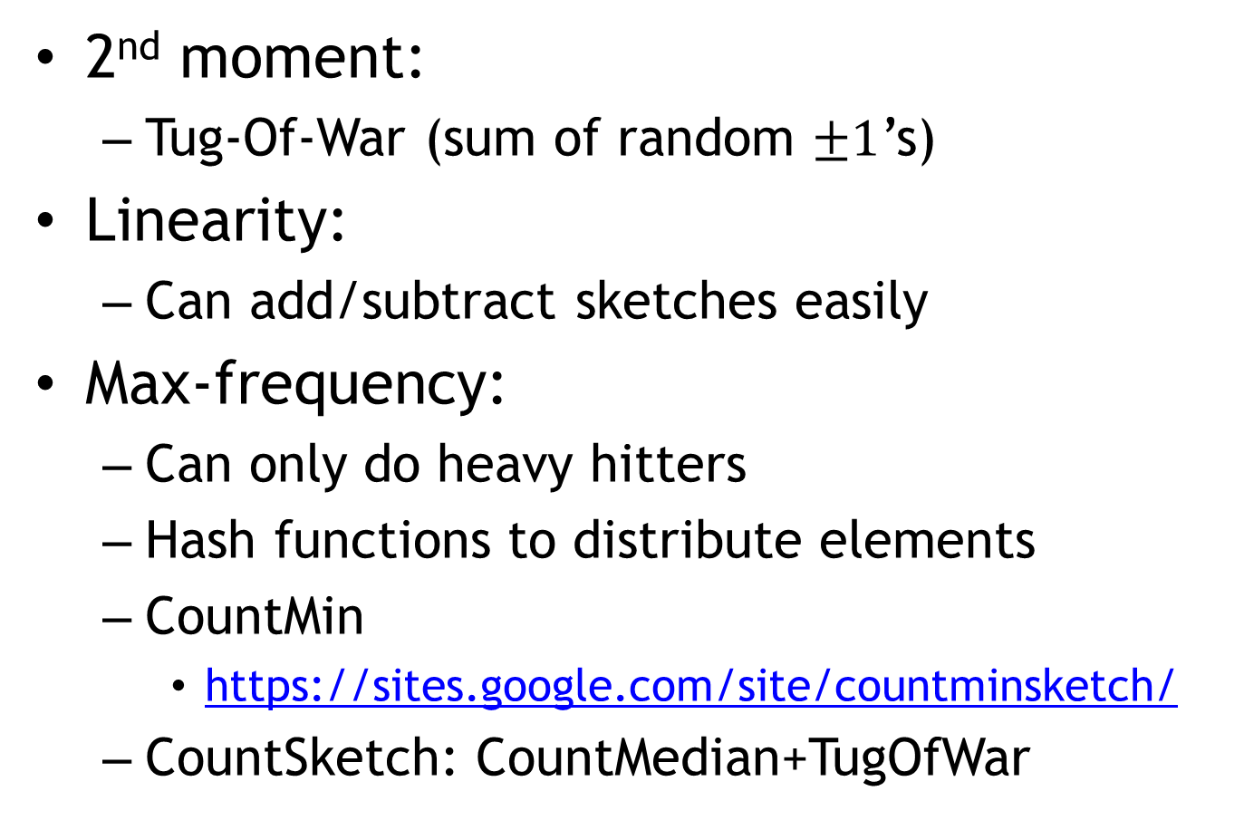
Recap
2nd moment:
  Tug-Of-War (sum of random $±1$’s)
Linearity:
  Can add/subtract sketches easily
Max-frequency:
  Can only do heavy hitters
  Hash functions to distribute elements
  CountMin
    https://sites.google.com/site/countminsketch/
  CountSketch: CountMedian+TugOfWar

