Slide 1
Lecture 22: Linearity Testing Sparse Fourier Transform
COMS E6998-9 F15
Notes:
Left to the title, a presenter can insert his/her own image pertinent to the presentation.

Slide 2
Administrivia, Plan
Thu: no class. Happy Thanksgiving!
Tue, Dec 1st:
Sergei Vassilvitskii (Google Research) on MapReduce model and algorithms
I’m away until next Thu, Dec 3rd
Office hours: Tue 2:30-4:30, Wed 4-6pm
Plan:
Linearity Testing (finish)
Sparse Fourier Transform

Slide 3
Last lecture
Linearity Testing:
$f:{\left\{−1,+1\right\}}^{n}$ is linear iff for any $x,y∈{\left\{−1,+1\right\}}^{n}$, we have:
$f\left(x\right)⋅f\left(y\right)=f(x⊕y)$
Test: repeat $O(1/ε)$ times
Pick random $x,y$
Verify that $f\left(x\right)⋅f\left(y\right)=f(x⊕y)$
Main Theorem:
If $f$ is $ε$-far from linearity, then $Pr\left[test fails\right]≥ε$

Slide 4
Linearity Testing
Remaining Lemma:
Let $T_{xy}=1$ iff $f\left(x\right)⋅f\left(y\right)=f(x⊕y)$
$\operatorname{Pr}\left[T_{xy}=1\right]=\frac{1}{2}+\frac{1}{2}\sum_{S⊆[n]}{{\hat{f}}_{S}^{3}}$
Where ${\hat{f}}_{S}=〈f,χ_{S}〉$ for $χ_{S}\left(x\right)=\prod_{i∈S}{x_{i}}$

Slide 5
Discrete Fourier Transform
${\hat{x}}_{i}=\frac{1}{n}\sum_{j∈[n]}{x_{j}ω^{−ij}}$,
$ω=e^{−2πi/n}$ ($n^{th}$ root of unity)
$x_{i}=\sum_{j∈\left[n\right]}{{\hat{x}}_{j}}ω^{ij}$
Consider
$f:\left[n\right]→ℜ$
also special case of more general setting:
$f:{\left[n\right]}^{d}→ℜ$
Will call such function: $x=(x_{1},…x_{n})$
Fourier transform:
${\hat{x}}_{i}=\frac{1}{n}\sum_{j∈[n]}{x_{j}ω^{−ij}}$,
where $ω=e^{−2πi/n}$ is the $n^{th}$ root of unity
$x_{i}=\sum_{j∈\left[n\right]}{{\hat{x}}_{j}}ω^{ij}$
Assume: $n$ is power of 2

Slide 6
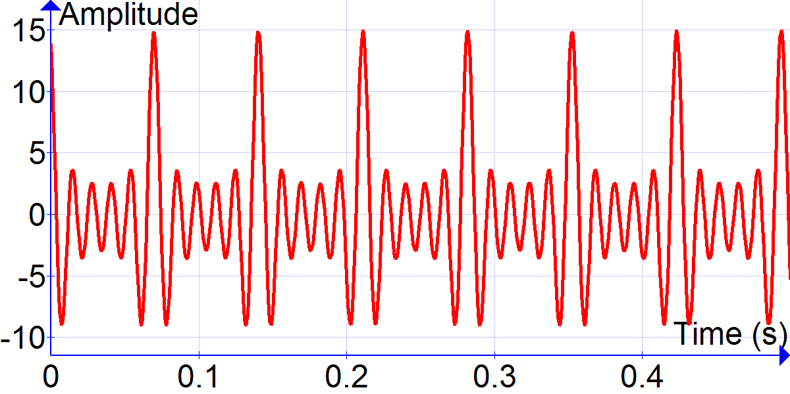
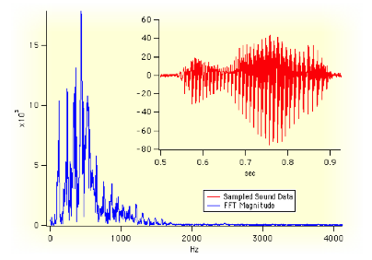
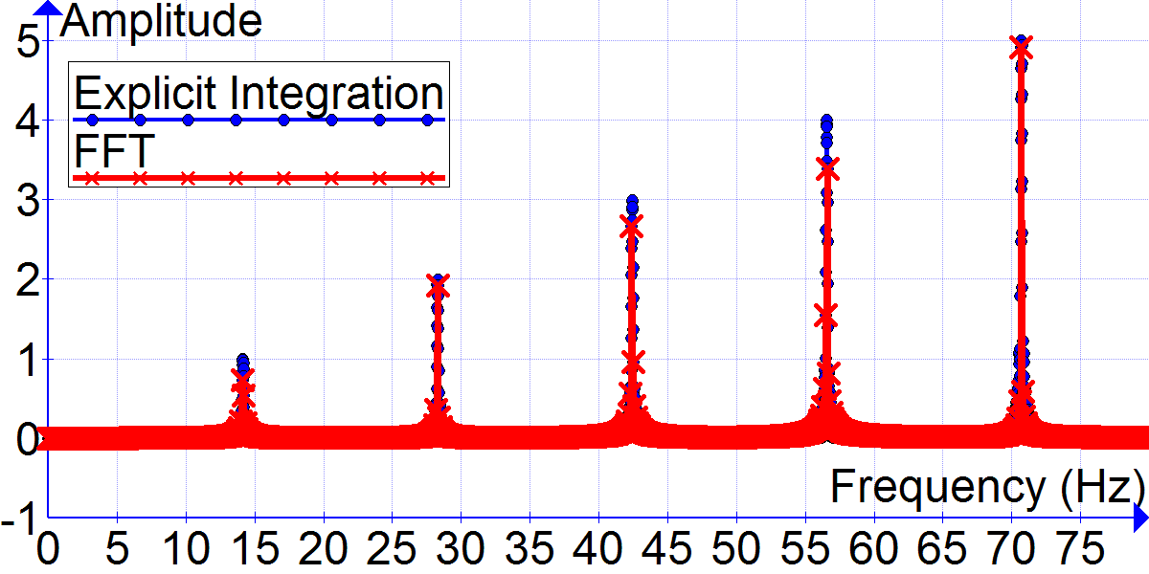
Why important?
${\hat{x}}_{i}=\frac{1}{n}\sum_{j∈[n]}{x_{j}ω^{−ij}}$,
$ω=e^{−2πi/n}$ ($n^{th}$ root of unity)
$x_{i}=\sum_{j∈\left[n\right]}{{\hat{x}}_{j}}ω^{ij}$
Imaging
MRI, NMR
Compression:
JPEG: retain only high Fourier coefficients
Signal processing
Data analysis
…

Slide 7
Computing
${\hat{x}}_{i}=\frac{1}{n}\sum_{j∈[n]}{x_{j}ω^{−ij}}$,
$ω=e^{−2πi/n}$ ($n^{th}$ root of unity)
$x_{i}=\sum_{j∈\left[n\right]}{{\hat{x}}_{j}}ω^{ij}$
Naively:
$O(n^{2})$
Fast Fourier Transform:
$O\left(n\log{n}\right)$ time
[Cooley-Tukey 1964]
[Gauss 1805]
One of the biggest open questions in CS:
Can we do in $O(n)$ time?

Slide 8
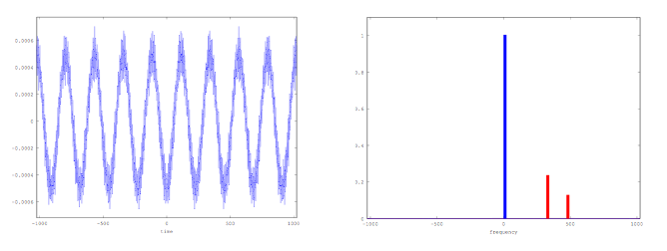
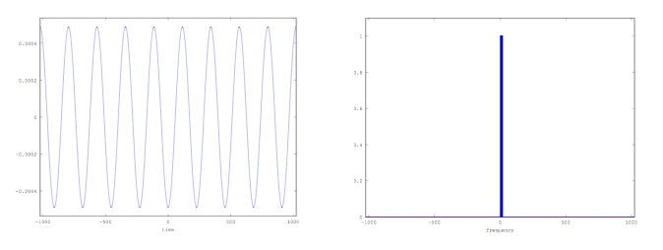
Sparse Fourier Transform
${\hat{x}}_{i}=\frac{1}{n}\sum_{j∈[n]}{x_{j}ω^{−ij}}$,
$ω=e^{−2πi/n}$ ($n^{th}$ root of unity)
$x_{i}=\sum_{j∈\left[n\right]}{{\hat{x}}_{j}}ω^{ij}$
Many signals represented
well by sparse Fourier transform
If $\hat{x}$ is sparse,
Can we do better?
YES!
$O(k⋅\log^{2}n)$ time possible, assuming $k$ non-zero Fourier coefficients!
Sublinear time: just sample a few positions in $x$
Even when $\hat{x}$ is approximately sparse

Slide 9
Similar to Compressed Sensing
${\hat{x}}_{i}=\frac{1}{n}\sum_{j∈[n]}{x_{j}ω^{−ij}}$,
$ω=e^{−2πi/n}$ ($n^{th}$ root of unity)
$x_{i}=\sum_{j∈\left[n\right]}{{\hat{x}}_{j}}ω^{ij}$
Sparse Fourier Transform
Sparse: $\hat{x}=Fx$
Access: $x=F^{−1}\hat{x}$ of dimension $n$
$F,\hat{F}$ = concrete matrix
Compressed Sensing
Sparse: $x∈ℜ^{n}$
Access: $y=Ax∈ℜ^{m}$, where $m=O\left(k\log{n}\right)$
$A$ is usually designed (though sometimes: random rows of the Fourier matrix)

Slide 10
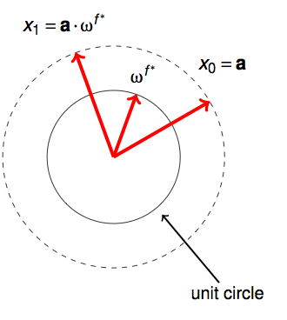
Warm-up: $k=1$
${\hat{x}}_{i}=\frac{1}{n}\sum_{j∈[n]}{x_{j}ω^{−ij}}$,
$ω=e^{−2πi/n}$ ($n^{th}$ root of unity)
$x_{i}=\sum_{j∈\left[n\right]}{{\hat{x}}_{j}}ω^{ij}$
Assume $\hat{x}$ is exactly 1-sp.
${\hat{x}}_{f}≠0$
Problem:
How many queries into $x$ ?
Algorithm:
Sample $x_{0},x_{1}$
$x_{0}=aω^{0f}=a$
$x_{1}=aω^{f}$
$ω^{f}=x_{1}/x_{0}$
Can read off the frequency $f$

Slide 11
What about noise?
${\hat{x}}_{i}=\frac{1}{n}\sum_{j∈[n]}{x_{j}ω^{−ij}}$,
$ω=e^{−2πi/n}$ ($n^{th}$ root of unity)
$x_{i}=\sum_{j∈\left[n\right]}{{\hat{x}}_{j}}ω^{ij}$
$x_{i}=aω^{if}+noise$
Problem:
Find $y$ s.t. 1-sparse (in Fourier domain)
Best approximation to $x$
$||\hat{x}−\hat{y}||_{2}≤C⋅\min_{\hat{y}: 1−sparse}{||\hat{x}−\hat{y}||}$
$||x−y||_{2}≤C⋅\min_{y: 1−sparse}{||x−y||}$
Will assume “error” is $ε$ fraction:
$\min_{\hat{y}: 1−sparse}{||\hat{x}−\hat{y}||^{2}}=\sum_{j≠f}{|\hat{x_{j}}|^{2}}≤ε^{2}⋅{\hat{x_{f}}}^{2}=ε^{2}a^{2}$
$E_{j}\left[{\left|x_{j}−y_{j}\right|}^{2}\right]≤ε^{2}a^{2}$ (Parserval’s)
Interesting when $ε≪1$
Parseval’s:
$$||\hat{z}||^{2}=\frac{1}{n}||z||^{2}=E_{j}\left[{\left|z_{j}\right|}^{2}\right]$$
Use for $z=x−y$ !

Slide 12
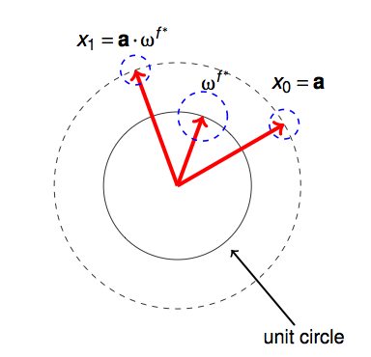
Re-use $k=1$ algorithm?
Suppose: $a=1$
$x_{0}=1+ε$
$x_{1}=ω^{f}+εω^{q}$
So: $\frac{x_{1}}{x_{0}}=\frac{1}{1+ε}(ω^{f}+εω^{q})$
Error in frequency!
Will recover $y=ω^{g}$ for $g≠f$
Thus $||\hat{x}−\hat{y}||≥||{\hat{x}}_{f}||=1$ instead of $O(ε)$…
Good news: error bounded, up to $εn$

Slide 13
Algorithm for $k=1$ + noise
$x_{i}=ω^{if}+noise$
Will find $f$ by binary search!
Bit 0:
$f=2f_{1}+b$ for $b∈\{0,1\}$
Claim: for pure signal $y_{i}=ω^{if}$:
$y_{n/2}=y_{0}⋅{\left(−1\right)}^{b}$
$y_{n/2+r}=y_{r}{\left(−1\right)}^{b}$
Proof:
$y_{n/2}=ω^{f⋅n/2}={\left(−1\right)}^{f}={\left(−1\right)}^{2f_{1}}⋅{\left(−1\right)}^{b}={\left(−1\right)}^{b}y_{0}$
$y_{n/2+r}=ω^{f⋅n/2+fr}={\left(−1\right)}^{f}ω^{fr}={\left(−1\right)}^{b}y_{r}$
What about noise?

Slide 14
Bit 0 with noise
If $b=0$:
$\left|y_{n/2+r}+y_{r}\right|=2$
$\left|y_{n/2+r}−y_{r}\right|=0$
If $b=1$:
$\left|y_{n/2+r}+y_{r}\right|=0$
$\left|y_{n/2+r}−y_{r}\right|=2$
We have:
$x_{i}=ω^{i⋅(2f_{1}+b)}+noise$
$y_{i}=ω^{i⋅(2f_{1}+b)}$
Claim: $y_{n/2+r}=y_{r}{\left(−1\right)}^{b}$
$E_{j}\left[{\left|x_{j}−y_{j}\right|}^{2}≤ε^{2}\right]$ (Parseval’s)
Algorithm:
For $t$ times:
Pick random $r∈[n]$
Check $\left|x_{n/2+r}+x_{r}\right|>|x_{n/2+r}−x_{r}|$ : then $b=0$
Otherwise $b=1$
Take majority vote
Claim: output the right $b$ with $1−2^{−Ω(t)}$ probability
Proof:
Each test:
$x_{n/2+r }, x_{r}$ are within $5ε^{2}$ of $y_{n/2+r},y_{r}$ with probability $1−2⋅1/5$ (Markov)
Hence test works with at least $0.6$ probability
Majority of $t$ tests work with $1−2^{−Ω\left(t\right)}$ probability (Chernoff bound concentration)

Slide 15
Bit 1
Reduce to bit 0 case!
We have
$x_{i}=ω^{i(2f_{1}+b)}+noise$
$y_{i}=ω^{i(2f_{1}+b)}$
Suppose $b=0$:
$y_{i}=ω^{i⋅2f_{1}}={\left(ω^{2}\right)}^{if_{1}}={\left(ω_{n/2}\right)}^{if_{1}}$
where $ω_{n/2}$ is the ${\left(n/2\right)}^{th}$ root of unity
Same problem as for Fourier transform over $[n/2]$ !
Suppose $b=1$ ?
Define $y_{i}^{′}=y_{i}ω^{−i}$
Then $y_{i}^{′}=ω^{if−i}=ω^{i\left(2f_{1}+1−1\right)}=ω^{i⋅\left(2f_{1}\right)}$
Just shifts all frequencies down by one!
Continue as above for $x_{i}^{′}=x_{i}ω^{−i}$
Note: we compute $x_{i}^{′}$ on the fly when whenever we query some $x_{i}$

Slide 16
Overall algorithm to recover $f$
$x_{i}=ω^{if}+noise$
Where $f=b_{0}+b_{1}⋅2^{1}+b_{2}⋅2^{2}+…+b_{\lg{\frac{n}{2}}}⋅\frac{n}{2}$
Algorithm:
Learn $b_{0}$: take majority of $t$ trials of
Pick random $r$
Check: $\left|x_{n/2+r}+x_{r}\right|>|x_{n/2+r}−x_{r}|$
Then set $b_{0}=0$
Learn $b_{1}$: take majority of $t$ trials of
Pick random $r$
Check: $\left|ω^{n/4{⋅b}_{0}}x_{n/4+r}+x_{r}\right|>|ω^{n/4{⋅b}_{0}}x_{n/4+r}−x_{r}|$
Then set $b_{1}=0$
Learn $b_{2}$: take majority of $t$ trials of
Pick random $r$
Check: $\left|ω^{n/8{⋅(b}_{0}+2b_{1})}x_{n/8+r}+x_{r}\right|>|ω^{n/8{⋅(b}_{0}+2b_{1})}x_{n/8+r}−x_{r}|$
Then set $b_{2}=0$
…

Slide 17
Wrap-up of the algorithm $k=1$
Correctness:
We learn $O(log n)$ bits
Each needs to succeed with probability $1−O(1/\log{n})$
Hence set $t=O(\log{\log{n}})$
Overall performance:
Number of samples: $O(\log{n}⋅\log{\log{n}})$
Same run-time

Slide 18
$k>1$
$x_{i}=a_{1}ω^{if_{1}}+a_{2}ω^{if_{2}}+…a_{k}ω^{if_{k}}+noise$
Main ideas:
Isolate each frequency
Like in CountSketch or compressed sensing!
“Throw” frequencies in “buckets”
Hope have 1 frequency per “bucket”
Throw in buckets:
permute the frequencies (pseudo-)randomly
Can have frequencies go as $i→ai+b$ for random $a,b$
partition in blocks: $\left[1,\frac{n}{k}\right], \left[\frac{n}{k}+1,\frac{2n}{k}\right],…$
Apply a filter that keeps only the correct block

