Slide 1
Algorithmic Techniques for Massive Data (COMS 6998-9)
Alex Andoni
Notes:
Left to the title, a presenter can insert his/her own image pertinent to the presentation.

Slide 2

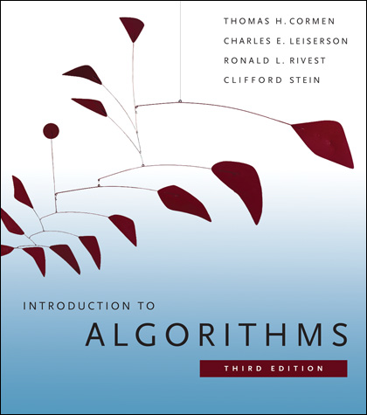
Algorithms
Happy when your algorithm is fast
Golden standard:
  “linear time” ≈ O(input size) time and space.
COMS E4231

Slide 3
Algorithms for massive data
Computer resources << data
Access data in a limited way
  Limited space (main memory << hard drive)
  Limited time (time << time to read entire data)
COMS E4231

Slide 4

Scenario: limited space
Challenge:
compute something on the table,
using small space.
160.39.142.2
18.9.22.69
Example of “something”:
# distinct IPs
max frequency
other statistics…
160.39.142.2
80.97.56.20
IP | Frequency
160.39.142.2 | 3
18.9.22.69 | 2
80.97.56.20 | 2
128.112.128.81 | 9
127.0.0.1 | 8
257.2.5.7 | 0
9.8.20.15 | 1
IP | Frequency
160.39.142.2 | 3
18.9.22.69 | 2
80.97.56.20 | 2
18.9.22.69
80.97.56.20
160.39.142.2

Slide 5
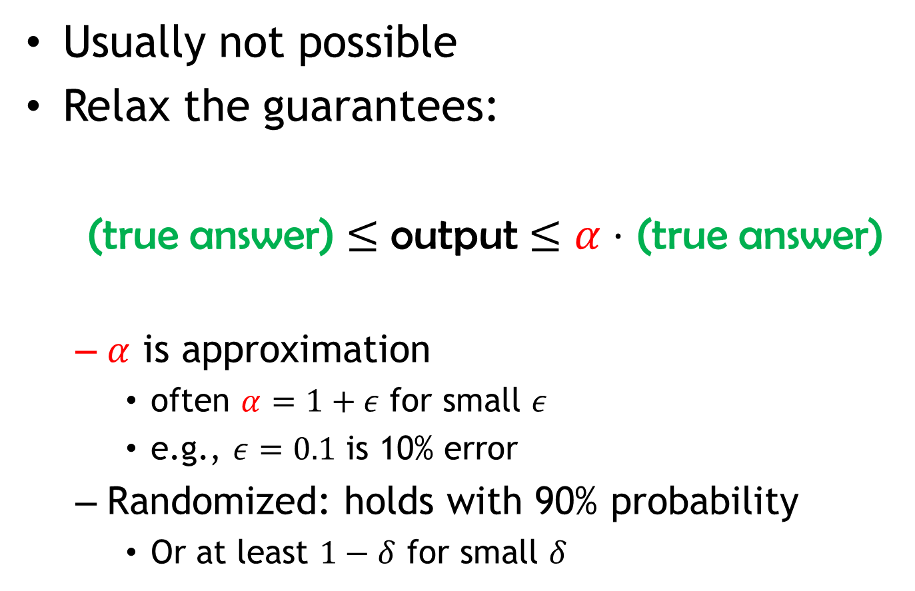
How?
Usually not possible
Relax the guarantees:
(true answer) $≤$ output $≤α⋅$ (true answer)
  $α$ is approximation
    often $α=1+ε$ for small $ε$
    e.g., $ε=0.1$ is 10% error
  Randomized: holds with 90% probability
    Or at least $1−δ$ for small $δ$

Slide 6
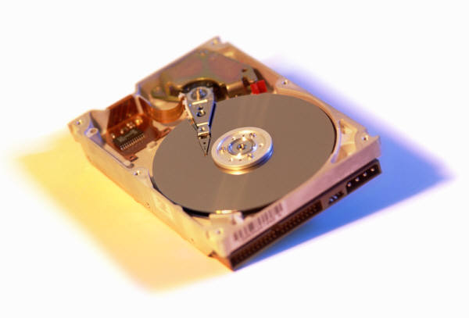
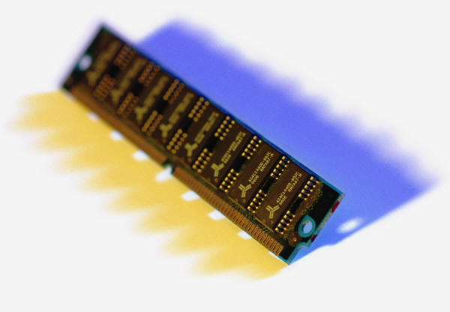
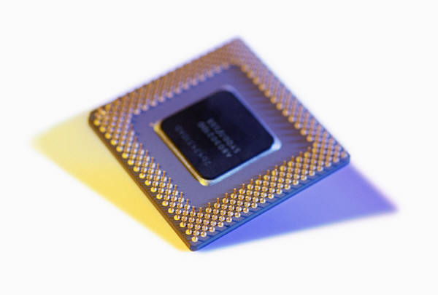
Topics
Streaming algorithms
IP | Frequency
160.39.142.2 | 3
18.9.22.69 | 2
80.97.56.20 | 2
2

Slide 7
Topics
Streaming algorithms
Dimension reduction, sketching
d
a
a
t
D
A
T
A

Slide 8


Topics
Streaming algorithms
Dimension reduction, sketching
High-dimensional Nearest Neighbor Search
000000
011100
010100
000100
010100
011111
000000
001100
000100
000100
110100
111111
$$p$$
$$q$$

Slide 9
Topics
Streaming algorithms
Dimension reduction, sketching
High-dimensional Nearest Neighbor Search
Sampling, property testing

Slide 10
Topics
Streaming algorithms
Dimension reduction, sketching
High-dimensional Nearest Neighbor Search
Sampling, property testing
Parallel algorithms

Slide 11
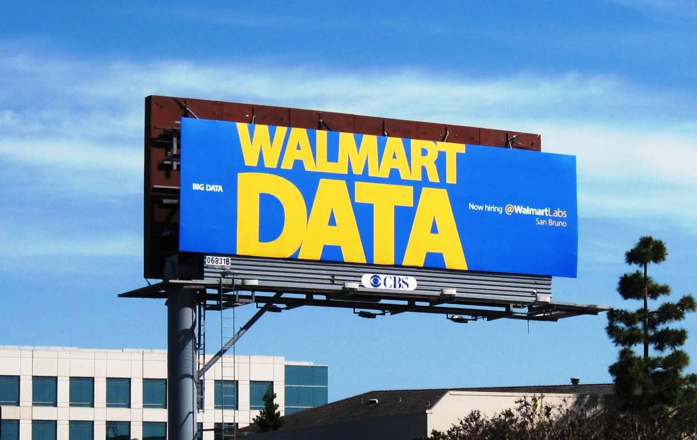
The class is not about
BIG DATA
  or Massive Data
  it is about algorithms where data volume is so large that classic algorithmic approaches don’t scale well
MapReduce, or other systems
  “theory class”, implementation-independent
  will mention application areas

Slide 12
Course Information
Instructor: Alex Andoni
TAs: Drishan Arora, Pedro Savarese, Kevin Shi
Grading:
  Scribing, 2-3 students per lecture (10%)
  5 homeworks (55%)
    1st : 7% (due next Thursday, Sep 17th)
    2nd-5th: 12% each
    5 days of lateness total (120 hours). No other extentions.
    OK to collaborate (4 max). Each writes their own solutions.
  Project, research-based (35%)
    Solve/make progress on an open problem in the area
    Apply algorithms to your research area (e.g., implement an algorithm)
    Synthesis of a few related papers
    In teams, up to 4ppl. Presentation at the end.
Scribing today?

Slide 13
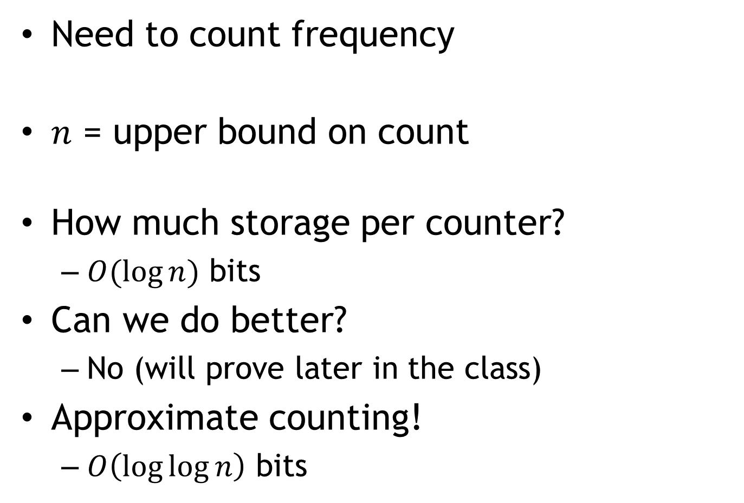
Problem: counting
Need to count frequency
$n$ = upper bound on count
How much storage per counter?
  $O(log⁡n)$ bits
Can we do better?
  No (will prove later in the class)
Approximate counting!
  $O\left(\log{\log{n}}\right)$ bits
IP | Frequency
160.39.142.2 | 3
18.9.22.69 | 2
80.97.56.20 | 2

Slide 14
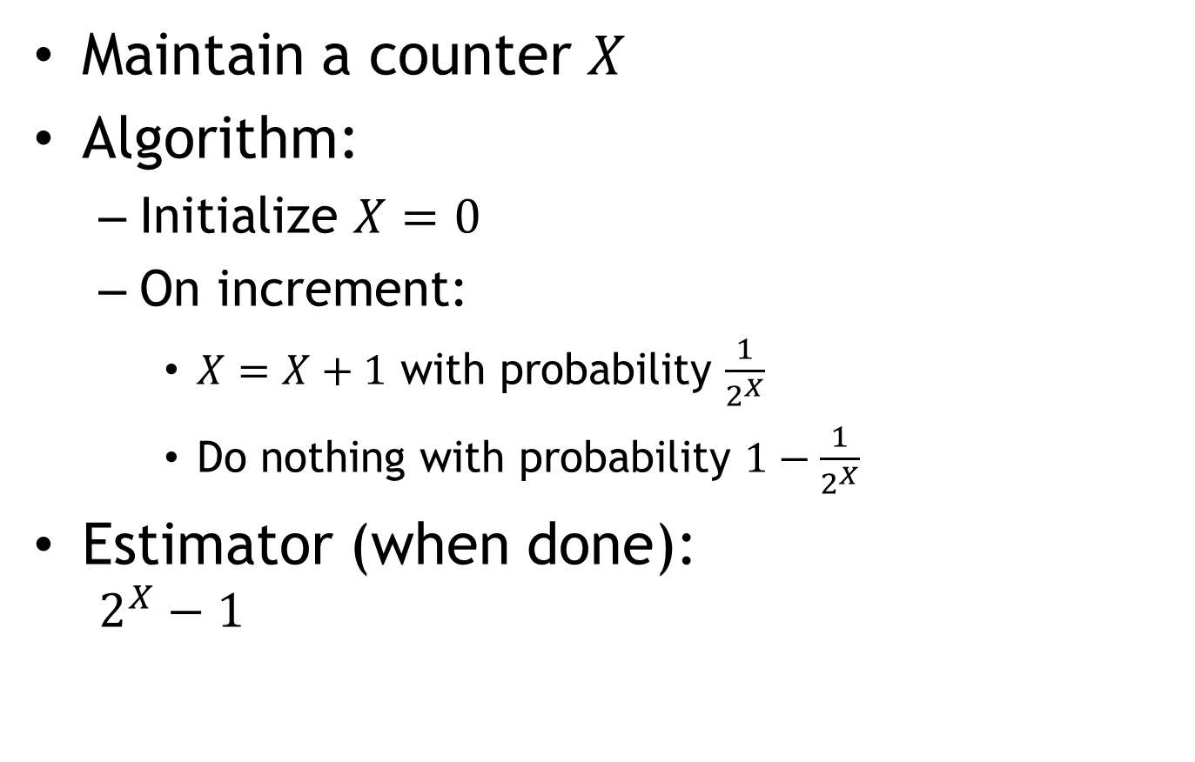
Morris Algorithm [1978]
Maintain a counter $X$
Algorithm:
  Initialize $X=0$
  On increment:
    $X=X+1$ with probability $\frac{1}{2^{X}}$
    Do nothing with probability $1−\frac{1}{2^{X}}$
Estimator (when done):
  $$2^{X}−1$$

