Slide 1
Intro to Reinforcement Learning
David Wingate
wingated@mit.edu

Slide 2
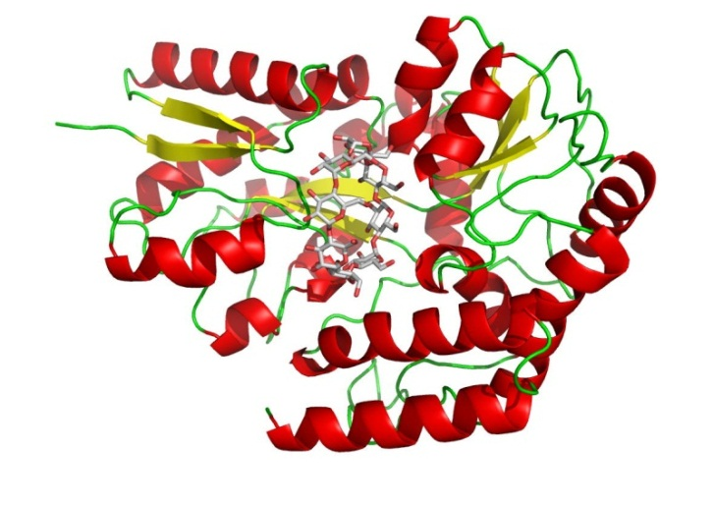
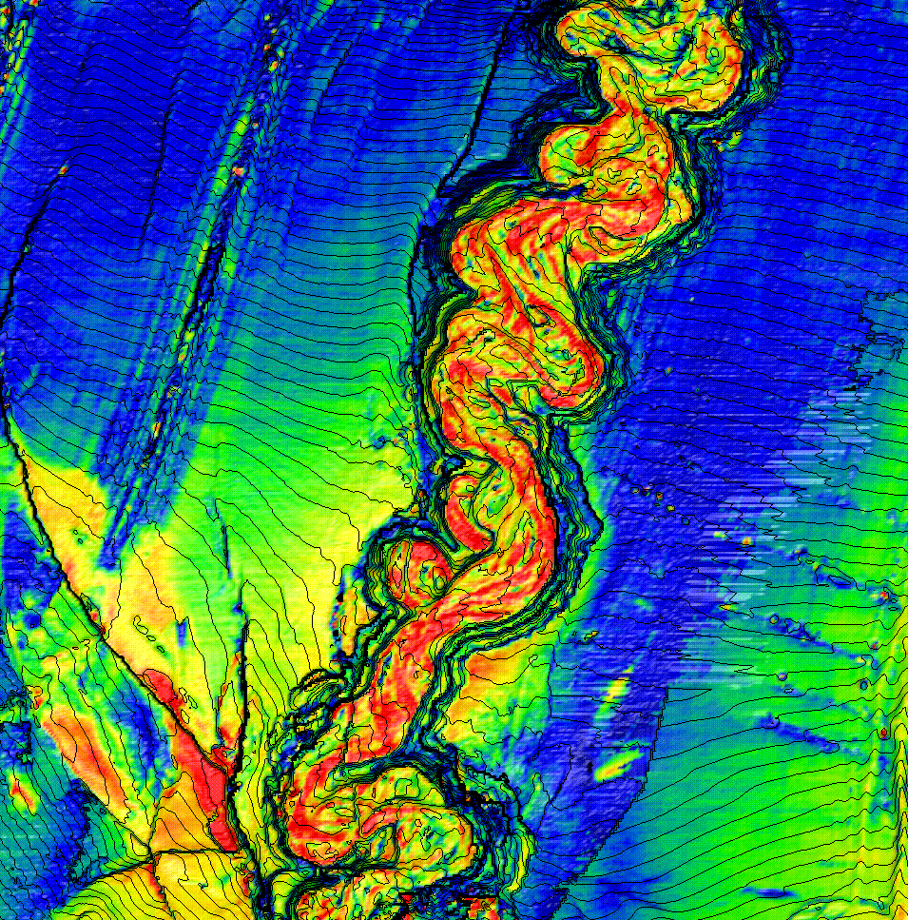
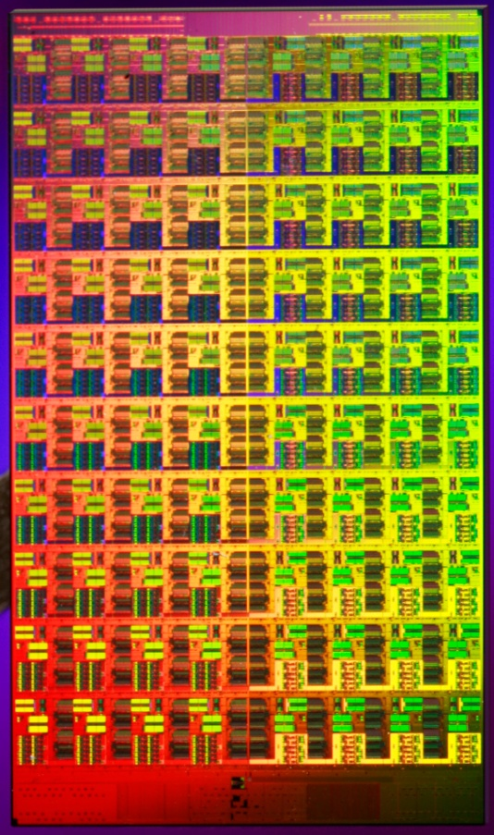
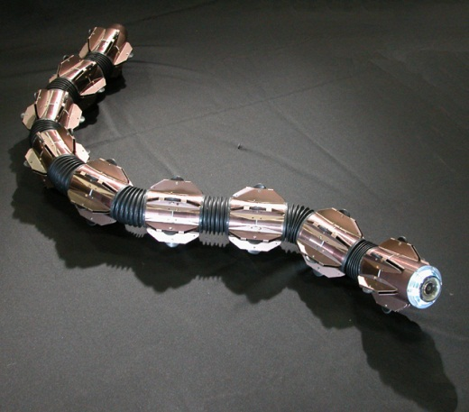
The Trajectory of Machine Learning
Science and engineering will increasingly turn to machine learning to help
find patterns in data
and
manage complex systems
Notes:
The goal is to make decisions based on the models
These might look like different problems, but they share some abstract properties.
In particular, they have structure that we can take advantage of.
A conceptual vision of the role ML plays in science
A technical vision of ML - to get there, it has to be integrated with these other activities

Slide 3
Learning and Acting under Uncertainty
Machine
learning
My research
Decision
making
Possible applications:
Personalized medicine
Fault tolerant systems
Broadly competent robots
Complex biological networks
Autonomous vehicles
Multicore optimization
…
Probabilistic
modeling
Notes:
ML must be increasingly integrated with these other activities.

Slide 4
Reinforcement Learning
A trial-and-error learning paradigm
  Rewards and Punishments
Not just an algorithm but a new paradigm in itself
Learn about a system –
  behaviour
  control
  from minimal feed back
Inspired by behavioural psychology

Slide 5
RL Framework
Environment
evaluation
State
Action
Agent
Learn from close interaction
Stochastic environment
Noisy delayed scalar evaluation
Maximize a measure of long term performance
Notes:
Benefits of RL.Applications.
Future rewards.
Situate in literature.. AI.
Stochastic systems.
Connections to OR.

Slide 6
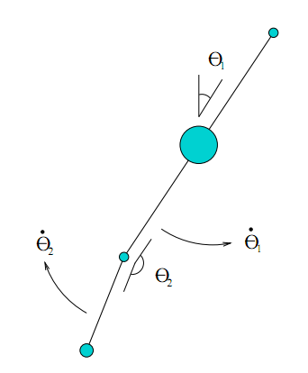
Application: DAP
What’s the…
  State space?
  Action space?
  Reward function?

Slide 7
Not Supervised Learning!
Input
Output
Agent
Error
Target
Very sparse “supervision”
No target output provided
No error gradient information available
Action chooses next state
Explore to estimate gradient – Trail and error learning

Slide 8
Not Unsupervised Learning
Input
Activation
Agent
Evaluation
Sparse “supervision” available
Pattern detection not primary goal

Slide 9
Reinforcement Learning
RL = learning meets planning

Slide 10
Reinforcement Learning
RL = learning meets planning
Logistics and scheduling
Acrobatic helicopters
Load balancing
Robot soccer
Bipedal locomotion
Dialogue systems
Game playing
Power grid control
…

Slide 11
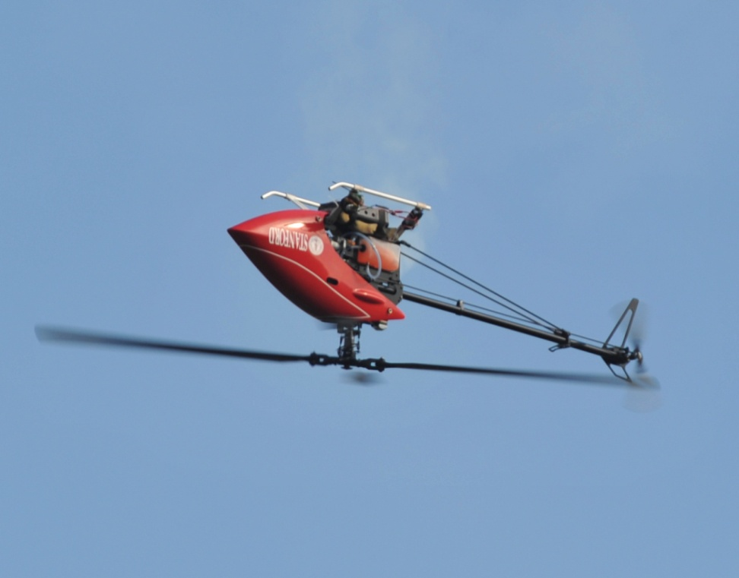
Reinforcement Learning
RL = learning meets planning
Logistics and scheduling
Acrobatic helicopters
Load balancing
Robot soccer
Bipedal locomotion
Dialogue systems
Game playing
Power grid control
…
Model: Pieter Abbeel. Apprenticeship Learning and Reinforcement Learning with Application to Robotic Control. PhD Thesis, 2008.

Slide 12
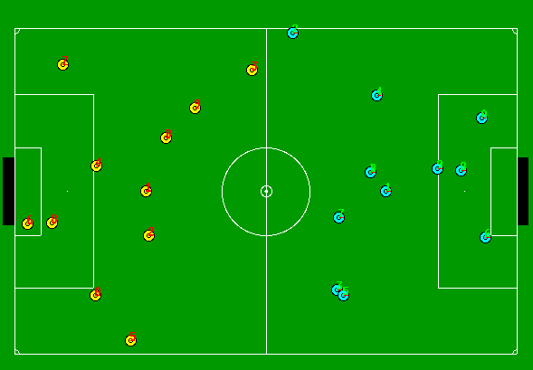
Reinforcement Learning
RL = learning meets planning
Logistics and scheduling
Acrobatic helicopters
Load balancing
Robot soccer
Bipedal locomotion
Dialogue systems
Game playing
Power grid control
…
Model: Peter Stone, Richard Sutton, Gregory Kuhlmann. Reinforcement Learning for RoboCup Soccer Keepaway. Adaptive Behavior, Vol. 13, No. 3, 2005

Slide 13
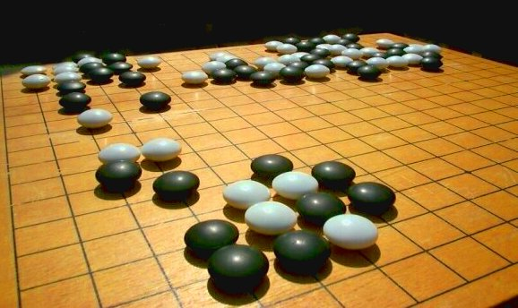
Reinforcement Learning
RL = learning meets planning
Logistics and scheduling
Acrobatic helicopters
Load balancing
Robot soccer
Bipedal locomotion
Dialogue systems
Game playing
Power grid control
…
Model: David Silver, Richard Sutton and Martin Muller. Sample-based learning and search with permanent and transient memories. ICML 2008

Slide 14
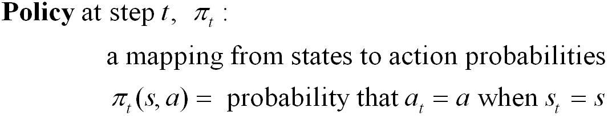
The Agent Learns a Policy
Reinforcement learning methods specify how the agent changes its policy as a result of experience.
Roughly, the agent’s goal is to get as much reward as it can over the long run.

Slide 15
Goals and Rewards
Is a scalar reward signal an adequate notion of a goal?—maybe not, but it is surprisingly flexible.
A goal should specify what we want to achieve, not how we want to achieve it.
A goal must be outside the agent’s direct control—thus outside the agent.
The agent must be able to measure success:
  explicitly;
  frequently during its lifespan.

Slide 16
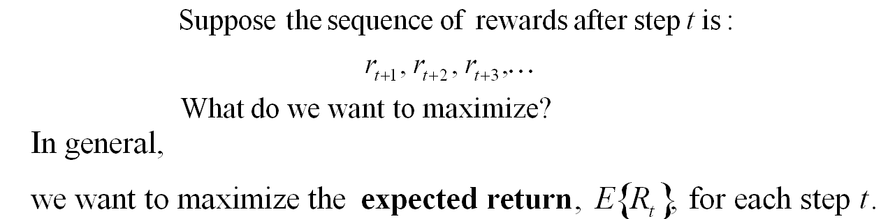
Returns
Episodic tasks: interaction breaks naturally into episodes, e.g., plays of a game, trips through a maze.

Slide 17
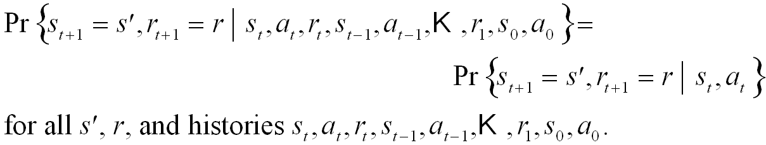
The Markov Property
“the state” at step t, means whatever information is available to the agent at step t about its environment.
The state can include immediate “sensations”, highly processed sensations, and structures built up over time from sequences of sensations.
Ideally, a state should summarize past sensations so as to retain all “essential” information, i.e., it should have the Markov Property:

Slide 18
Markov Decision Processes
If a reinforcement learning task has the Markov Property, it is basically a Markov Decision Process (MDP).
If state and action sets are finite, it is a finite MDP.
To define a finite MDP, you need to give:
  state and action sets
  one-step “dynamics” defined by transition probabilities:
  reward expectations:

Slide 19
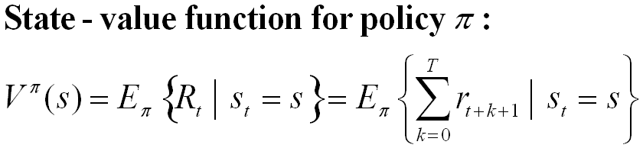
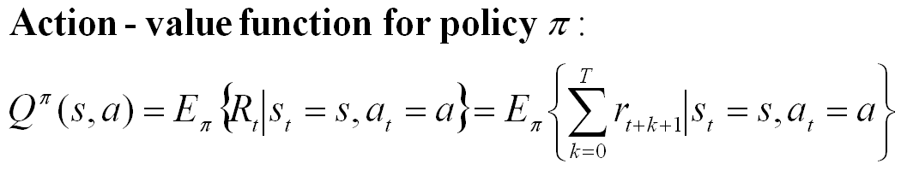
Value Functions
The value of a state is the expected return starting from that state; depends on the agent’s policy:
The value of a state-action pair is the expected return starting from that state, taking that action, and thereafter following π :

Slide 20
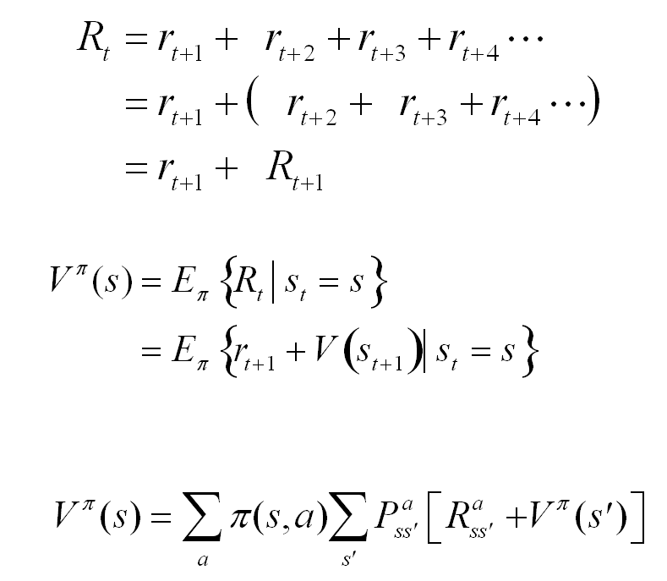
Bellman Equation for a Policy π
The basic idea:
So:
Or, without the expectation operator:

Slide 21

Optimal Value Functions
For finite MDPs, policies can be partially ordered:
There is always at least one (and possibly many) policies that is better than or equal to all the others. This is an optimal policy. We denote them all π *.
Optimal policies share the same optimal state-value function:

Slide 22
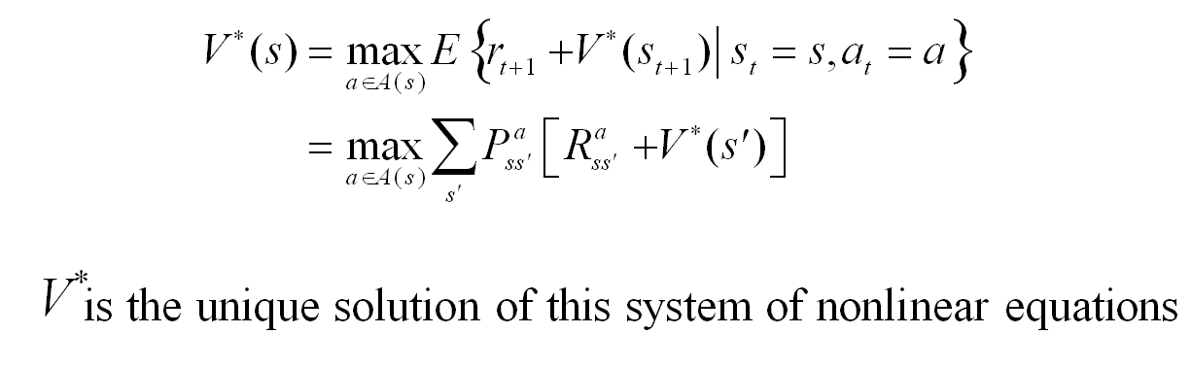
Bellman Optimality Equation
The value of a state under an optimal policy must equal
the expected return for the best action from that state:

Slide 23
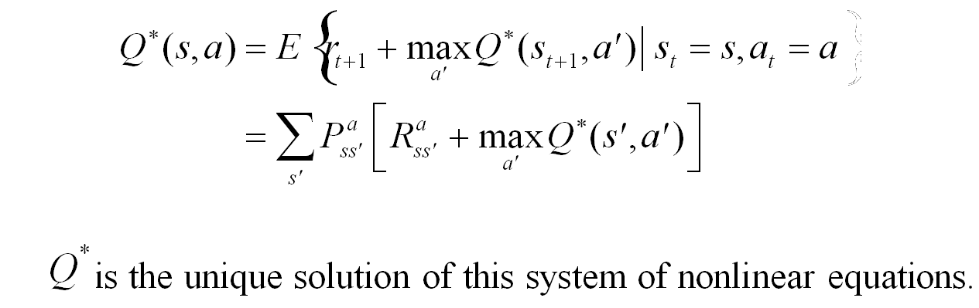
Bellman Optimality Equation
Similarly, the optimal value of a state-action pair is the
expected return for taking that action and thereafter
following the optimal policy

Slide 24
Dynamic Programming
DP is the solution method of choice for MDPs
  Require complete knowledge of system dynamics
    (P and R)
  Expensive and often not practical
  Curse of dimensionality
  Guaranteed to converge!
RL methods: online approximate dynamic programming
  No knowledge of P and R
  Sample trajectories through state space
  Some theoretical convergence analysis available

Slide 25
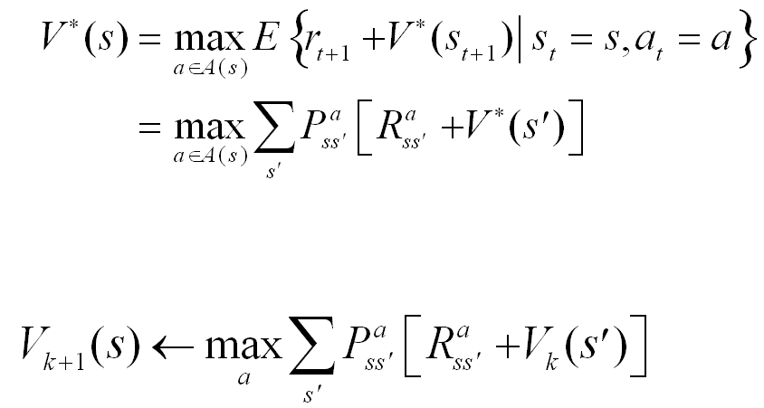
Value Iteration
Recall the Bellman optimality equation:
We can convert it to an full value iteration backup:
Iterate until “convergence”

Slide 26
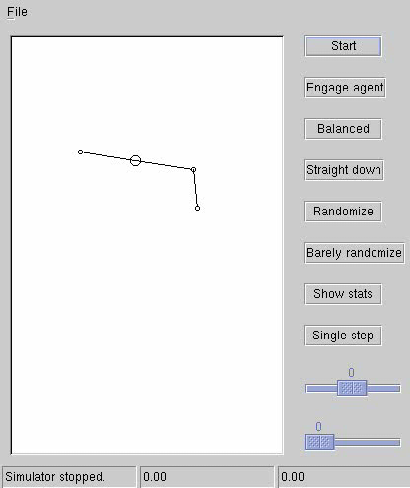
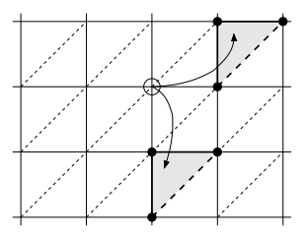
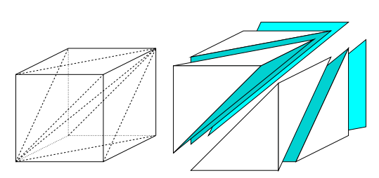
Application: DAP

Slide 27
Q-values and its update
Q(x,u) is the expected total discounted reward obtained by taking action u from state x and follow μ* thereafter.
V*(x) is the “Reward-to-go”:
The optimal policy:
The Q-values lookup table is updated according to:
Learning rate

Slide 28
Convergence
1. The environment is Markovian.
2. A lookup table is used to store the Q-values.
3. Every state-action pair is visited infinite times.
(The order of the visits is not important.)
4. The learning rate α is decreased to zero appropriately over time.
  Robbins-Monroe: fast, but not too fast

Slide 29
Policy Search

Slide 30
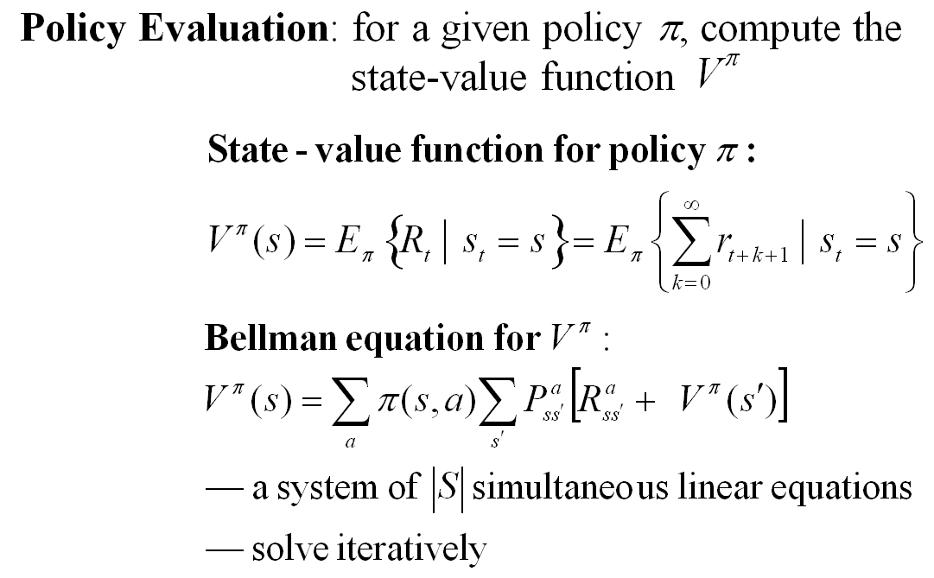
Policy Evaluation

Slide 31
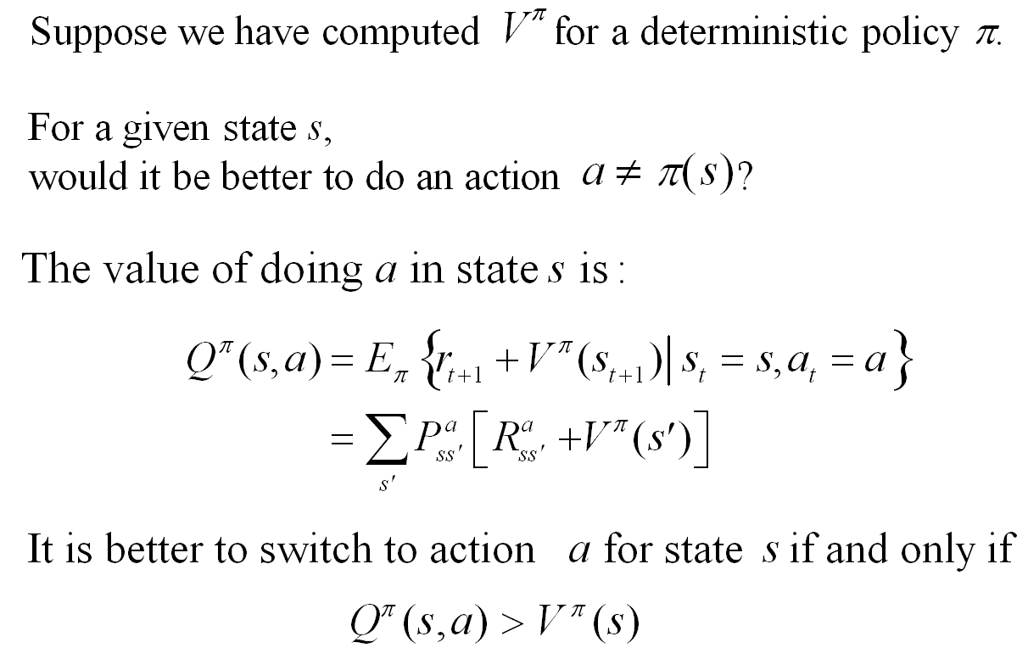
Policy Improvement

Slide 32
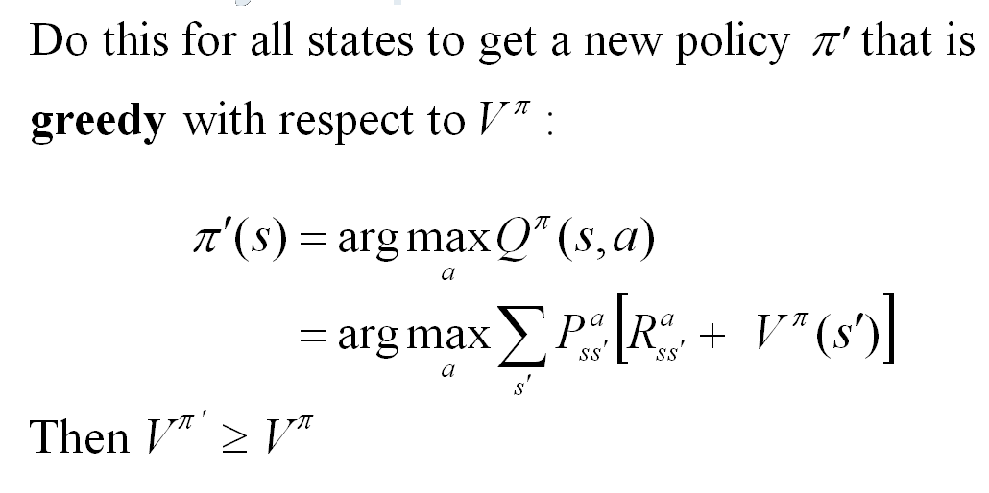
Policy Improvement Cont.

Slide 33
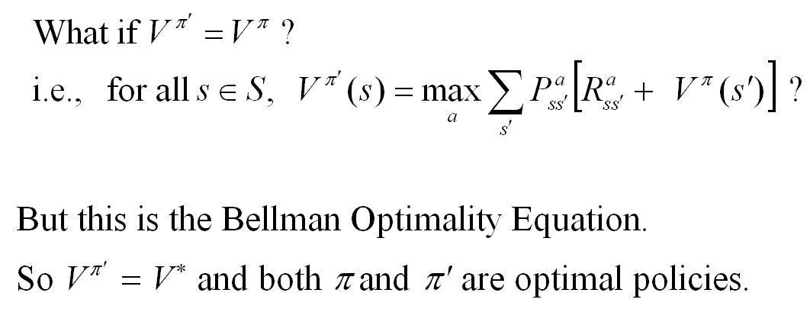
Policy Improvement Cont.

Slide 34
Policy Iteration
policy evaluation
policy improvement
“greedification”

Slide 35
RL for Complex Systems
A future multicore scenario
  It’s the year 2018
  Intel is running a 15nm process
  CPUs have hundreds of cores
There are many sources of asymmetry
  Cores regularly overheat
  Manufacturing defects result in different frequencies
  Nonuniform access to memory controllers
  Intrinsically different capabilities
We’re actually there now!

Slide 36
RL for Complex Systems
How can a programmer take full advantage of this hardware?
One answer:
let machine learning help
Observation: resource allocation matters
Let’s optimize it – without
burdening the programmer
Approach: reinforcement learning
Notes:
I’m going to show you how to use RL to
optimize resource allocation – thereby improving performance.
A basic observation is that the way you choose to allocate your computational resources makes a difference in performance

Slide 37
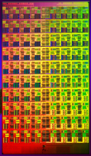

Smartlocks
A mutex combined with a
reinforcement learning agent
Who should get the lock next?
Different choices affect performance
observations
Goal: find an optimal policy
Approach: prioritize threads
actions
Eastep, Wingate, Agarwal, ICAC 2010 (best paper)
Notes:
A mutex is a datastructure with operations that are guaranteed to be atomic.
It typically guards shared resources in a multi-threaded application, ensuring that only one thread can access the resource at a time.
When one thread releases the mutex, it must decide: who gets the lock next?
In the language of reinforcement learning
We’re treating the computer as a complex dynamical system
We can think of the decisions these locks are making as actions taken by an abstract agent

Slide 38
Big Problem
What is the model?

Slide 39
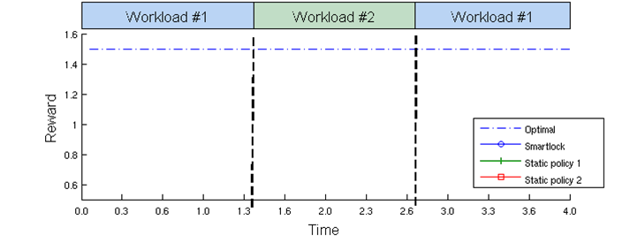
Smartlocks
A mutex combined with a
reinforcement learning agent
Learns to resolve contention by adaptively prioritizing lock acquisition
Eastep, Wingate, Agarwal, ICAC 2010 (best paper)
Notes:
A mutex is a datastructure with operations that are guaranteed to be atomic.
It typically guards shared resources in a multi-threaded application, ensuring that only one thread can access the resource at a time.
When one thread releases the mutex, it must decide: who gets the lock next?

Slide 40
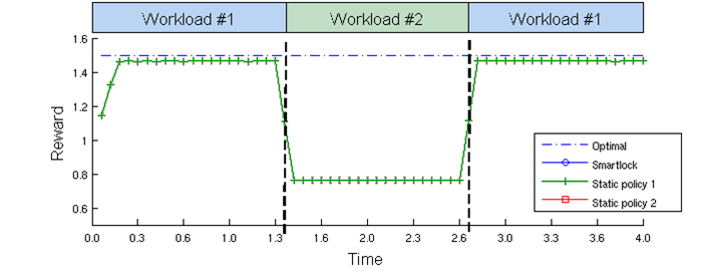
Smartlocks
A mutex combined with a
reinforcement learning agent
Learns to resolve contention by adaptively prioritizing lock acquisition

Slide 41
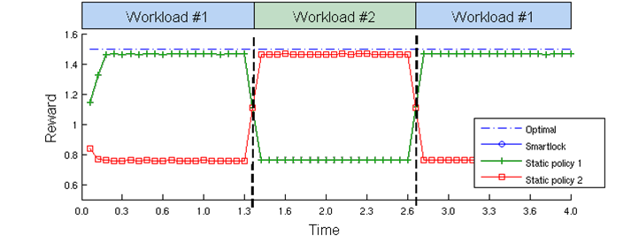
Smartlocks
A mutex combined with a
reinforcement learning agent
Learns to resolve contention by adaptively prioritizing lock acquisition

Slide 42
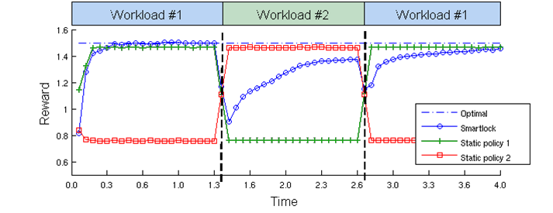
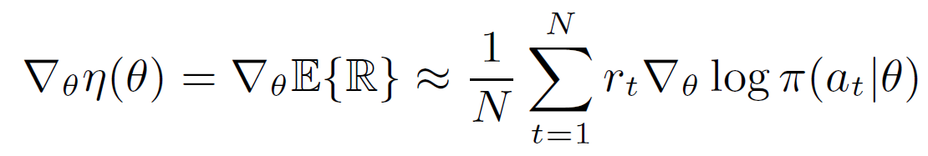
Smartlocks
A mutex combined with a
reinforcement learning agent
Learns to resolve contention by adaptively prioritizing lock acquisition
Approach:
policy gradients

Slide 43
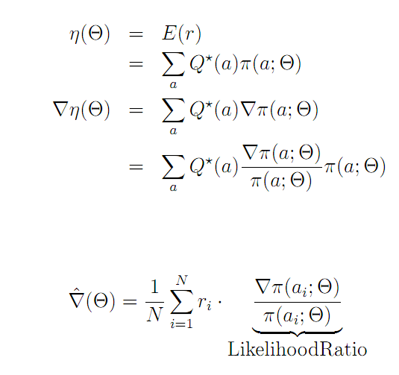
Policy Gradients

Slide 44
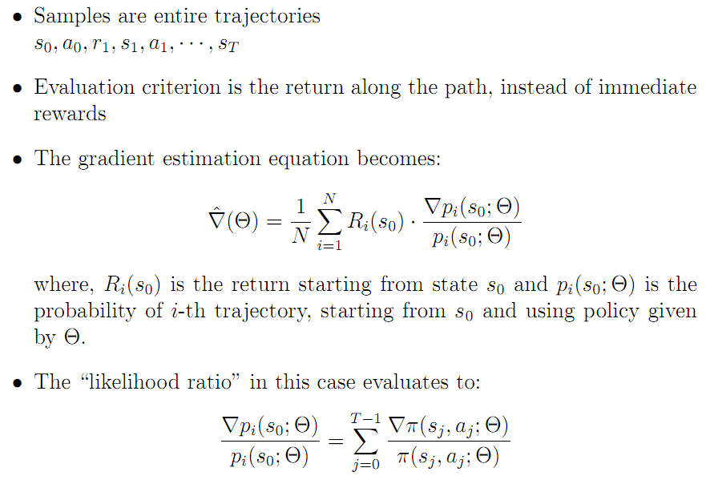
MC Policy Gradients

Slide 45
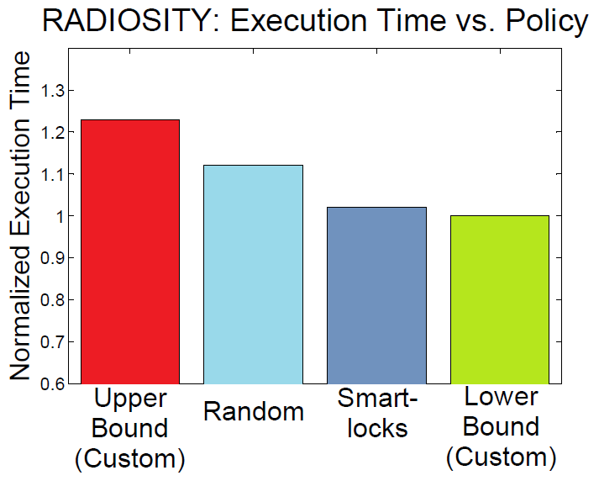
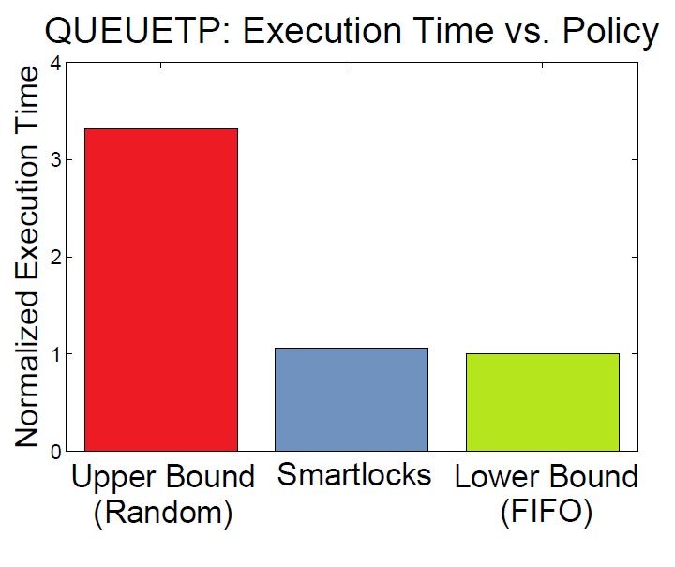
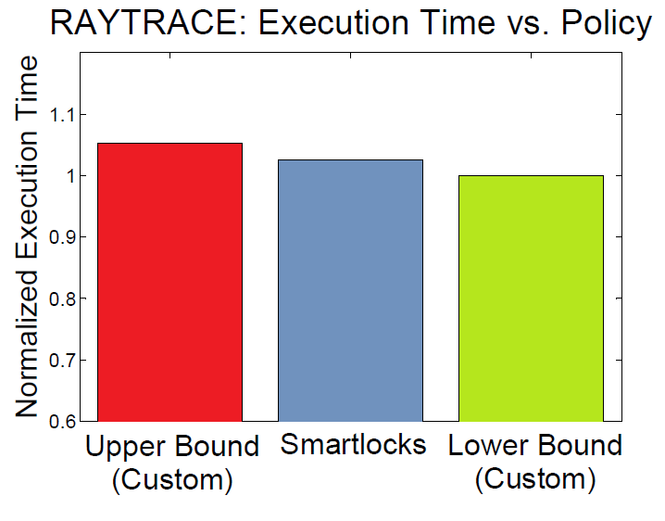
Benchmark Results
Can deliver significant performance gains
20%
330%
3%

Slide 46
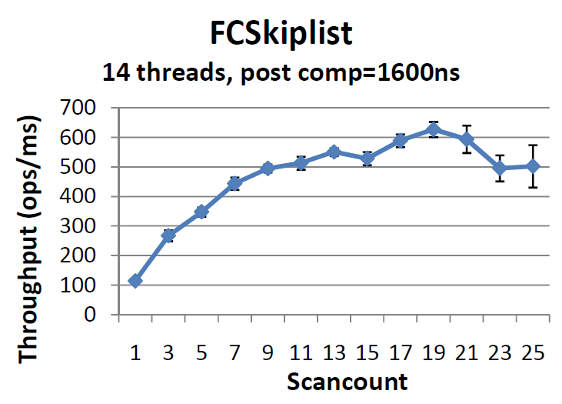
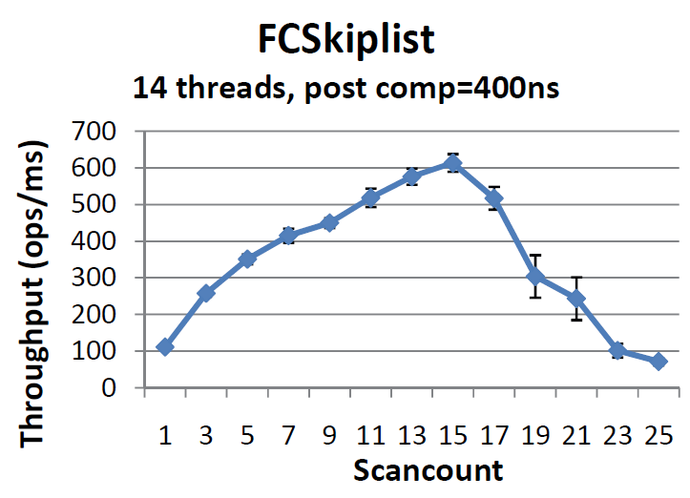
Smart Data Structures
The same idea applies to
learning good parameters for multicore data structures
Flat Combining Queue
Pairing Heap
Skiplist
…
Eastep, Wingate, Agarwal, ICAC 2011 (in sub)

Slide 47
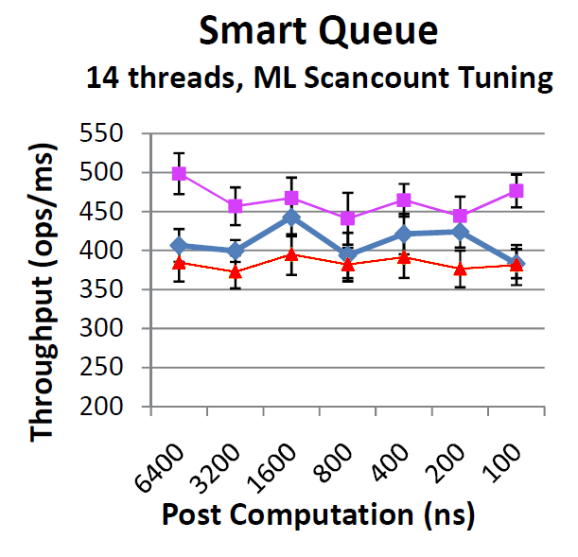
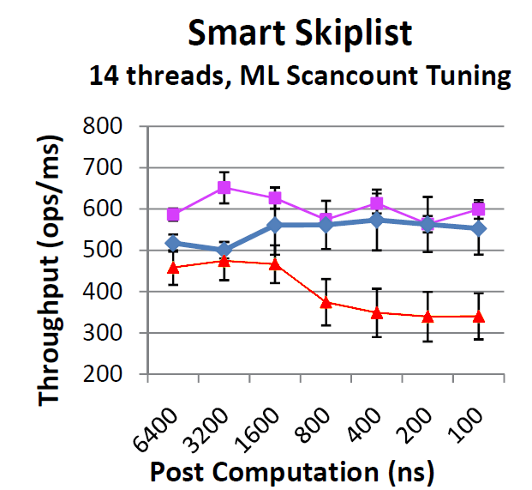
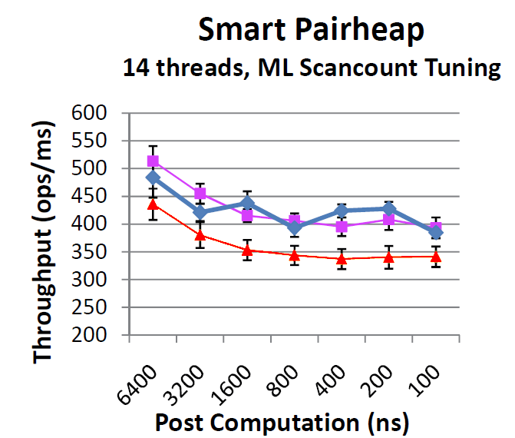
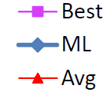
Results
7-15%
10-60%
12-15%

Slide 48
Bayesian Reinforcement Learning

Slide 49
What is Bayesian Modeling?
Find structure in data
while dealing explicitly with uncertainty
The goal of a Bayesian is to reason about the distribution of structure in data

Slide 50
Example
What line generated this data?
That one?
This one?
What about this one?
Probably not this one

Slide 51

What About the “Bayes” Part?
Bayes Law is a mathematical fact that helps us
Likelihood
Prior

Slide 52
Distributions Over Structure
Visual perception
Natural language
Speech recognition
Topic understanding
Word learning
Causal relationships
Modeling relationships
Intuitive theories
…

Slide 53
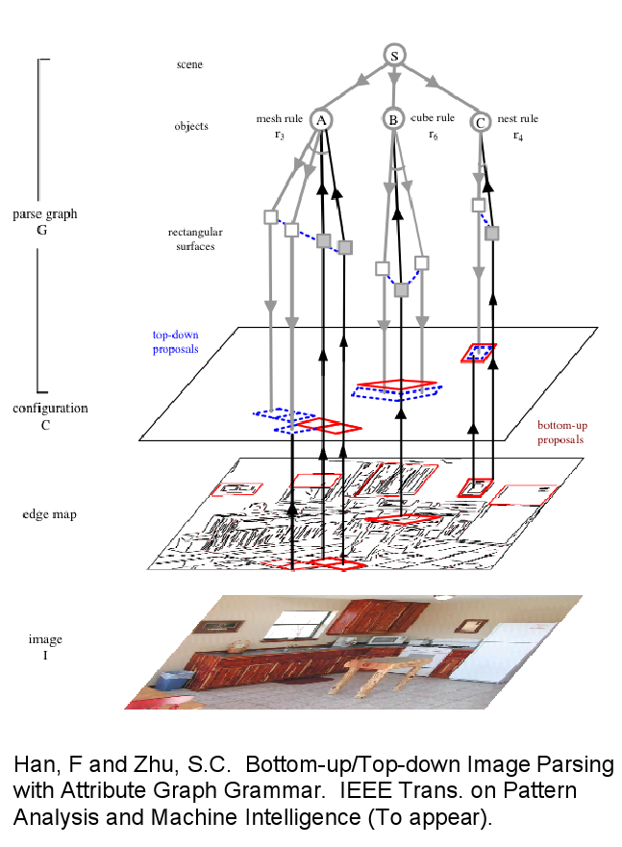
Distributions Over Structure
Visual perception
Natural language
Speech recognition
Topic understanding
Word learning
Causal relationships
Modeling relationships
Intuitive theories
…

Slide 54
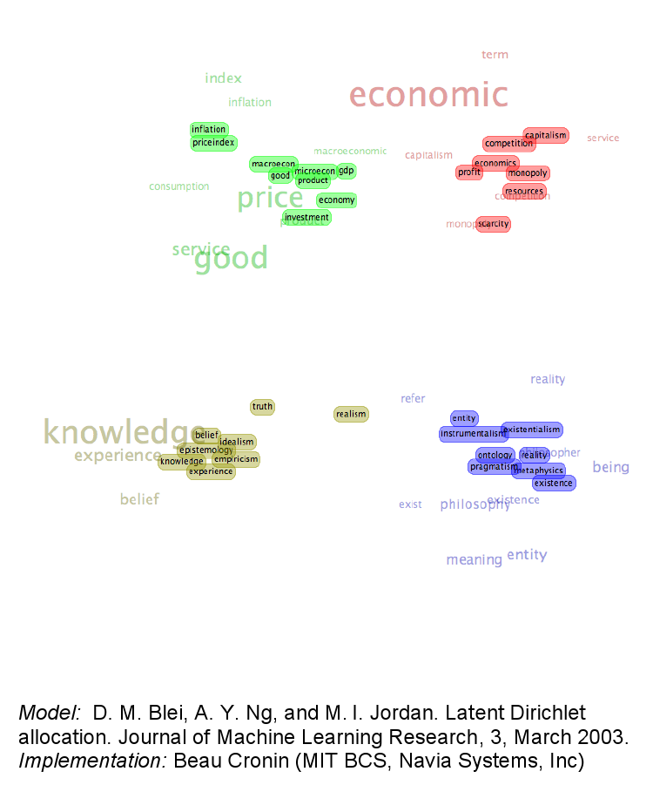
Distributions Over Structure
Visual perception
Natural language
Speech recognition
Topic understanding
Word learning
Causal relationships
Modeling relationships
Intuitive theories
…

Slide 55
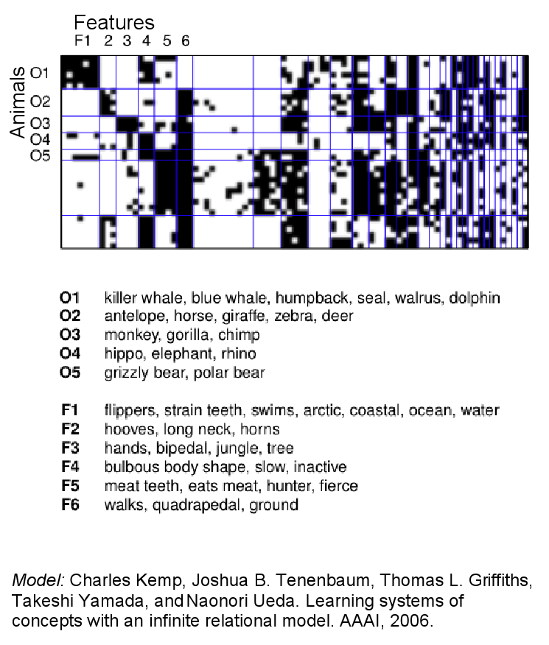
Distributions Over Structure
Visual perception
Natural language
Speech recognition
Topic understanding
Word learning
Causal relationships
Modeling relationships
Intuitive theories
…

Slide 56
Bayesian Trajectory Optimization
Posterior
This is what we want to optimize!
Likelihood
We’ll use “distance along the maze”
Prior
Allows us to incorporate knowledge
This is a MAP inference problem.

Slide 57
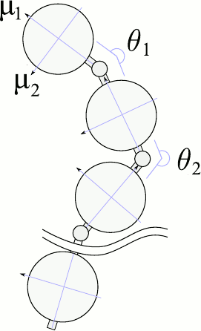
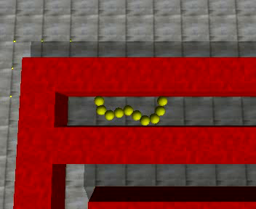
Structured Optimal Control
Human* Controlling Snake
40 dimensional state space
9 dimensional continuous actions
Anisotropic friction
Deterministic
*Yes, it’s me

Slide 58
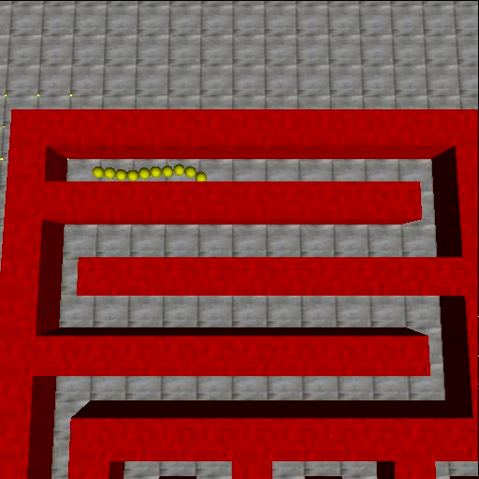
Results - RRT
Note: running at 2x

Slide 59








Structured Optimal Control
Extend the nonparametric finite state controller by adding
(an unknown number of)
motor primitives
a₁
a₂
a₃
a₁
a₂
a₁
a₂
a₃
a₁
a₂
a₁
a₂
a₃
Wingate, Goodman, Roy et al, 2011 (in sub)

Slide 60
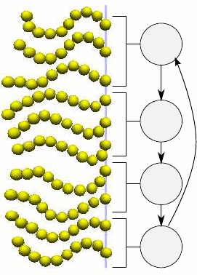
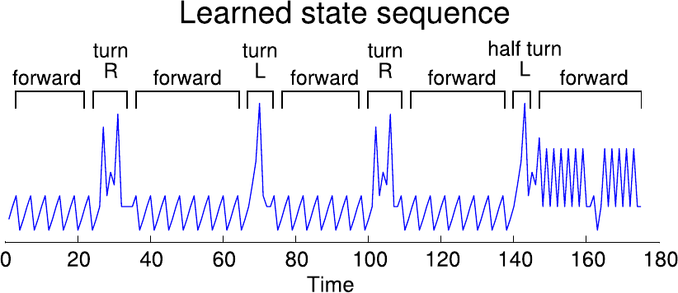
Snakes in a Maze
Let’s examine what was learned
Four states wiggle forward

Slide 61
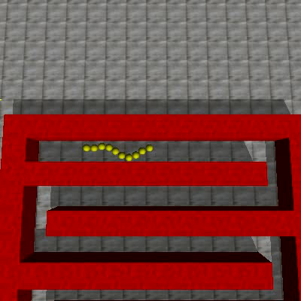
Results - NPFSC

Slide 62

Bonus: Spiders!

Slide 63
Other topics
Model-free RL
  Q-learning, TD, eligibility traces
Function approximation
Actor-critic methods
Bayesian RL
Relational RL
Modern applications / algorithms
  GPTD, TD-Search, TDC, GTD2, …
Partially observable systems…

Slide 64
Thank you!

